Slide 1
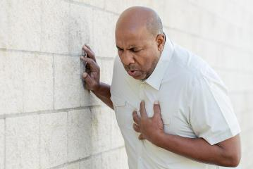
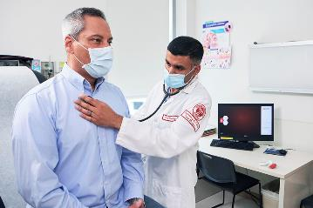
PDO Second Alert
Date: 21.11.2021 Incident title: NAD#21
What happened?
On 21.11.2021 at 6:30 am the deceased (HGV Tanker Driver) reported to site manager complaining that he had a chest pain. He was immediately escorted to the PDO Yibal clinic for medical treatment by NAA Driver. The deceased was walking normally to the doctor, and the doctor started talking to him regarding his personal details medical condition and his discomfort. The doctor advised him for ECG test, he adjusted his self and laid down on the stretcher by his own. Then CPR was given as his condition was worsening. unfortunately, at around 08:36 AM he was pronounced dead by PDO doctor.
Your learning from this incident..
Conduct FTW. As per PDO standards.
Report if any medical assistance is required might consider early reporting
Ensure health checkups are done for employees with chronic illness as per doctors recommendations.
Ensure to follow healthy life style (diet , regular exercise and adequate water intake)
Avoid consuming alcohol/ tobacco as it injures health.
Fitness is not a destination, it is a way of life
Notes:
No names or detail of company to link this to any recent specific incident

