Slide 1
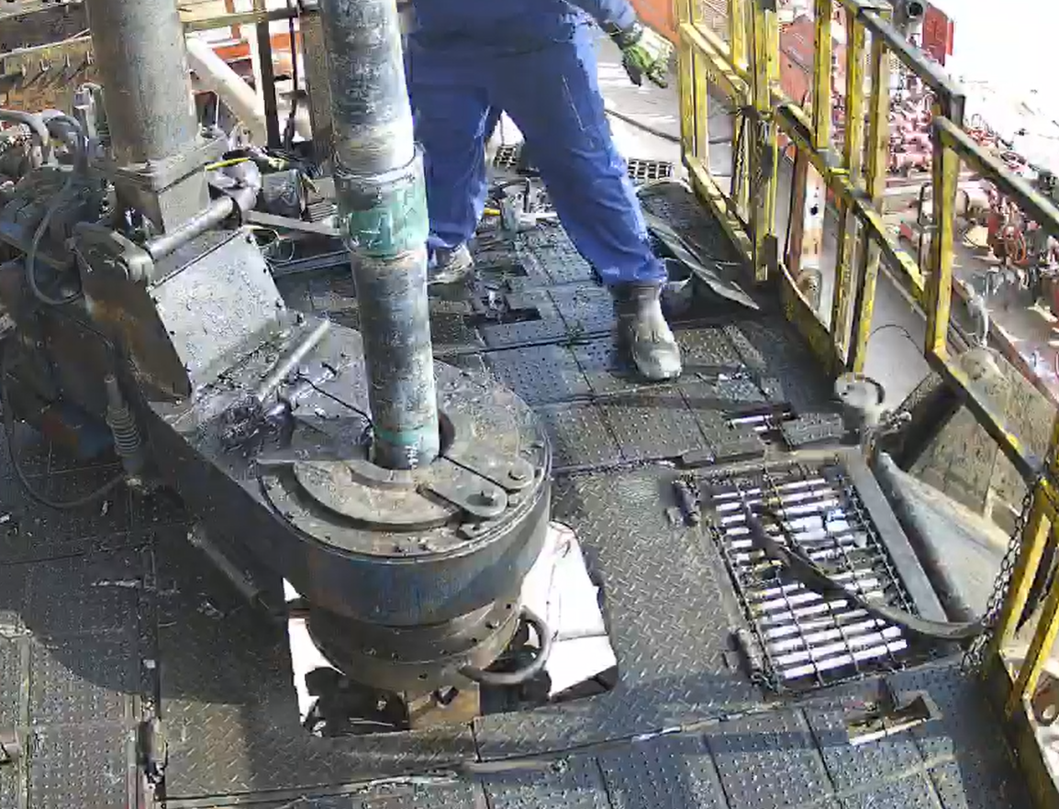
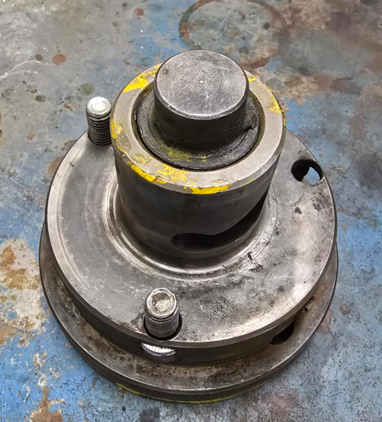
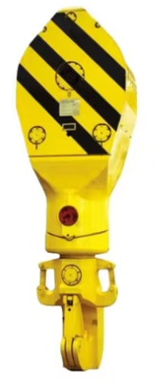
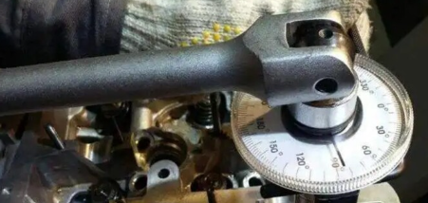
PDO Second Alert
Date: Time: | 19-07-2025 08:24 Am | Incident title: PIM# | HiPo#21 1179873 | Risk Category: Injury / Asset Damaged: | Drop Minor Damage | Actual Severity: Potential severity: | 0P C4P | Activity: Location: | Running In Hole (RIH) Qarn Alam
Target Audience: Operations Managers, Well Engineers, Assurance team, Hoist Supervisors
What happened?
While making up a connection of 4 ½” EUE GRE WI tubing, the locking pin device of the travelling block swivel (weighing approximately 5.5 kg) detached unintentionally from its profile and fell from a height of approximately 13 meters. The pin landed on the rig floor between crew members before continuing to bounce and slide through the V-door.
The expectation was the RIH activity is completed with the travelling block swivel lock pin remaining secured in position by 3 locking bolts.
Why it happened/Finding:
The primary securing bolts (3 Allen bolts) of swivel locking pin were found loose, leading to disengagement.
Visual inspection conducted, but no physical verification of bolt tightness performed; OEM did not recommend this.
Design limitation of travelling block prevented visual verification of torque/tightness securing bolts during inspection.
Secondary retention requirement not identified during OEM design.
Swivel lock pin detached during jarring/fishing operations, indicating inadequate securing under dynamic loads.
Your learning from this incident:
How do you verify inspections on potential dropped objects, such as travelling block swivel locking pin, is carried out and recorded?
How do you ensure that all Work Crew are aware and conduct effective inspections?
What process do you have to ensure those items, including OEM components, requiring secondary retention is in place and periodically inspected via the Hoist/Rig Drops register?
Locking Pin dropped 13m close to Crew member
Physical verification of the bolts
Always ensure to conduct regular, detailed physical inspections of travelling block locking device
Notes:
Ensure all dates and titles are input
A short description should be provided without mentioning names of contractors or individuals. You should include, what happened, to who (by job title) and what injuries this resulted in. Nothing more!
Four to five bullet points highlighting the main findings from the investigation. Remember the target audience is the front line staff so this should be written in simple terms in a way that everyone can understand.
The strap line should be the main point you want to get across
The images should be self explanatory, what went wrong (if you create a reconstruction please ensure you do not put people at risk) and below how it should be done.

Slide 2
PDO Second Alert
To make sure learning is translated to the site day to day activities , please answer the below questions :-
How learning can be implemented at site?
Supervisors to ensure that any design-related limitations (e.g., inability to verify bolt torque visually) are identified and escalated for engineering review.
Learning from Incidents (LFI) focal point to ensure previous similar incidents from other contractors are formally shared, reviewed, and discussed during safety meetings and commissioning activities.
Weekly DROPS inspections to be conducted by the Hoist team and verified by supervisors, with specific focus on critical equipment above work areas and high-risk components.
How can you sustain the action?
Log all deviations, loose components, near misses, or incidents related to swivel pins or overhead equipment in the Aegis tracking system, and regularly review DROPS-related trends during monthly HSE and maintenance review meetings.
Rig Managers and Night Tool pushers to consistently engage with crews on the importance of securing critical overhead components and reinforce positive behaviors through recognition programs or safety interventions when necessary.
Assurance team to verify implementation of LFI actions during equipment acceptance and commissioning phases, with documentation of compliance or additional risk controls.
HSE Supervisor to ensure weekly DROPS inspections are completed, documented, and discussed, with clear accountability for closing identified issues as part of ILTIZAM assurance plan.
Notes:
Guideline for Effective Learning & Sustainability
•Can be replicated across similar contractor / activities
•Shall be SMART- Specific ,Measurable , Achievable ,Realistic & Timebound
•Can be implemented in a months' time

