Slide 1
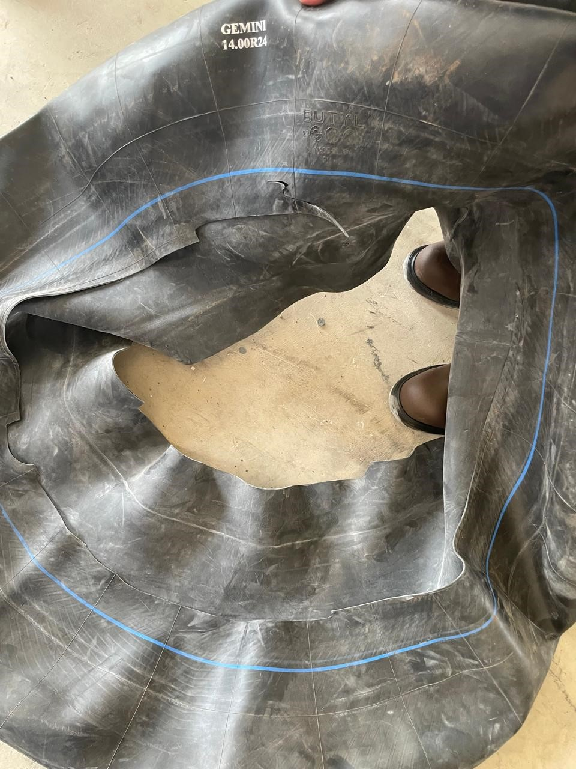
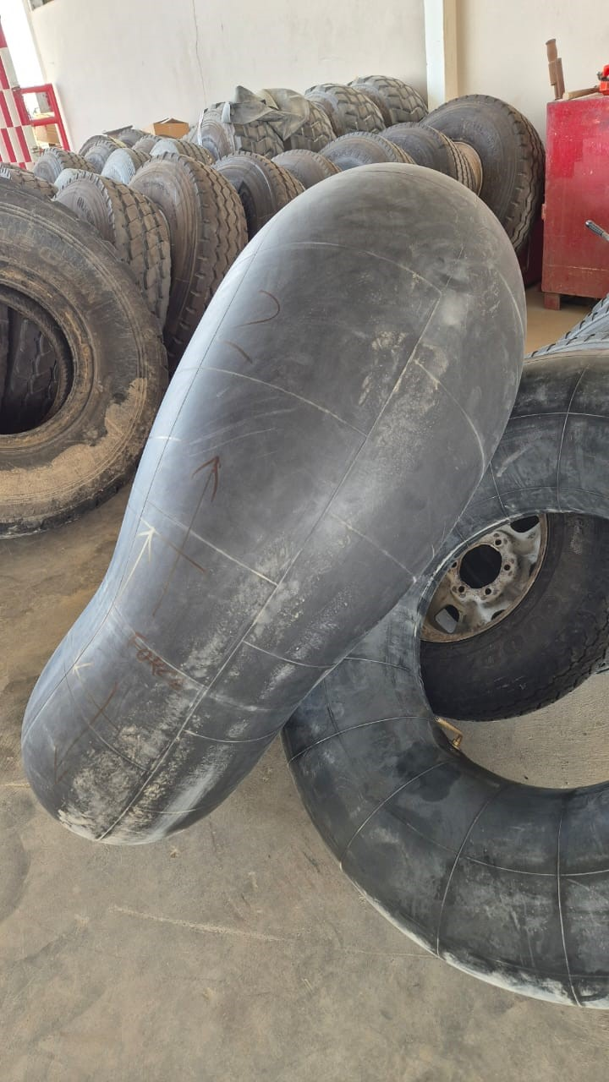
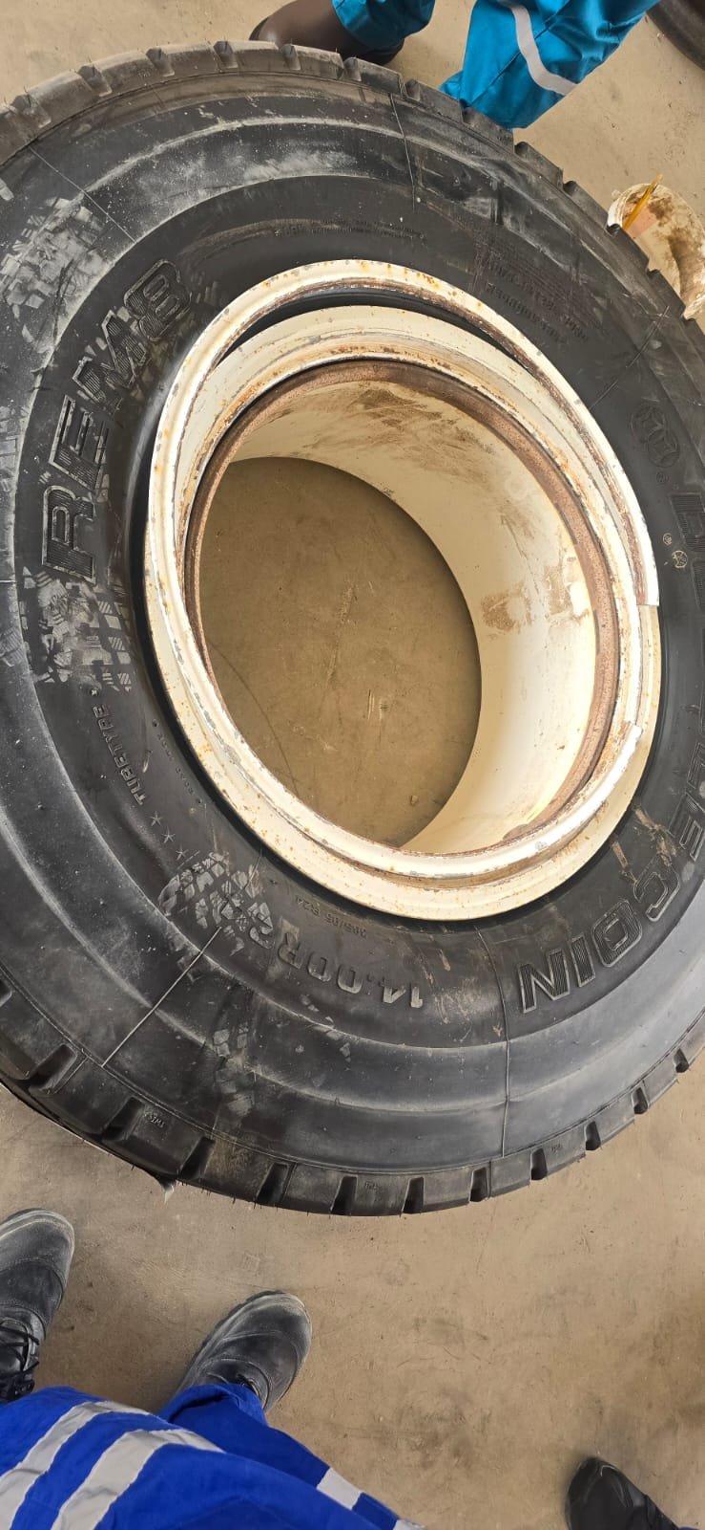
ACTION ALERT (Non-PDO related)
Action Alert# | 202408-01 | Date & Time | 13.08.2024, 08:30 PM | Location | Fahud
Incident Type | Fatality | Category | Stored/Released Energy/ Line Of Fire | Activity | Inflating tire
FATALITY DURING TIRE INFLATION
Target audience for this alert: - Managers/Users of Heavy Goods Vehicles (HGV)
- Tires repairs workshop supervisors/Users conducting tire repairs
What happened
After the pre-inflation of a HGV tire inner tube, the inner tube ruptured around one side of the radius, ejecting the locking ring and hitting a 52 years old driver located nearby, causing fatal injuries.
Ruptured inner tube
Different inner tube from same batch
Initial findings
The exact causes of the incident are still under investigation:
The inner tube of the tire completely burst.
The tire is a split rim with locking ring.
The inner tube was one of a 1st batch newly received from different manufacture.
The new inner tube has no specification/information on them.
The tire was partially inflated with pressure around 25 psi outside the tire cage and placed vertically.
The deceased was in the Line Of Fire.
Tire involved with incident
Ejected locking ring
Notes:
Target audience for this alert
List the position names or roles that are the target audience for this alert. Wherever possible, the target audience should be limited to those in positions or roles or locations for which the lesson learnt are relevant, or who are required to take action upon receiving this Alert.
Position or role name
Position or role name
Description of the incident:
This should be free text writing and include the relevant facts explaining. what happened to all the relevant parties in a short sharp factual paragraph that describes the incident. Without mentioning names of contractors or individuals. You should include, what happened, to who (by job title) and what injuries this resulted in. Nothing more!
The description should be in sufficient detail to allow a person who does not know anything about the incident to imagine it.
It should only be about what happened and not why it happened.
DO NOT include investigation findings here, simply describe the incident as the investigation has shown it happened.
DO NOT give us a sequence of events here.

Slide 2
ACTION ALERT (Non-PDO related)
How to prevent this type of incident
ACTION - CONFIRM THE FOLLOWING:
Your process for procuring tire inner tubes does not allow for out of specification purchases to be made.
Your tire inner tubes conform to the correct industry/country standards.
Your work practices related to tire inflation/deflation is compliant with the requirements of SP-2000 v.5 (Annex B-3: Tires).
You have an established barricaded zone in the tire inflation area, preventing exposure to ‘Line Of Fire’ hazards.
Notes:
Why it happened
Describe here the:
Immediate causes of the incident; and
Underlying causes of the incident
Lessons Learned: Four to five bullet points highlighting the main findings from the investigation. Remember the target audience is the front line staff so this should be written in simple terms in a way that everyone can understand.
Contract managers: Must review their risk assessment for this task capturing all points raised as a minimum and provide assurance to Contract Holders
Actions
Describe mandatory actions here. Actions must be signed off by Business Leaders before the Alert is issued. When describing actions focus on what, by whom and by when.
Post action verifier is giving the assurance that the action has been addressed and learnings imbedded.
(actions from RAM4 plus incident reported to MDIRC and MDC fortnightly)

