Slide 1
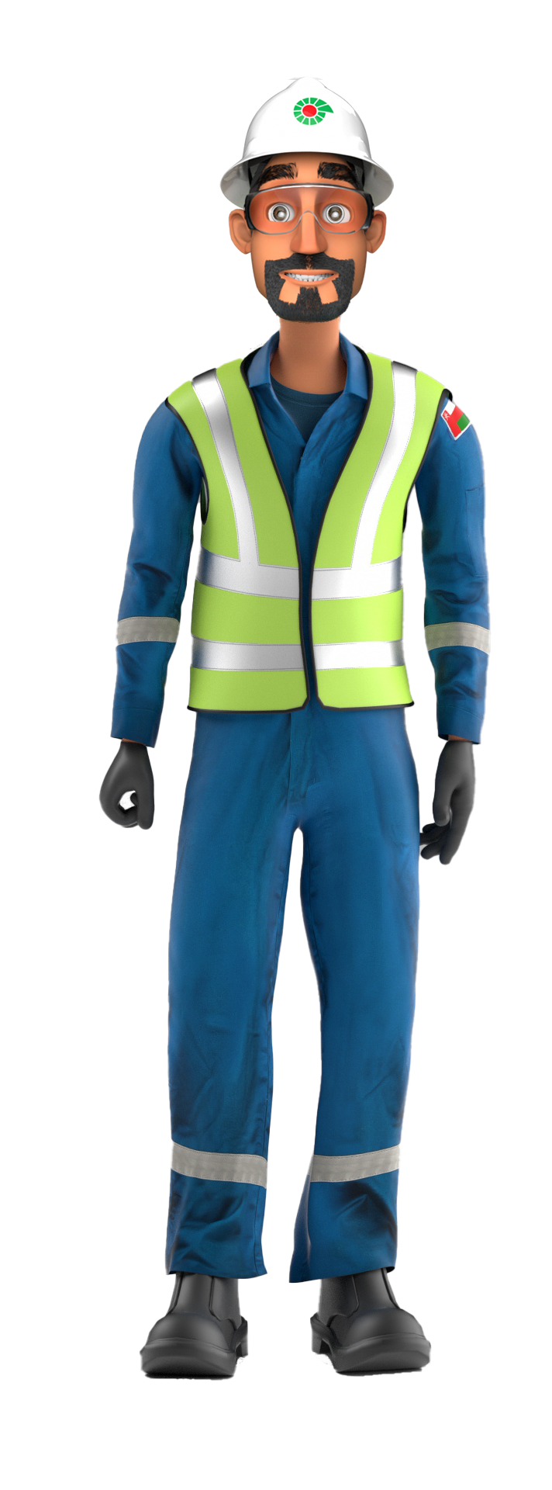
Mr. Musleh’s
Learnings from Incidents
2023 Quarter Two Incidents

Slide 2

FOREWORD
Dear Colleagues,
Welcome to Mr. Musleh’s Newsletter, a ‘one stop shop’ communication highlighting the learnings from incidents in PDO.
Mr. Musleh newsletter (Q2, 2023) summarizes the learnings from incidents related to Lost Time Injuries (LTIs) ,High Potential Incidents (HiPos) and High Value Learning (HVL)
DROPs & Lifting related incidents, followed with Motor Vehicle Incidents (MVI), which continues to be one of the main contributor to these serious incidents.
I would like to emphasize on the importance of learning from repeated incidents.
In addition to the above, we have included the learnings related to Non-Accidental Deaths (NADs) for your reflection.
We encourage you to discuss and reflect on the learnings from these incidents and utilize the information relevant to your activities in your engagements.
  Regards,
  Mahmoud Al Shukri (MSEM)
  Corporate Health Safety & Environment Manager

Slide 3

Contents
Drop:
02 LTI
06 HiPo
01 HVL
Motor Vehicle Incident:
05 HiPos
Released Energy:
01 LTI
01 HiPo
Slip & Fall:
01 LTI
01 HiPo
NAD:
02 NAD
Hand & Finger
02 LTI

Slide 4

Drops
# | Short Description of Incidents (Hyperlinked) | Incident # | Activity | Actual Severity | Potential Severity
1 | Dropped MWD Tool at the catwalk | HiPo#71 | POOH Operation | NM | C4P
2 | Floor man was climbing the Circulation Tank ladder | LTI#43 | climbing ladder | LTI | C3P
3 | Offloading of the Power Swivel in the New location | HiPo#81 | offloading | EQD | C4P
4 | Prepare the rig floor and handling equipment | HiPo#84 | RIH tubing | NM | C4P
5 | Roustabout un-intentionally operated remote control to prepare the joint | HVL#01 | RIH Tubing | NM | C3P
6 | While picking up 1st joint of 2.7/8’’ PAC pipe using 3rd party elevator | HPE#02 | RIH | NM | C3P
7 | mobile crane was in the process of transferring a submersible pump | HiPo#14 | Lifting Operation | EQD | C4P
8 | While laying down the 9.5/8" landing joint | HiPo#15 | RIH | EQD | C4P
9 | The beam pump horse head disassembled from its position. | LTI#10 HiPo#25 | Beam Pump Installation | LTI | C4P
Table of contents

Slide 5
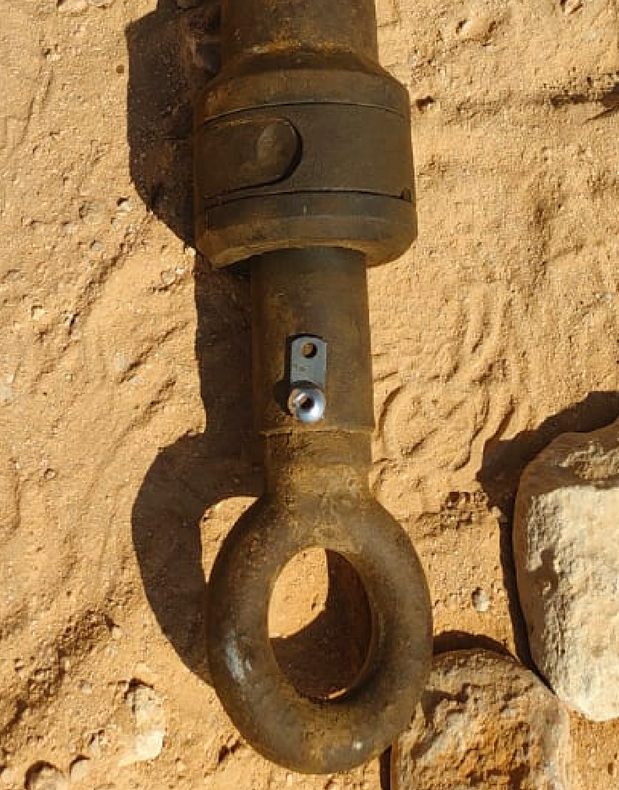
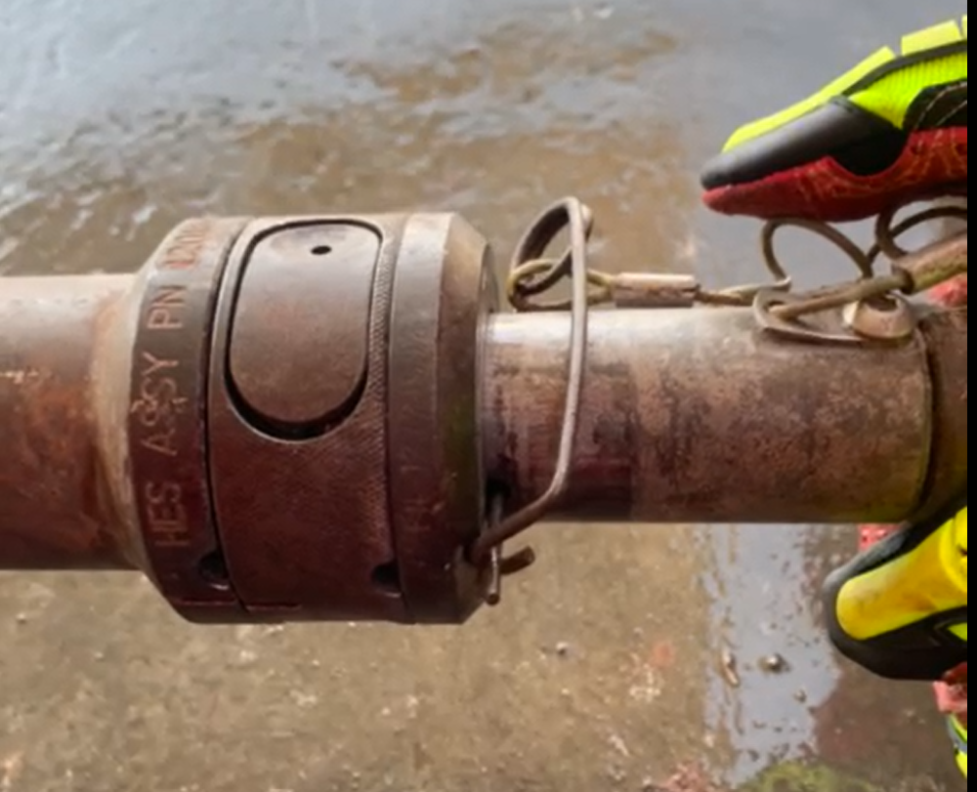

PDO Second Alert
Date: 05/11/2022 Incident title: HiPo#71 Pattern: Dropped Object Potential severity: C4P Activity: POOH operation
Target Audience: Well Placement Services – Rigs (Driller – Rig Manager - DSV)
What happened?
On 05 Nov 2022, around 08:40 AM, the operation was POOH BHA; the MWD Engineer removed the probe assembly from the collar using the handling tool. Then the probe was lifted using the winch and guided to the V-door to lay down the same to the catwalk. While the winch was lowering the assembly, it got unlatched from the handling tool and slide down to the catwalk and then further to the ground.
Operations were stopped and a stand down was conducted with the crew discussing the initial findings and learnings.
No Injury to Personnel / No Asset Damage
Why it happened/Finding :
Locking pin was not installed on the lifting tool to secure the MWD probe from falling.
No checklist/JSA was followed by the engineer to ensure locking pin is installed.
MWD Engineer followed company procedure of L/D the tools instead of PDO’s which requires the MWD tools to be assembled/dis-assembled on the ground
Why is it repeated:
MWD company didn’t include learning from previous incident in their procedure
Your learning from this incident.
Always ensure MWD engineer laydown and dismantle the MWD tools on ground.
Always ensure Driller and MWD engineer using recent HEMP, TBT and JSA before perform the task.
Always ensure MWD engineer locking the pin correctly and installed on the lifting tool of MWD tool.
Always ensure to add learning from incident in 3rd party checklist .
Always ensure DSV and Rig manager inspect 3rd party tools before perform the activity.
MWD tools without safety pin
Safety pin insert in MWD tools
Always ensure MWD engineer locking the pin correctly and installed on the lifting tool of MWD tool
Notes:
Ensure all dates and titles are input
A short description should be provided without mentioning names of contractors or individuals. You should include, what happened, to who (by job title) and what injuries this resulted in. Nothing more!
Four to five bullet points highlighting the main findings from the investigation. Remember the target audience is the front line staff so this should be written in simple terms in a way that everyone can understand.
The strap line should be the main point you want to get across
The images should be self explanatory, what went wrong (if you create a reconstruction please ensure you do not put people at risk) and below how it should be done.

Slide 6
Management self audit
Date: 05/11/2022 Incident title: HiPo#71 Pattern: Dropped Object Potential severity: C4P Activity: POOH operation
As a learning from this incident and ensure continual improvement all contract managers must review their HSE risk management against the questions asked below
Confirm the following:
Do you ensure the previous learnings are reflected in the SOP, JSA, and HEMP?
Do you ensure the control measures listed in the JSA are properly discussed in TBT
Do you ensure the Zone management is adequality complied with?
Do you ensure the coordination between third parties and rig crew is effective?
Do you ensure the traceability of the lifting equipment?
* If the answer is NO to any of the above questions please ensure you take action to correct this finding
Notes:
Ensure all dates and titles are input
Make a list of closed questions (only ‘yes’ or ‘no’ as an answer) to ask others if they have the same issues based on the management or HSE-MS failings or shortfalls identified in the investigation.
Imagine you have to audit other companies to see if they could have the same issues.
These questions should start with: Do you ensure…………………?

Slide 7
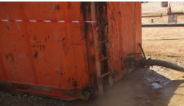
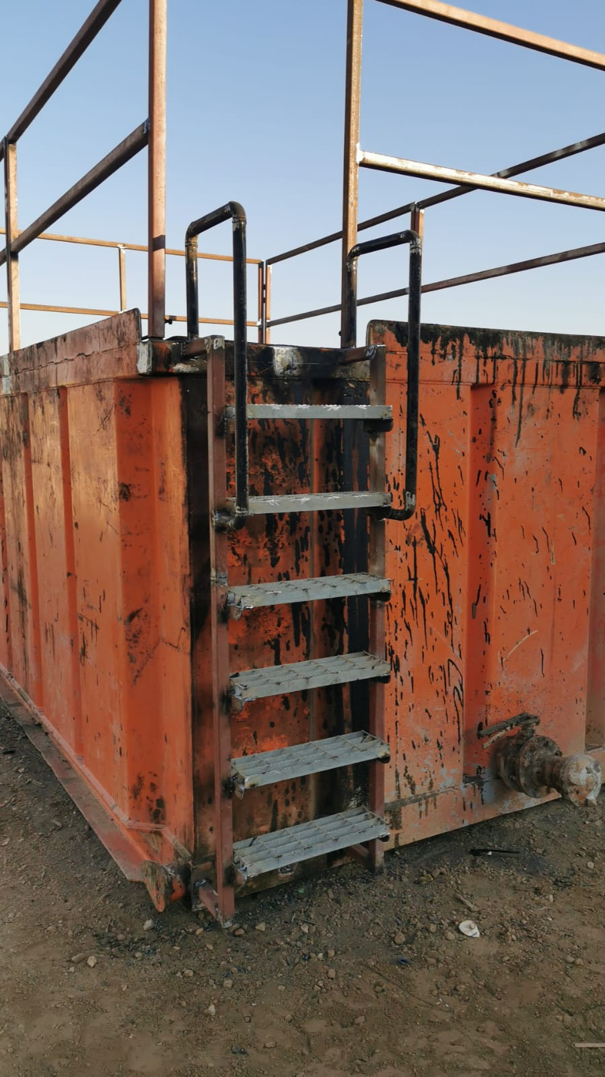
PDO Second Alert
Date 17/11/2022 Incident title: LTI#43 Pattern: Slips, Trips, Falls Potential severity: C3P Activity: climbing ladder
Target Audience: Rig Managers, Drillers, Asst. Drillers, Derrickmen, Floormen, Roustabouts
What happened?
On 17.11.2022 at 16:30, during Milling with 6.1/8'' Bit. The Floor man was climbing the Circulation Tank ladder. While he was climbing his foot slipped and he fell about half a meter. floorman completed his duty, but later complained of pain in his right wrist. The floorman was taken to Tawoos clinic for a check-up and then transferred to Salalah for an X ray. The X Ray revealed that he had fractured his wrist.
Why it happened/Finding :
Floorman attended TBT
TRIC card was issued but did not clearly mention the hazard of slips and falls
The steps of the ladder were covered with oil and the ground was muddy, which made the soles of the floorman’s Safety Boots slippery.
The design of the Ladder was inadequate
If it is repeated, Why is it repeated:
The learning was shared with all. However, no assurance was done.
Learning from this incident :
Floorman always to ensure you have three-point contact when climbing up ladders.
Floorman always to ensure to clean the work area to avoid slippery surfaces.
Floorman always to check his PPE (Safety shoes) condition.
Site management always to ensure the ladder design is adequate to use.
Slippery Step Ladder
Non-Slippery Step Ladder
Always ensure to you have three-point contact when climbing up ladders

Slide 8
Management self audit
Date 17/11/2022 Incident title: LTI#43 Pattern: Slips, Trips, Falls Potential severity: C3P Activity: climbing ladder
As a learning from this incident and ensure continual improvement all contract managers must review their HSE risk
management against the questions asked below
Confirm the following:
Do you ensure that three-point contact rule is part of your TBT?
Do you ensure that Safety Boots sole are cleaned from Oil before ascending and descending?
Do you ensure that Ladder Steps are designed to allow their safe use?
* If the answer is NO to any of the above questions please ensure you take action to correct this finding
Notes:
Ensure all dates and titles are input
Make a list of closed questions (only ‘yes’ or ‘no’ as an answer) to ask others if they have the same issues based on the management or HSE-MS failings or shortfalls identified in the investigation.
Imagine you have to audit other companies to see if they could have the same issues.
These questions should start with: Do you ensure…………………?

Slide 9
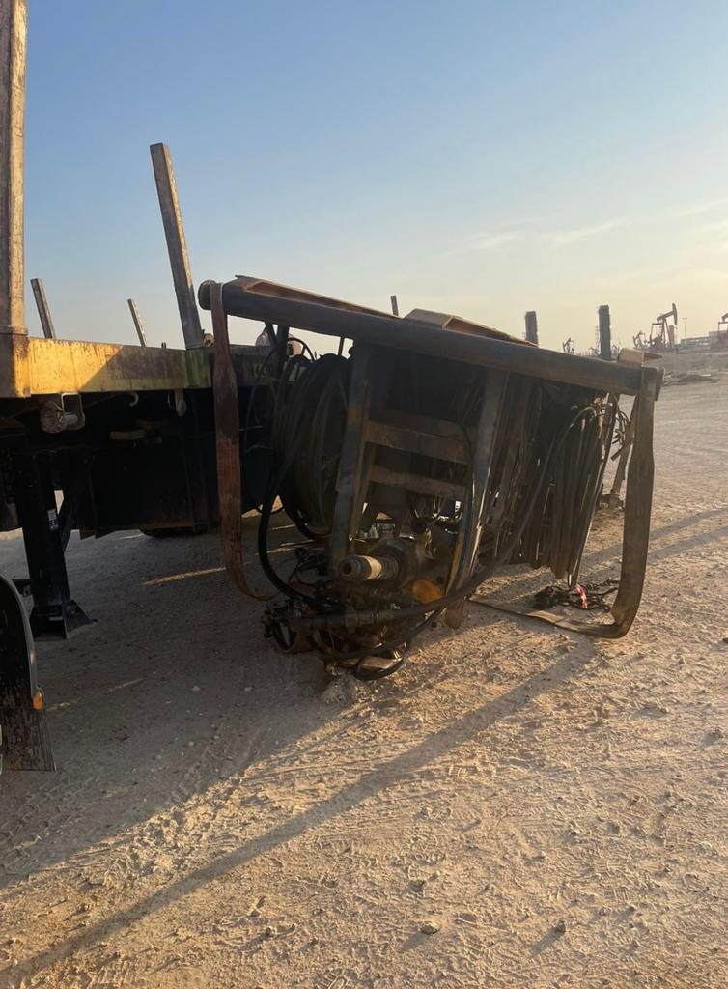

PDO Second Alert
Date: 09.12.2022 Incident title:HiPo#81 Pattern: DROPs Potential severity:C4P Activity: offloading of the Power Swivel
Target Audience :Logistics team, RM, Rig move team & Drivers
What happened?
During the offloading of the Power Swivel in the New location On December 9th at 17:00 hrs. The AD faced difficulty to connect the Web Sling to the Pad Eye which was too close to the Truck Stopper. The supervisor directed the Forklift Operator to move the Power Swivel Skid pad from the Truck Stopper, while moving the Power Swivel this resulted in a fall to the ground
Why it happened/Finding :
All crew members attended the Pre-Task meeting
No one was on the Line of Fire
STP was supervising the task during offloading swivel.
SWA was not implemented at any unsafe act.
Restraint belt was installed from 3 sides only.
Forklift operator tried to push the power swivel skid to move the pad eye from the truck stopper
The risk was not assessed before the push Power Swivel by the forklift
Your learning from this incident…
Lifting supervisor always to follow the lift plan during lifting operations
Driver always to ensure equipment is secured properly during loading/offloading
All team to always use SWA at any unsafe act.
Supervisor to ensure all tasks are Risk assisted and Mitigated.
Supervisor to ensure the Slings or Belts used during loading shall remain in place and the same to be used during the unloading
Make sure to follow the lifting plan and any restrictions to implement the lifting plan the need to perform a risk assessment
Notes:
Ensure all dates and titles are input
A short description should be provided without mentioning names of contractors or individuals. You should include, what happened, to who (by job title) and what injuries this resulted in. Nothing more!
Four to five bullet points highlighting the main findings from the investigation. Remember the target audience is the front line staff so this should be written in simple terms in a way that everyone can understand.
The strap line should be the main point you want to get across
The images should be self explanatory, what went wrong (if you create a reconstruction please ensure you do not put people at risk) and below how it should be done.

Slide 10
Management Self Audit
Date: 09.12.2022 Incident title:HiPo#81 Pattern: DROPs Potential severity:C4P Activity: offloading of the Power Swivel
As a learning from this incident and ensure continual improvement all contract managers must review their HSE risk management against the questions asked below
Confirm the following:
Do you ensure that frequent tasks are not subject for normalization of deviance among personnel?
Do you ensure that the assurance framework includes Learning from incidents
Do you ensure that proactive monitoring tools (e.g. CCTV reviews, inspections and audits) are used for verification of implementation of Learning from incidents
Do you ensure that there is adequate process of implementing Learnings from incidents?
Do you ensure that work instructions have clear break points for longer repetitive tasks to check equipment condition
* If the answer is NO to any of the above questions please ensure you take action to correct this finding
Notes:
Ensure all dates and titles are input
Make a list of closed questions (only ‘yes’ or ‘no’ as an answer) to ask others if they have the same issues based on the management or HSE-MS failings or shortfalls identified in the investigation.
Imagine you have to audit other companies to see if they could have the same issues.
These questions should start with: Do you ensure…………………?

Slide 11
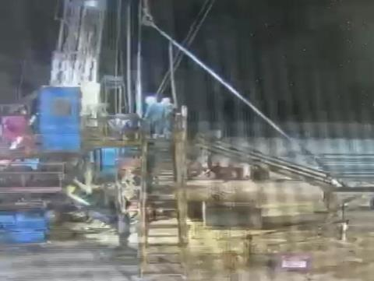
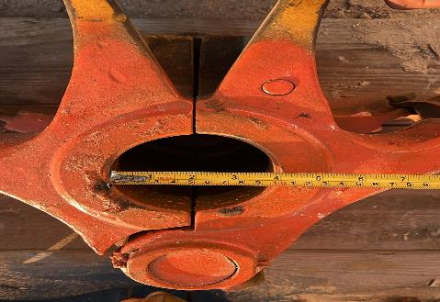
PDO Second Alert
Date: 31/12/2022 Incident title: Dropped object Pattern: HiPo#84 Potential severity: C4P Activity: run 3 ½” tubing at rig floor
Target Audience: Rigs & Hoist. Rig Manager, Tool pusher, Camp Boss, HSV.
What happened?
On 31st Dec 2022 early morning the AD was instructed to prepare the rig floor and handling equipment to run 3 ½” tubing. At 04:59 am, the first joint of 3 ½” tubing was picked up by the AD and the joint of 3 ½ Tubing dropped to the rig floor.
Why it happened/Finding :
4.5” Elevators were used to pick up 3.5” Tubing.
The handling gear check list was not used.
TBT or Job planning was not considered for this task.
The Assistant Driller decided to lift the first joint (at his own accord) / Tubing without the presence of Driller / Night Tool Pusher.
AD had fatigue due to lack of sleep.
If it is repeated, Why is it repeated:
Lack of active monitoring on Learning from previous incident.
Learning from this incident :
Install tags on Elevators with its size written.
Design skids specific for different size of elevators with specific size of stamps on it.
Elevators must be measured during the job planning before being brought to the floor.
AD should not operate the hoist without supervision.
RM and NTP to ensure TBT is done prior to each task.
During TBT ask if everyone has had adequate rest.
If you feel fatigue, report to supervisor and take a break.
Perform verification audit to confirm that internal and external learnings from incidents are effectively implemented.
Tubing Dropped on the Rig Floor
Always physically check equipment before use.
Always ensure to measure the elevator before installing
Notes:
Ensure all dates and titles are input
A short description should be provided without mentioning names of contractors or individuals. You should include, what happened, to who (by job title) and what injuries this resulted in. Nothing more!
Four to five bullet points highlighting the main findings from the investigation. Remember the target audience is the front line staff so this should be written in simple terms in a way that everyone can understand.
The strap line should be the main point you want to get across
The images should be self explanatory, what went wrong (if you create a reconstruction please ensure you do not put people at risk) and below how it should be done.

Slide 12
Management self audit
Date: 31.12.2022 Incident title: Dropped object Pattern: HiPo#84 Potential severity: C4P Activity: Run tubing
As a learning from this incident and ensure continual improvement all contract managers must review their HSE risk management against the questions asked below
Confirm the following:
Do the handling gears have clear ID, tags with size details?
Do the Driller perform handling gear inspection each time?
Do you have a system in place to consistently monitor and verify work performance standards to act on the non-compliances to SOP?
Do you have a system in place to effectively monitor the learnings from past incidents?
Do you have a system in place for the Mental Well being of the workforce?
* If the answer is NO to any of the above questions please ensure you take action to correct this finding
Notes:
Ensure all dates and titles are input
Make a list of closed questions (only ‘yes’ or ‘no’ as an answer) to ask others if they have the same issues based on the management or HSE-MS failings or shortfalls identified in the investigation.
Imagine you have to audit other companies to see if they could have the same issues.
These questions should start with: Do you ensure…………………?

Slide 13
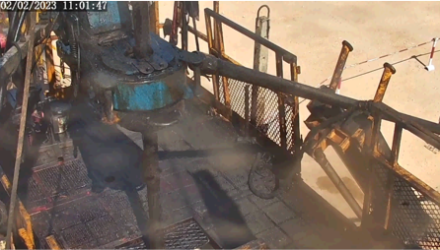
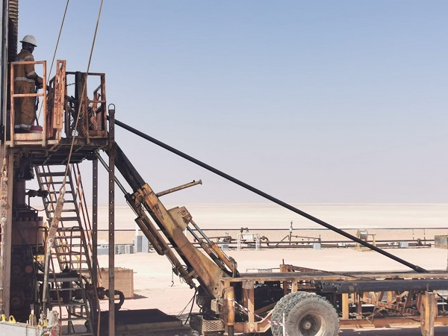
PDO Second Alert
PDO Second Alert
Date: 02/02/2023 Incident title: HVL#01 Pattern: Drops Potential severity: C3P Activity: RIH Tubing
Target Audience: Drilling, Operations
What happened?
On 02 February 2023 @ 11:00 AM, Operation was to RIH 3 ½ ‘’ Tubing using power cat walk, after Running 70 Joints, Roustabout un-intentionally operated remote control to prepare the joint for next RIH and pushed the tubing toward the rig floor resulting in the tubing to hit the power tong, Crew Stopped work Immediately and held safety stand down, No Injuries and No asset damaged.
No consequence of assets damage or injury occurred during this event.
Why it happened/Finding :
TBT was done and SOP with JSA was discussed during pre job safety meeting.
Lack of attention for the task from Roustabout.
Roustabout prepared Joint # 71 while F/M was making up the joint # 70 and before driller tripping joint # 70.
Roustabout didn’t wait for signal prior to push pipe toward the rig floor.
Roustabout been trained & have 10 months experience on operating of power cat work.
FM was on the line of Fire while making up the joint.
Your learning from this incident..
Always ensure to discuss in TBT steps and identify risks associated to the task.
Always ensure power cat work operator is not distracted and aware of risks.
Always keep away from the LOF.
Never prepare for RIH or operate power cat work unless signal is given by FM.
Always Intervene whenever feel un safe.
Always ensure that he pipe is not operated (pushed) until the signal is received
Always ensure that he pipe is not operated (remote control) until the signal is received
Notes:
Ensure all dates and titles are input
A short description should be provided without mentioning names of contractors or individuals. You should include, what happened, to who (by job title) and what injuries this resulted in. Nothing more!
Four to five bullet points highlighting the main findings from the investigation. Remember the target audience is the front line staff so this should be written in simple terms in a way that everyone can understand.
The strap line should be the main point you want to get across
The images should be self explanatory, what went wrong (if you create a reconstruction please ensure you do not put people at risk) and below how it should be done.

Slide 14
Management self audit
Management self audit
Date: 02/02/2023 Incident title: HVL#01 Pattern: Drops Potential severity: C3P Activity: RIH Tubing
As a learning from this incident and ensure continual improvement all contract managers must review their HSE risk management against the questions asked below
Confirm the following:
Do you have a procedure addressing the need of effective communication with the catwalk operator and the floorman during RIH?
Have you identified the position of the catwalk operator while RIH as ‘standing on the rig floor’?
* If the answer is NO to any of the above questions please ensure you take action to correct this finding
Notes:
Ensure all dates and titles are input
Make a list of closed questions (only ‘yes’ or ‘no’ as an answer) to ask others if they have the same issues based on the management or HSE-MS failings or shortfalls identified in the investigation.
Imagine you have to audit other companies to see if they could have the same issues.
These questions should start with: Do you ensure…………………?

Slide 15
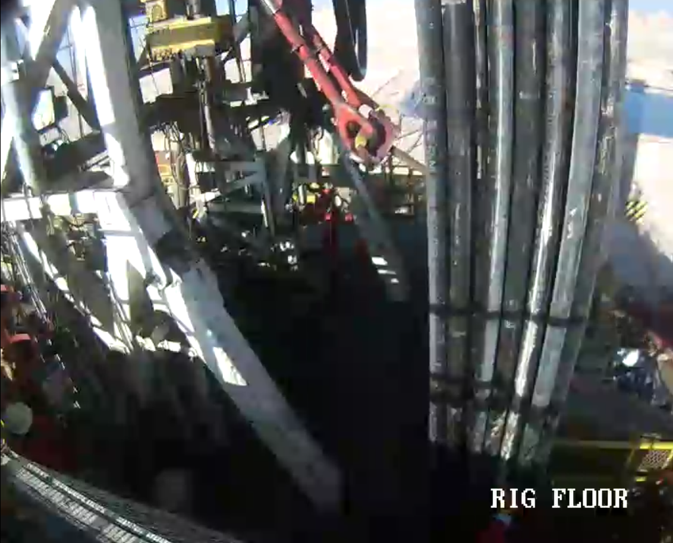
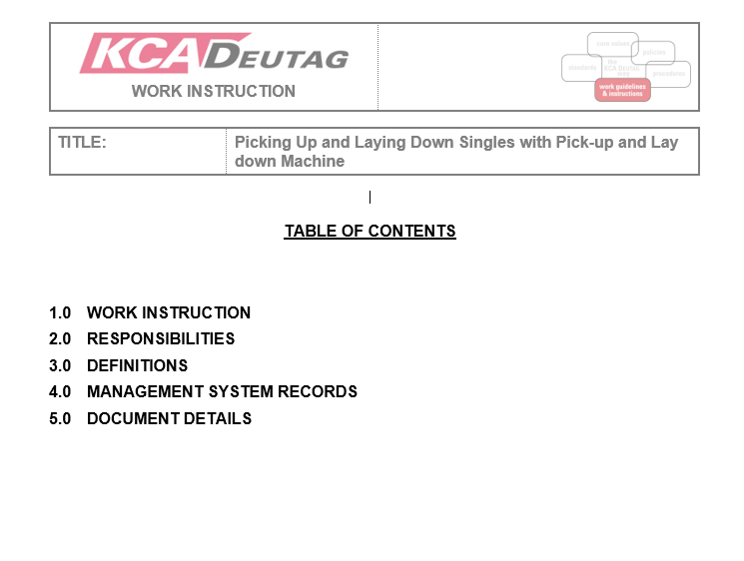
PDO Second Alert
Date:12/02/2023 Incident title: HPE#02 Pattern: Drops Potential severity: C4P Activity: RIH
Target Audience: Rigs and Hoists (TP, NTP, DSV,ADSV, DRL, AD)
What happened?
On 12/02/2023 at 16:45 hours while picking up 1st joint of 2.7/8’’ PAC pipe using 3rd party elevator from the hydraulic catwalk. Driller has started picking up the PAC around 2 meters, the PAC pipe came out from the elevator bore and slipped from the hydraulic catwalk at No-Go zone. Nobody was in the No-Go zone and no body was injured and no damage to any equipment.
Why it happened/Finding :
Rig never used to run 2 7/8” PAC pipe and there was no work instructions/SOPs provided by PDO/CADRES (PDO 3rd party supplier) at rig site and site team not insisted to ask for same from PDO/CADRES.
Site team not physically verified the measurement of handling tools supplied by CADRES and just relied the stencil of the elevator showing 2 7/8”. Site team normalized the risk by assuming the job is normal like handling other size of DPs.
Previous learning from similar incidents which captured during a workshop conducted in March 2022 was not cascaded to other client operations, contractors and suppliers
Why it is Repeated
Reason for repeat is that learning was not shared which has been mentioned on this line
Your learning from this incident..
Crewmembers must ask for written SOPs/work instructions and risk assessment from PDO/supplier before using equipment at site.
AD/Foreman must measure all the tubulars and handling tools to verify the tool joint of tubulars and bore of elevators.
Management and site team to keep good communication for new tasks from planning to execution level.
Learning from incidents to be shared with all contractors/business partners as learning tool. Rig team must not engage in concurrent operation if not absolutely necessary. Whenever there is a movement on the catwalk, all surrounding operation shall cease until the task is completed.
Rig team must use 48hrs LAP planning tool effectively to capture new tasks and management must provide suitable support to the rig in terms of equipment and CoW documentation.
Rig supervisors must conduct effective pre-spud meeting before each well with special focus on new and non routine task.
Before running 2 7/8’’ PAC pipe, ensure that lifting sub and elevators have been physically measured.
Notes:
Ensure all dates and titles are input
A short description should be provided without mentioning names of contractors or individuals. You should include, what happened, to who (by job title) and what injuries this resulted in. Nothing more!
Four to five bullet points highlighting the main findings from the investigation. Remember the target audience is the front line staff so this should be written in simple terms in a way that everyone can understand.
The strap line should be the main point you want to get across
The images should be self explanatory, what went wrong (if you create a reconstruction please ensure you do not put people at risk) and below how it should be done.

Slide 16
Management self audit
Date:12/02/2023 Incident title: HPE#02 Pattern: Drops Potential severity: C4P Activity: RIH
As a learning from this incident and ensure continual improvement all contract managers must review their HSE risk management against the questions asked below
Confirm the following:
Do you ensure that written SOPs/Work instructions are available and referred to, from planning stage to task execution?
Do you ensure that all tubulars and handling tools are measured to verify their dimension and ensure their compatibility?
Do you ensure that learning from incidents are shared with all relevant parties and recommended actions are effectively implemented to prevent repeat of incident?
Do you ensure that pre-mobilization process is completed for equipment and personnel for each callout?
Do you ensure that effective pre-spud meeting is being conducted prior to each well?
Do you ensure that 2 7/8’’ PAC pipe is run using a 2 7/8’’ lifting sub and 2 7/8’’ elevators?
* If the answer is NO to any of the above questions please ensure you take action to correct this finding
Notes:
Ensure all dates and titles are input
Make a list of closed questions (only ‘yes’ or ‘no’ as an answer) to ask others if they have the same issues based on the management or HSE-MS failings or shortfalls identified in the investigation.
Imagine you have to audit other companies to see if they could have the same issues.
These questions should start with: Do you ensure…………………?

Slide 17
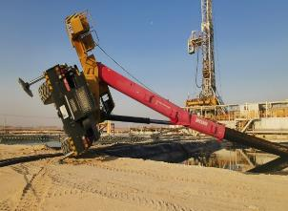
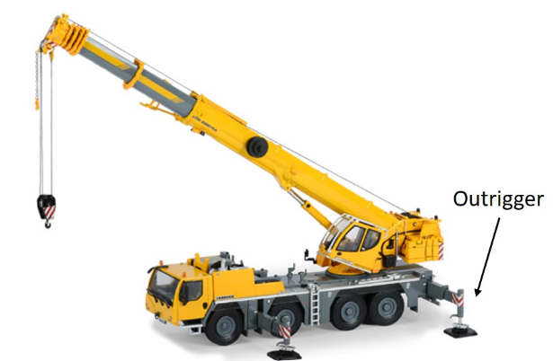
PDO Second Alert
Date:12/03/2023 Incident title: HiPo#14 Pattern: Roll over Potential severity: C4P Activity: Lifting Operation
Target Audience: Crane Operator/Banks Man/Rigger/LEC/Lifting Supervisor/Appointed person
What happened?
At 3:10am, the mobile crane was in the process of transferring a submersible pump from cutting pit to water pit. The pump was lifted from the water pit, transferred to the cutting pit and began to hoist down. Once the pump touched the bottom, the crane fell over and the boom landed in the pit. The crane outriggers were not extended during this job .
Why it happened/Finding:
Team did not use JSA ,TRIC and routine lifting plan prior to task.
The 10 questions for safe lifting operation & 7 steps technique from the team was not applied.
There was no TBT conducted prior the lift is being conducted
No PTW Was issued for the job
There was no lifting supervisor along with the lift.
Crane operator did not extend the crane outriggers.
The crane was spot on narrow place and close to the pits.
Your learning from this incident..
Always ensure to follow the 7 steps Musta”ed technique prior starting any task.
10 question for safe lifting operation should be in place before any lifting task.
Always ensure effective TBT is conducted prior to the activity, and make sure all controls in place.
Always ensure PTW is issued for the lifting operation to verify the controls are in place.
Ensure that approve lifting plan to be used only.
Crane turned over near the water bit
Always ensure outriggers are fully extended and engaged prior to lifting
Notes:
Ensure all dates and titles are input
A short description should be provided without mentioning names of contractors or individuals. You should include, what happened, to who (by job title) and what injuries this resulted in. Nothing more!
Four to five bullet points highlighting the main findings from the investigation. Remember the target audience is the front line staff so this should be written in simple terms in a way that everyone can understand.
The strap line should be the main point you want to get across
The images should be self explanatory, what went wrong (if you create a reconstruction please ensure you do not put people at risk) and below how it should be done.

Slide 18
Management self audit
Date:12/03/2023 Incident title: HiPo#14 Pattern: Roll over Potential severity: C4P Activity: Lifting Operation
As a learning from this incident and ensure continual improvement all contract managers must review their HSE risk management against the questions asked below
Confirm the following:
Do you ensure that SP-2273 followed and understood ?
Do you ensure that JSA, TBT, PTW and lifting plan review prior the task started?
Do you ensure that all learning from incidents circulated to everyone?
Do you ensure supervision in place for lifting operations.
* If the answer is NO to any of the above questions please ensure you take action to correct this finding
Notes:
Ensure all dates and titles are input
Make a list of closed questions (only ‘yes’ or ‘no’ as an answer) to ask others if they have the same issues based on the management or HSE-MS failings or shortfalls identified in the investigation.
Imagine you have to audit other companies to see if they could have the same issues.
These questions should start with: Do you ensure…………………?

Slide 19
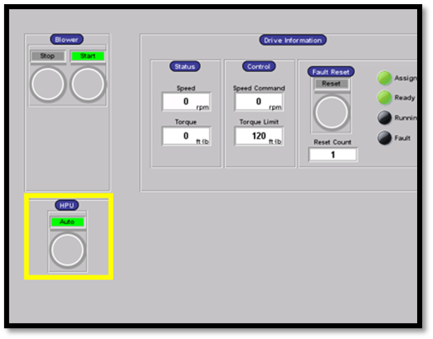
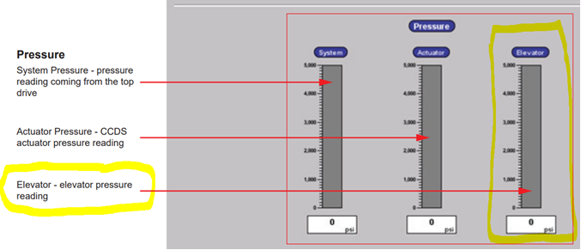
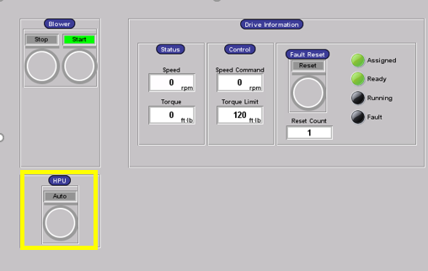
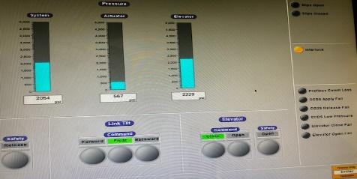
PDO Second Alert
Date:14/03/2023 Incident title: HiPo#15 Pattern: Drop Potential severity: D4P Activity: Laying down landing joint
Target Audience: Rigs & Hoists – Drillers, Assistant Drillers and equipment operators
What happened?
On 14.03.2023 at around 16:16 hours, while laying down the 9.5/8" landing joint, the driller closed the Hydraulic Single Joint Elevator (HSJE). Then he picked up the landing joint, and the floor man pushed the joint's pin end into the catwalk's trough. The driller then started to lower the joint into the trough. While doing so, the HSJE unexpectedly opened, causing the joint to fall, bounce onto the rig floor and land on the ground with its coupling side resting on the V-Door. The zone management was in place and no injury to anyone.
Why it happened/Finding :
The elevator and safety latch function tests were conducted successfully in accordance with the Elevator Product Manual. No abnormalities.
The TDS HPU was operating in Auto mode, which includes a 5-minute timeout period. After 5 minutes of inactivity, the HPU system will automatically stop, and the system pressure drop to zero.
The driller failed to notice that the HPU was off (display on screen + alarm activated on the display).
The HSJE is equipped with a mechanical lock as a secondary barrier but can not keep the elevator in a closed position in the event of a system pressure loss and a joint in an inclined position (weight loss).
The Catwalk area has metal chain as a barrier (as per SP-2097 DROPS standard), the off-driller side chain was temporarily removed to allow the forklift to access the catwalk to remove the landing joint.
The CCTV records shows that the crew complied with the red zone and the no-go zone requirement.
Why was it repeated?
The driller failed to acknowledge the alarm on the driller display and failed to notice the hydraulic system pressure drop on the CRT screen
Your learning from this incident :
Driller and AD to ensure compliance with the zone management system.
Driller and AD to ensure that the TDS HPU is set to the "ON Mode" when using the CRT.
Maintenance team to consult the OEM of the TDS & HSJE elevator to upgrade the hydraulic system to prevent the elevator from opening in case of system pressure loss.
Driller and AD to concentrate on ongoing operation, check all reading (HPU hydraulic pressure, alarms, etc.).
TDS HPU in Auto mode during Run CSG with CRT
TDS HPU in ON mode during Run CSG with CRT
Be vigilant during operation, regularly check HPU hydraulic pressure and monitor alarms
Notes:
Ensure all dates and titles are input
A short description should be provided without mentioning names of contractors or individuals. You should include, what happened, to who (by job title) and what injuries this resulted in. Nothing more!
Four to five bullet points highlighting the main findings from the investigation. Remember the target audience is the front line staff so this should be written in simple terms in a way that everyone can understand.
The strap line should be the main point you want to get across
The images should be self explanatory, what went wrong (if you create a reconstruction please ensure you do not put people at risk) and below how it should be done.

Slide 20
Management self audit
Date:14/03/2023 Incident title: HiPo#15 Pattern: Drop Potential severity: D4P Activity: Laying down landing joint
As a learning from this incident and ensure continual improvement all contract managers must review their HSE risk management against the questions asked below
Confirm the following:
Do you ensure, procedures are clear and understood by site team?
Do you ensure, site team is following the procedures?
Do you ensure, site team is fully aware about safety features/interlock?
Do you ensure, driller is aware that “ON” mode must be used while operating CRT?
Do you ensure, driller is aware about the consequences on CRT incase of hydraulic system pressure drop?
* If the answer is NO to any of the above questions, please ensure you take action to correct this finding
Notes:
Ensure all dates and titles are input
Make a list of closed questions (only ‘yes’ or ‘no’ as an answer) to ask others if they have the same issues based on the management or HSE-MS failings or shortfalls identified in the investigation.
Imagine you have to audit other companies to see if they could have the same issues.
These questions should start with: Do you ensure…………………?

Slide 21
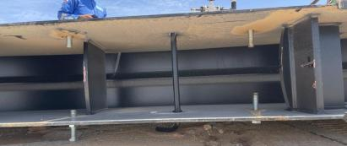
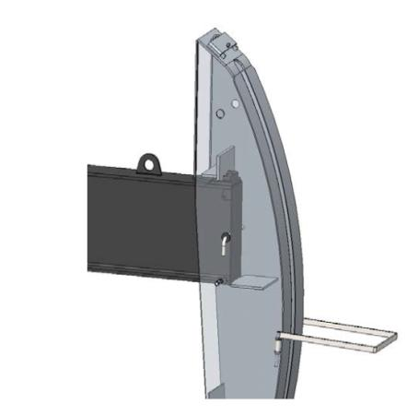
PDO Second Alert
Date:04/06/2023 Incident title: LTI#10 Pattern: Drops Potential severity: C4P Activity: Beam Pump Installation
Target Audience: Drilling, Logistics, Operation & Construction
Safety bar went through horse head but missed walking beam slot
What happened?
On 04 June 2023, Mechanical/Instrument crew were engaged in pre-commissioning activity for Al Burj 213 well. ATE Instrument fitter was removing the load cell cable tape standing near the monkey ladder of beam pump, meanwhile Mechanical PH was aligning the load cell unit fitted on polish rod by operating the manual gear on the rear side of beam pump. During the course of action, the horse head got detached from walking beam, fell on the polish rod of X-mas tree and slid towards monkey ladder, hitting the fitter’s left leg and resulting in injury.
Why it happened/Finding :
Safety bar connecting the walking beam and horse head missed the correct slot
The visual checks carried out was insufficient to identify the missed slot.
Instrumentation technician was working in exclusion zone of dropped object
Mechanical PH failed to alert other crew at site before operating the manual gear to align the load cell unit.
Management of Change was not applied when there was a change in design of the Beam pump.
Your learning from this incident..
How do you ensure checks carried out on equipment are enough to verify their safety?
How do you ensure that you are aware of potential line-of-fire positions and exclusion zones so you can avoid them?
How do you maintain communication between crews carrying out simultaneous operations to ensure safety?
Safety bar should go through the slots on the horse head and walking beam.
Always carryout double checks on completion of critical activities.
Notes:
Ensure all dates and titles are input
A short description should be provided without mentioning names of contractors or individuals. You should include, what happened, to who (by job title) and what injuries this resulted in. Nothing more!
Four to five bullet points highlighting the main findings from the investigation. Remember the target audience is the front line staff so this should be written in simple terms in a way that everyone can understand.
The strap line should be the main point you want to get across
The images should be self explanatory, what went wrong (if you create a reconstruction please ensure you do not put people at risk) and below how it should be done.

Slide 22
Management self audit
Date:04/06/2023 Incident title: LTI#10 Pattern: Drops Potential severity: C4P Activity: Beam Pump Installation
As a learning from this incident and ensure continual improvement all contract managers must review their HSE risk management against the questions asked below
Confirm the following:
How do you ensure your employees remain clear of the line of fire and keep all other out of the potential red zone?
How do you ensure your procedures are reviewed and discussed with your team to identify any additional site-specific concerns?
How do you ensure the Management of change is documented when the scope of work change?
How do you ensure the changes are communicated to your work force?
How do you ensure your risk register is updated with all hazards and controls identified?
* If the answer is NO to any of the above questions please ensure you take action to correct this finding
Notes:
Ensure all dates and titles are input
Make a list of closed questions (only ‘yes’ or ‘no’ as an answer) to ask others if they have the same issues based on the management or HSE-MS failings or shortfalls identified in the investigation.
Imagine you have to audit other companies to see if they could have the same issues.
These questions should start with: Do you ensure…………………?

Slide 23
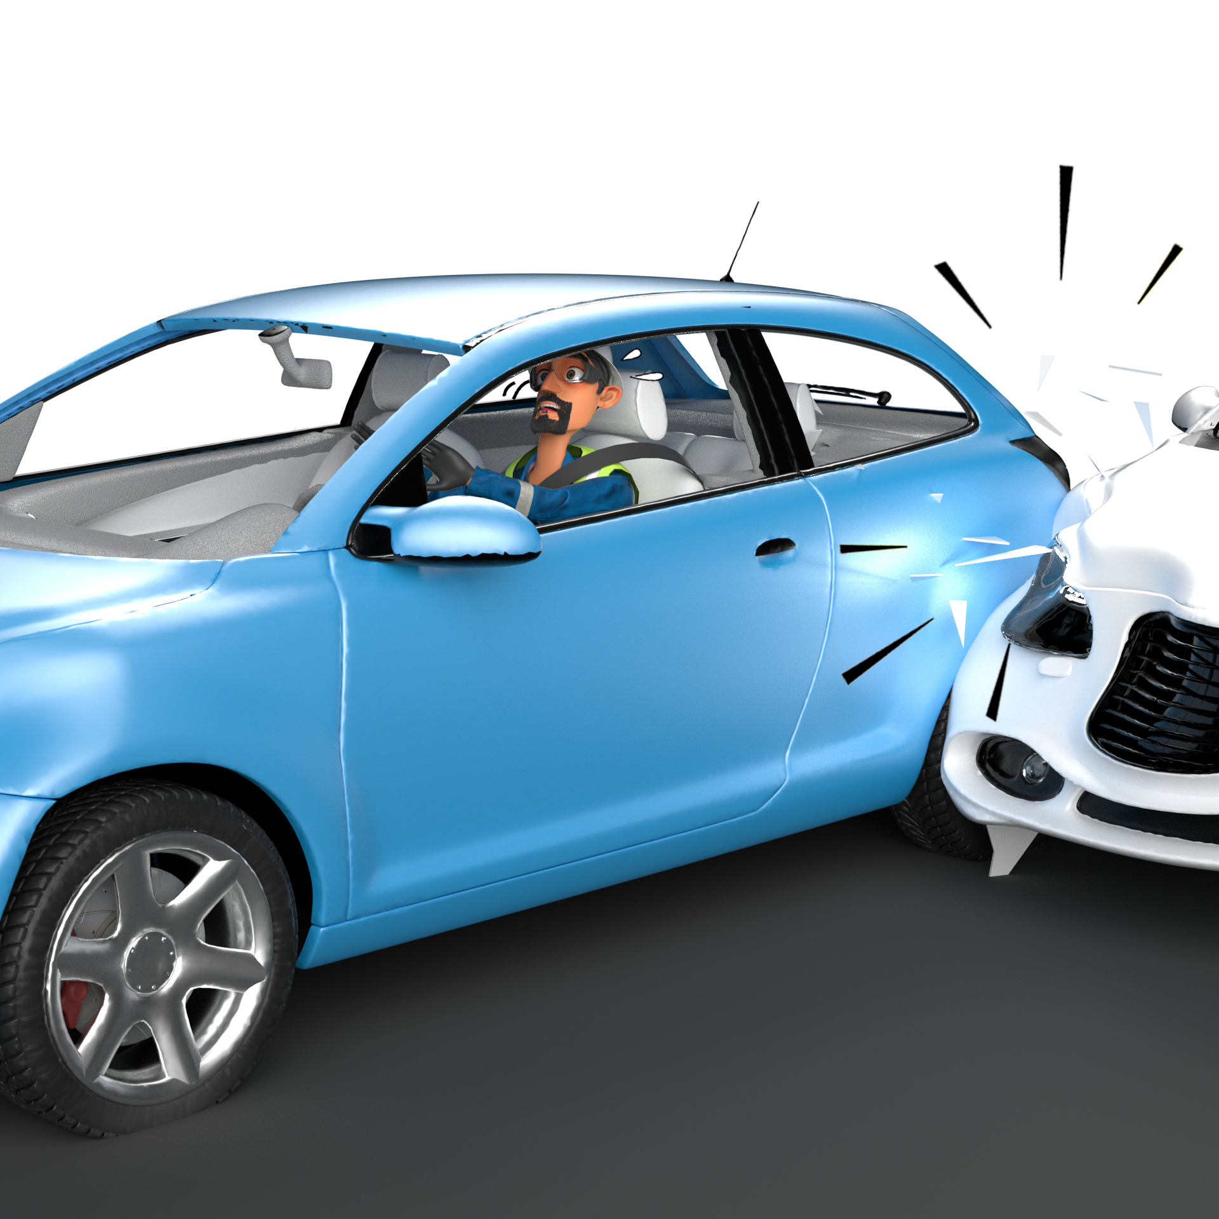
Motor Vehicle Incident
# | Short Description of Incidents (Hyperlinked) | Incident # | Activity | Actual Severity | Potential Severity
1 | Suddenly a running camel appeared on road and driver hit | HiPo#70 | Driving | EQD | C4P
2 | Camp convoy was moving on the Awafia road from Rig old to new location | HiPo#78 | Rig Move | EQD | B4P
3 | While a TO forklift was reversing and came into contact with three chemical drums. | HiPo#08 | Driving | EQD | C4P
4 | Convoy load hit the flowline during rig-32 move | HiPo#11 | Rig Move | EQD | D4E
5 | PI vacuum tanker collided with ATE tipper | HiPo#16 | Driving | EQD | C4P
Table of contents

Slide 24
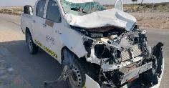






PDO Second Alert
Date: 26/10/2022 Incident title: HiPo#70 Pattern: Road Safety Potential severity: C4P Activity: Driving
Target Audience: All Drivers and Journey Managers
What happened?
On 26.10.2022 around 15:15 hours, Rig driver was on the way from Nizwa to Wadi Al Omairi through Al zahiya black top road. Suddenly a running camel appeared on road and driver hit without applying brake resulting the death of the camel and damaging the car. Driver did not sustain any injury, however driver was sent for further examination in Adam’s hospital where he is declared medically fit.
Why it happened/Finding :
Journey plan was issued for this particular trip.
The visibility on the road was not clear because of direct sunlight and driver did not apply defensive driving techniques
Driver has valid Defensive Driving Permit, till February 2025
Vehicle is fitted with IVMS and speed is approximately 80 km/hour on black top road at the time of incident.
Camels were present in the surroundings and one of the camel entered the road suddenly and was hit by the car.
Why it is repeated?
Hazards of regional animals not captured in defensive driving training
Your learning from this incident..
Drivers need to be more focused when vision is not clear
Drivers to ensure to drive carefully and slowly when camels are in the area
Drivers to ensure sun glasses / prescription glasses are in good condition for driving
Drivers to ensure wind screen is clear of any vision impairment (cracks, sand damage, dust or dirt)
Unit Manager to discuss with visitors the risk of animals while moving in field.
Always follow Defensive driving techniques and drive to surrounding conditions
Notes:
Ensure all dates and titles are input
A short description should be provided without mentioning names of contractors or individuals. You should include, what happened, to who (by job title) and what injuries this resulted in. Nothing more!
Four to five bullet points highlighting the main findings from the investigation. Remember the target audience is the front line staff so this should be written in simple terms in a way that everyone can understand.
The strap line should be the main point you want to get across
The images should be self explanatory, what went wrong (if you create a reconstruction please ensure you do not put people at risk) and below how it should be done.

Slide 25
Management self audit
Date: 26/10/2022 Incident title: HiPo#70 Pattern: Road Safety Potential severity: C4P Activity: Driving
As a learning from this incident and ensure continual improvement all contract managers must review their HSE risk management against the questions asked below
Confirm the following:
Do you ensure Journey plan checklist is updated by covering checks / hazards related to animals?
Do you Ensure that your drivers are reducing speed once road visibility is reduced?
Do you ensure your vehicle wind screen are monitored for damages or impaired visibility?
* If the answer is NO to any of the above questions please ensure you take action to correct this finding
Notes:
Ensure all dates and titles are input
Make a list of closed questions (only ‘yes’ or ‘no’ as an answer) to ask others if they have the same issues based on the management or HSE-MS failings or shortfalls identified in the investigation.
Imagine you have to audit other companies to see if they could have the same issues.
These questions should start with: Do you ensure…………………?

Slide 26
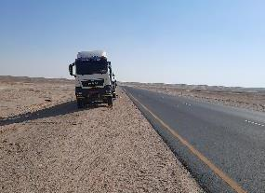
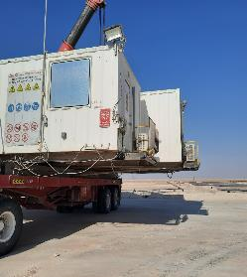
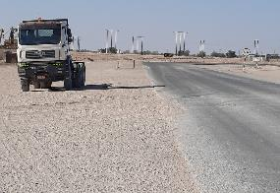
PDO Second Alert
Date: 27/11/2022 Incident title: HiPo #78 Pattern: MVI Potential severity: B4P Activity: Driving
Target Audience: All Drivers and Journey Managers
What happened?
On the 27th November 2022 a camp convoy was moving on the Awafia road from Rig old to new location under ROP and rig movers escort when an incident occurred. The ROP signaled an oncoming 3rd party truck to exit the road at the convoys left side, to allow the convoy to pass. After the ROP and Rig move escort passed the 3rd party vehicle, a wide load being carried by the 3rd vehicle in the convoy (behind ROP and Rig move escort) collided with the 3rd party vehicle driver side front corner of the driver cab. The wide load incurred damage and the 3rd party truck suffered damage to the A pillar, windscreen, side mirror and trailer side stanchions. There were no injuries to either driver involved.
Why it happened/Finding :
Third-party truck was very close to edge of the road when convoy was passing.
Service road available but not used by non convoy vehicle.
You're learning from this incident
Always pull over as far as safely possible when approaching wide loads, use service road where available.
Always be pro-active and exit the road/park at a safe place away from road till convoy passes.
Always ensure whilst escorting a convoy, if a vehicle is close to the road, do not pass, stop and let the vehicle move far from road and then resume driving.
Always be pro-active and defensive and take appropriate steps when you see any vehicle or obstruction near the road.
Always respect warning from wide load escort supervisor and ROP
Maintain sufficient gap from road for convoy to pass
Provide sufficient space for passing wide loads
Notes:
Ensure all dates and titles are input
A short description should be provided without mentioning names of contractors or individuals. You should include, what happened, to who (by job title) and what injuries this resulted in. Nothing more!
Four to five bullet points highlighting the main findings from the investigation. Remember the target audience is the front line staff so this should be written in simple terms in a way that everyone can understand.
The strap line should be the main point you want to get across
The images should be self explanatory, what went wrong (if you create a reconstruction please ensure you do not put people at risk) and below how it should be done.

Slide 27
Management self audit
Date: 27/11/2022 Incident title: HiPo #78 Pattern: MVI Potential severity: B4P Activity: Driving
As a learning from this incident and to ensure continual improvement all contract managers must review their HSE risk management against the questions asked below
Confirm the following:
Do you ensure your competency assessment framework is adequate for drivers and supervisors?
Do you ensure your safe journey management system is compliant to PDO standards?
Do you ensure safety critical requirements are prescriptive where possible instead of leaving open to interpretation?
Do you ensure your drivers / operators are aware of wide load hazards?
* If the answer is NO to any of the above questions, please ensure you take action to correct this finding
Notes:
Ensure all dates and titles are input
Make a list of closed questions (only ‘yes’ or ‘no’ as an answer) to ask others if they have the same issues based on the management or HSE-MS failings or shortfalls identified in the investigation.
Imagine you have to audit other companies to see if they could have the same issues.
These questions should start with: Do you ensure…………………?

Slide 28
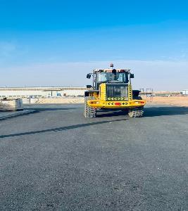
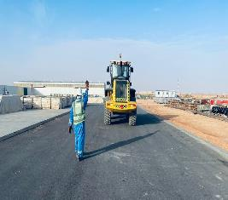
PDO Second Alert
Date: 20/02/2023 Incident title: HiPo#08 Pattern: MVI Potential severity: C4P Activity: Driving
Target Audience: Forklift operators, Banksman / Signaler, Supervisors
What happened?
On February 20th, around 14.47hrs an asset damage incident was reported from Nimr Supply Yard that occurred during loading chemical pallets in NIMR Supply Yard. The incident occurred while one of the forklift was reversing and the operator lost the control to the forklift. It collided with some foam chemical drums. Partial damage occurred to chemical drums and a slight scratch was sustained by the forklift. No injuries were sustained.
Why it happened/Finding :
The FLT operator reversed on a long distance instead of making U-turn and move forward.
The lack of adequate supervision during such long-distance reversing.
No intervention by those involved during such a situation when supervision is inadequate.
The positioning of banksman was not accurate as he did not have 360° view during signalling
Your learning from this incident..
Always ensure adequate supervision is available during operation.
Always ensure that the banksman is positioned away from line of fire and should have 360° view before signalling.
Always ensure induction is being given to the crew/visitor working in the yard.
Always ensure your FLT operator is aware of the hazards at site.
Banksman! Always be visible to plant operators
Notes:
Ensure all dates and titles are input
A short description should be provided without mentioning names of contractors or individuals. You should include, what happened, to who (by job title) and what injuries this resulted in. Nothing more!
Four to five bullet points highlighting the main findings from the investigation. Remember the target audience is the front line staff so this should be written in simple terms in a way that everyone can understand.
The strap line should be the main point you want to get across
The images should be self explanatory, what went wrong (if you create a reconstruction please ensure you do not put people at risk) and below how it should be done.

Slide 29
Management self audit
Date: 20/02/2023 Incident title: HiPo#08 Pattern: Drop Potential severity: C4P Activity: Driving
As a learning from this incident and ensure continual improvement all contract managers must review their HSE risk management against the questions asked below
Confirm the following:
Do you ensure all activities performed are included in HEMP and SOP ?
Do you ensure you identify all hazards before starting a task?
Do you ensure your crew are aware of their roles and responsibilities prior to commencement of work?
Do you ensure all operation are carried out under appropriate supervision?
Do you ensure the competency of the personnel involved?
Do you ensure specific TBT are being carried out for all work activities?
* If the answer is NO to any of the above questions please ensure you take action to correct this finding
Notes:
Ensure all dates and titles are input
Make a list of closed questions (only ‘yes’ or ‘no’ as an answer) to ask others if they have the same issues based on the management or HSE-MS failings or shortfalls identified in the investigation.
Imagine you have to audit other companies to see if they could have the same issues.
These questions should start with: Do you ensure…………………?

Slide 30
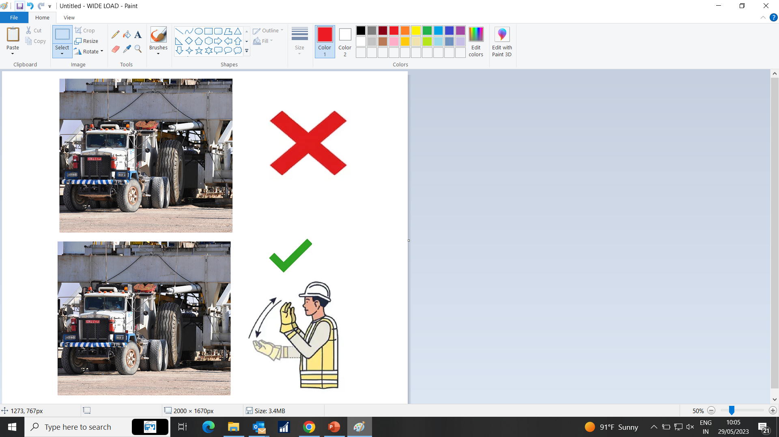
PDO Second Alert
Date:03/03/2023 Incident title: HiPo#11 Pattern: MVI Potential severity: D4E Activity: Rig Move
Target Audience: Logistics and transportation
What happened?
An asset damage occurred on the 03.03.2023 during the office move convoy, when one of the fleets moved without getting any signal from the supervisor in charge and the side of the load collided with the flowline pipe valves, damaging it. No injuries / spillage were sustained.
Why it happened/Finding :
The driver maneuvered his vehicle without getting the signal from the supervisor.
The driver normalized the risk involved during the maneuvering of wide load through flowline areas.
The driver had no view on the sides of the load and forgot about that the steps in the sides.
Your learning from this incident..
Always ensure that you follow the rig convoy procedures and come to a stop before areas where obstructions like flowlines and wellheads are present.
Always ensure that you receive signals from the supervisor or banksman to maneuver when your mirror view of the loads is obstructed.
Always ensure that the supervisor in charge of convoy give instructions on how to maneuver through narrow sections before start of convoy.
Always ensure to mark the nearby flowline pipes in the convoy route in the route survey.
Drivers stop and wait to be called forward
Notes:
To be signed prior to MSE IRC
Here the CEO or senior manager agrees their commitment in writing in front of the PDO Director or MD stating that they will ensure all actions are implemented, contract holder informed for PIM closeout and that they will show adequate leadership to improve safety and prevent a re-occurrence
They also agree to pass on the learning's to their workforce and sub-contractors

Slide 31
Management self audit
Date:03/03/2023 Incident title: HiPo#11 Pattern: MVI Potential severity: D4E Activity: Rig Move
As a learning from this incident and ensure continual improvement all contract managers must review their HSE risk management against the questions asked below
Confirm the following:​
​​
Do you ensure all activities performed are included in HEMP and SOP ?
Do you ensure RMS identified all hazards before starting a task?
Do you ensure the training given to your workforce is effective?
Do you ensure the competency of the personnels involved?
Do you ensure that the scheduling of the work is carried out efficiently?
Do you ensure all possible hazards are identified in the route survey?
* If the answer is NO to any of the above questions please ensure you take action to correct this finding
Notes:
Ensure all dates and titles are input
Make a list of closed questions (only ‘yes’ or ‘no’ as an answer) to ask others if they have the same issues based on the management or HSE-MS failings or shortfalls identified in the investigation.
Imagine you have to audit other companies to see if they could have the same issues.
These questions should start with: Do you ensure…………………?

Slide 32
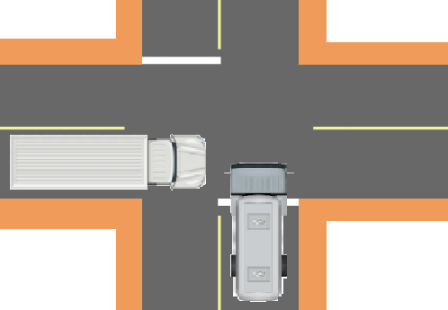

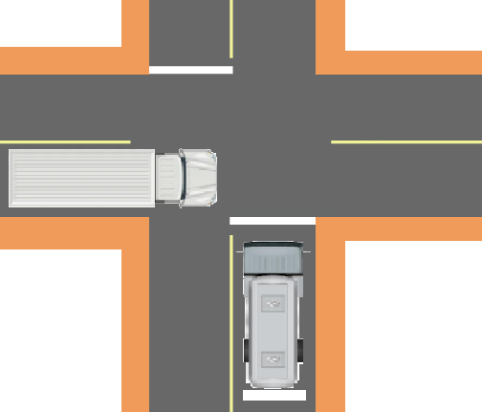

PDO Second Alert
Date:03/04/2023 Incident title: HiPo#16 Pattern: MVI Potential severity: D4P Activity: Driving
Target Audience: Drilling, Logistics, Operation & Construction
What happened?
On 03rd April 23 at 10:27 hrs, a motor vehicle incident happened at the road intersection in front of Marmul B station involving a Vacuum Tanker and HGV tipper. The HGV tipper was coming from Marmul direction and the vacuum tanker was coming from Marmul A station direction. Both vehicles were involved in a collision at the intersection, resulting in vehicle damage to both vehicles. The HGV tipper driver has the right of way, but the VT driver did not stop at the intersection with the STOP Signboard and did not give way. No injury to both drivers only asset damages to the vehicles.
Why it happened/Finding :
Lack of Identifying distraction from personal problems and fatigue of employees.
Did not apply defensive driving techniques. Failed to STOP at the intersection with the STOP Signboard.
Non-compliance with SP2000 DD Permit. Operator who drove the VT does not have DD04 Permit.
Lack of Supervision and Management. Failed to supervise, failed to train and mentor the new employees and subcontractors.
Your learning from this incident..
Always stay alert while driving-if you feel fatigued/tired or distracted, STOP and contact the Journey Manager.
Always apply defensive driving techniques by following road signboards such as STOP or YIELD at intersections or junctions.
Always ensure you have a valid driving license and driving permit for the type of vehicle you intend to drive
Always ensure adequate and competent supervision is provided in your workplace.
Always look ahead to the road to assess any signboards, road hazards, and changes to road conditions.
Vehicle Collision
STOPPING at Intersections with STOP Signboards prevents accidents
STAY Alert. Avoid Fatigue. STOP at Intersections with STOP Signboards.
Notes:
Ensure all dates and titles are input
A short description should be provided without mentioning names of contractors or individuals. You should include, what happened, to who (by job title) and what injuries this resulted in. Nothing more!
Four to five bullet points highlighting the main findings from the investigation. Remember the target audience is the front line staff so this should be written in simple terms in a way that everyone can understand.
The strap line should be the main point you want to get across
The images should be self explanatory, what went wrong (if you create a reconstruction please ensure you do not put people at risk) and below how it should be done.

Slide 33
Management self audit
Date:03/04/2023 Incident title: HiPo#16 Pattern: MVI Potential severity: D4P Activity: Driving
As a learning from this incident and ensure continual improvement all contract managers must review their HSE risk management against the questions asked below
Confirm the following:
How do you ensure your drivers are alert and in good condition before driving? How do you identify distractions from personal issues from family or at work?
How do you ensure your company has established and implemented an effective Fatigue Management System?
How do you ensure your drivers are following defensive driving techniques by slowing down and stopping at road intersections and by following signboards?
How do you ensure your drivers are authorized to drive and complying valid driving licenses and driving permits for vehicles they intend to use?
How do you ensure you have adequate and competent supervision in your workplace?
* If the answer is NO to any of the above questions please ensure you take action to correct this finding
Notes:
Ensure all dates and titles are input
Make a list of closed questions (only ‘yes’ or ‘no’ as an answer) to ask others if they have the same issues based on the management or HSE-MS failings or shortfalls identified in the investigation.
Imagine you have to audit other companies to see if they could have the same issues.
These questions should start with: Do you ensure…………………?

Slide 34
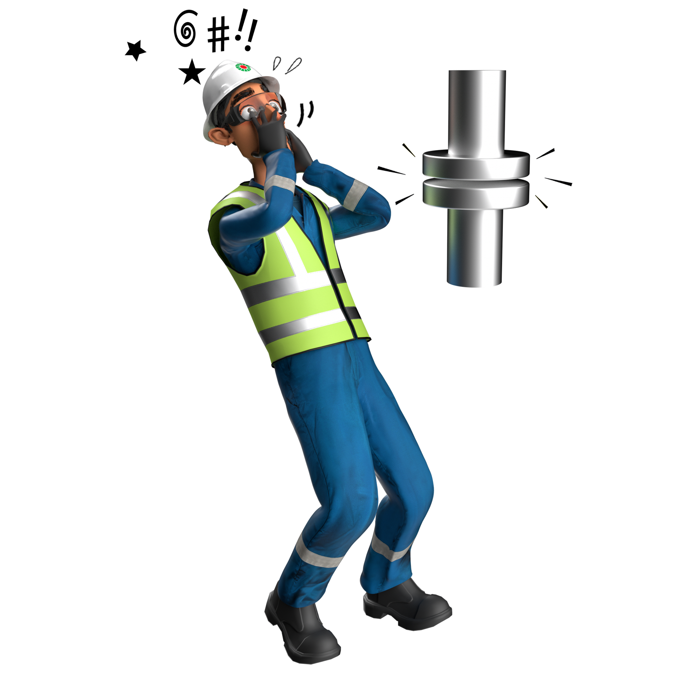
Released Energy
# | Short Description of Incidents (Hyperlinked) | Incident # | Activity | Actual Severity | Potential Severity
1 | Empty water tanker was detached from a prime mover | HiPo#18 | Driving | EQD | B4P
2 | While the mechanic was engaged to unbolt the mud pump cover, the cover moved and hit his leg | LTI#05 | Pneumatic testing | LTI | C4P
Table of contents

Slide 35
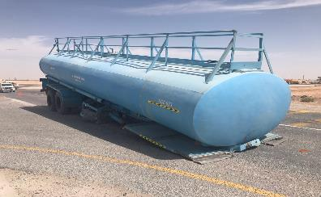
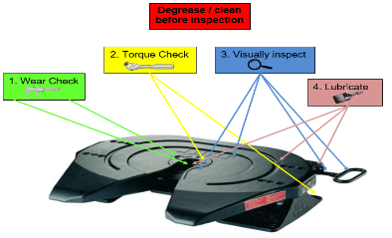
PDO Second Alert
Date: 09/04/2023 Incident title: HiPo#18 Pattern: Released Energy Potential severity: B4P Activity: Driving
Target Audience: Drilling, Logistics, Operation & Construction
What happened?
On 09th April 2021 at approx. 0959 hrs. an empty water tanker was detached from a prime mover and dropped to the ground after making a left turn at a T junction near to the Marmul roundabout. The prime mover and water tanker was on its ways to its base thereafter for renewing the expired ROP of water tanker.
Why it happened/Finding :
Inadequate maintenance of fifth wheel
Pull test not completed
Use not assessed in line with failure expectations wear rates
Your learning from this incident..
Always ensure king pin and fifth wheel are inspected and maintained as per OEM recommendation as well as PDO standard.
Always report any defect to the maintenance team.
Always ensure driver is carrying out pull test
Always ensure you carry out quality checks on your maintenance process
Always ensure you have sufficient rest between shifts
Consider adding the 5th wheel lock tool also
Ensure all parts are correct, before you connect
Notes:
Ensure all dates and titles are input
A short description should be provided without mentioning names of contractors or individuals. You should include, what happened, to who (by job title) and what injuries this resulted in. Nothing more!
Four to five bullet points highlighting the main findings from the investigation. Remember the target audience is the front line staff so this should be written in simple terms in a way that everyone can understand.
The strap line should be the main point you want to get across
The images should be self explanatory, what went wrong (if you create a reconstruction please ensure you do not put people at risk) and below how it should be done.

Slide 36
Management self audit
Date: 09/04/2023 Incident title: HiPo#18 Pattern: Released Energy Potential severity: B4P Activity: Driving
As a learning from this incident and ensure continual improvement all contract managers must review their HSE risk management against the questions asked below
Confirm the following:
Do you ensure your maintenance team follow OEM recommendation?
Do you ensure assurance checks are being carried out to ensure the maintenance process are followed?
Do you ensure defect reporting procedure is being followed and acted upon?
Do you ensure you have a robust vehicle breakdown recovery plan?
Do you ensure your planning considers employees having adequate rest before starting work?
Do you ensure your maintenance process includes Identification of wear limits?
* If the answer is NO to any of the above questions please ensure you take action to correct this finding
Notes:
Ensure all dates and titles are input
Make a list of closed questions (only ‘yes’ or ‘no’ as an answer) to ask others if they have the same issues based on the management or HSE-MS failings or shortfalls identified in the investigation.
Imagine you have to audit other companies to see if they could have the same issues.
These questions should start with: Do you ensure…………………?

Slide 37
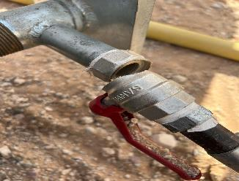
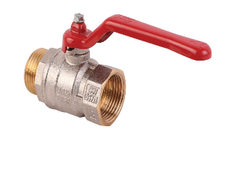

PDO Second Alert
Date:17/05/2023 Incident title: LTI#05 Pattern: Released Energy Potential severity: CP4 Activity: Pneumatic testing
Target Audience: Drilling, Logistics, Operation & Construction
What happened?
At around 15:40 Hrs a Sub-Contractor crew was performing pneumatic testing activity for 16" HDPE liner at Dhulaima Water Injection (WI) line section. The helper closed the ball valve to check intermediate pressure. While walking away from the set up, the ball valve on the test plug unit failed and the manifold section detached and swung due to sudden release of pressure. The manifold hit the helper’s left leg causing injuries. After first aid, the helper was evacuated to Ibri hospital for treatment where X ray revealed displaced oblique fracture of tibia and fibula.
Why it happened/Finding :
Risks associated with potential failure of the valve were not identified and mitigated
Replaced ball valve on test plug was not locally tested and certified
No support to secure the pressure testing equipment
Your learning from this incident..
Always use tested equipment when dealing with pressurized equipment
Always secure equipment and tools when performing pressurized activities
Use certified equipment while dealing with pressure
Notes:
Ensure all dates and titles are input
A short descrhelpertion should be provided without mentioning names of contractors or individuals. You should include, what happened, to who (by job title) and what injuries this resulted in. Nothing more!
Four to five bullet points highlighting the main findings from the investigation. Remember the target audience is the front line staff so this should be written in simple terms in a way that everyone can understand.
The strap line should be the main point you want to get across
The images should be self explanatory, what went wrong (if you create a reconstruction please ensure you do not put people at risk) and below how it should be done.

Slide 38
Management self-audit
Date:17/05/2023 Incident title: LTI#05 Pattern: Released Energy Potential severity: CP4 Activity: Pneumatic testing
As a learning from this incident and ensure continual improvement all contract managers must review their HSE risk management against the questions asked below
Confirm the following:
- Do you ensure that all relevant Material testing certificates are provided with pressure equipment and tools?
- Do you ensure you review the procedures involved with pressure equipment to control energy release?
- Do you review your subcontractor's method statements and risk mitigation prior to deployment?
- Do you ensure that your process includes subcontractors change or critical tools are verified?
* If the answer is NO to any of the above questions please ensure you take action to correct this finding
Notes:
Ensure all dates and titles are input
Make a list of closed questions (only ‘yes’ or ‘no’ as an answer) to ask others if they have the same issues based on the management or HSE-MS failings or shortfalls identified in the investigation.
Imagine you have to audit other companies to see if they could have the same issues.
These questions should start with: Do you ensure…………………?

Slide 39
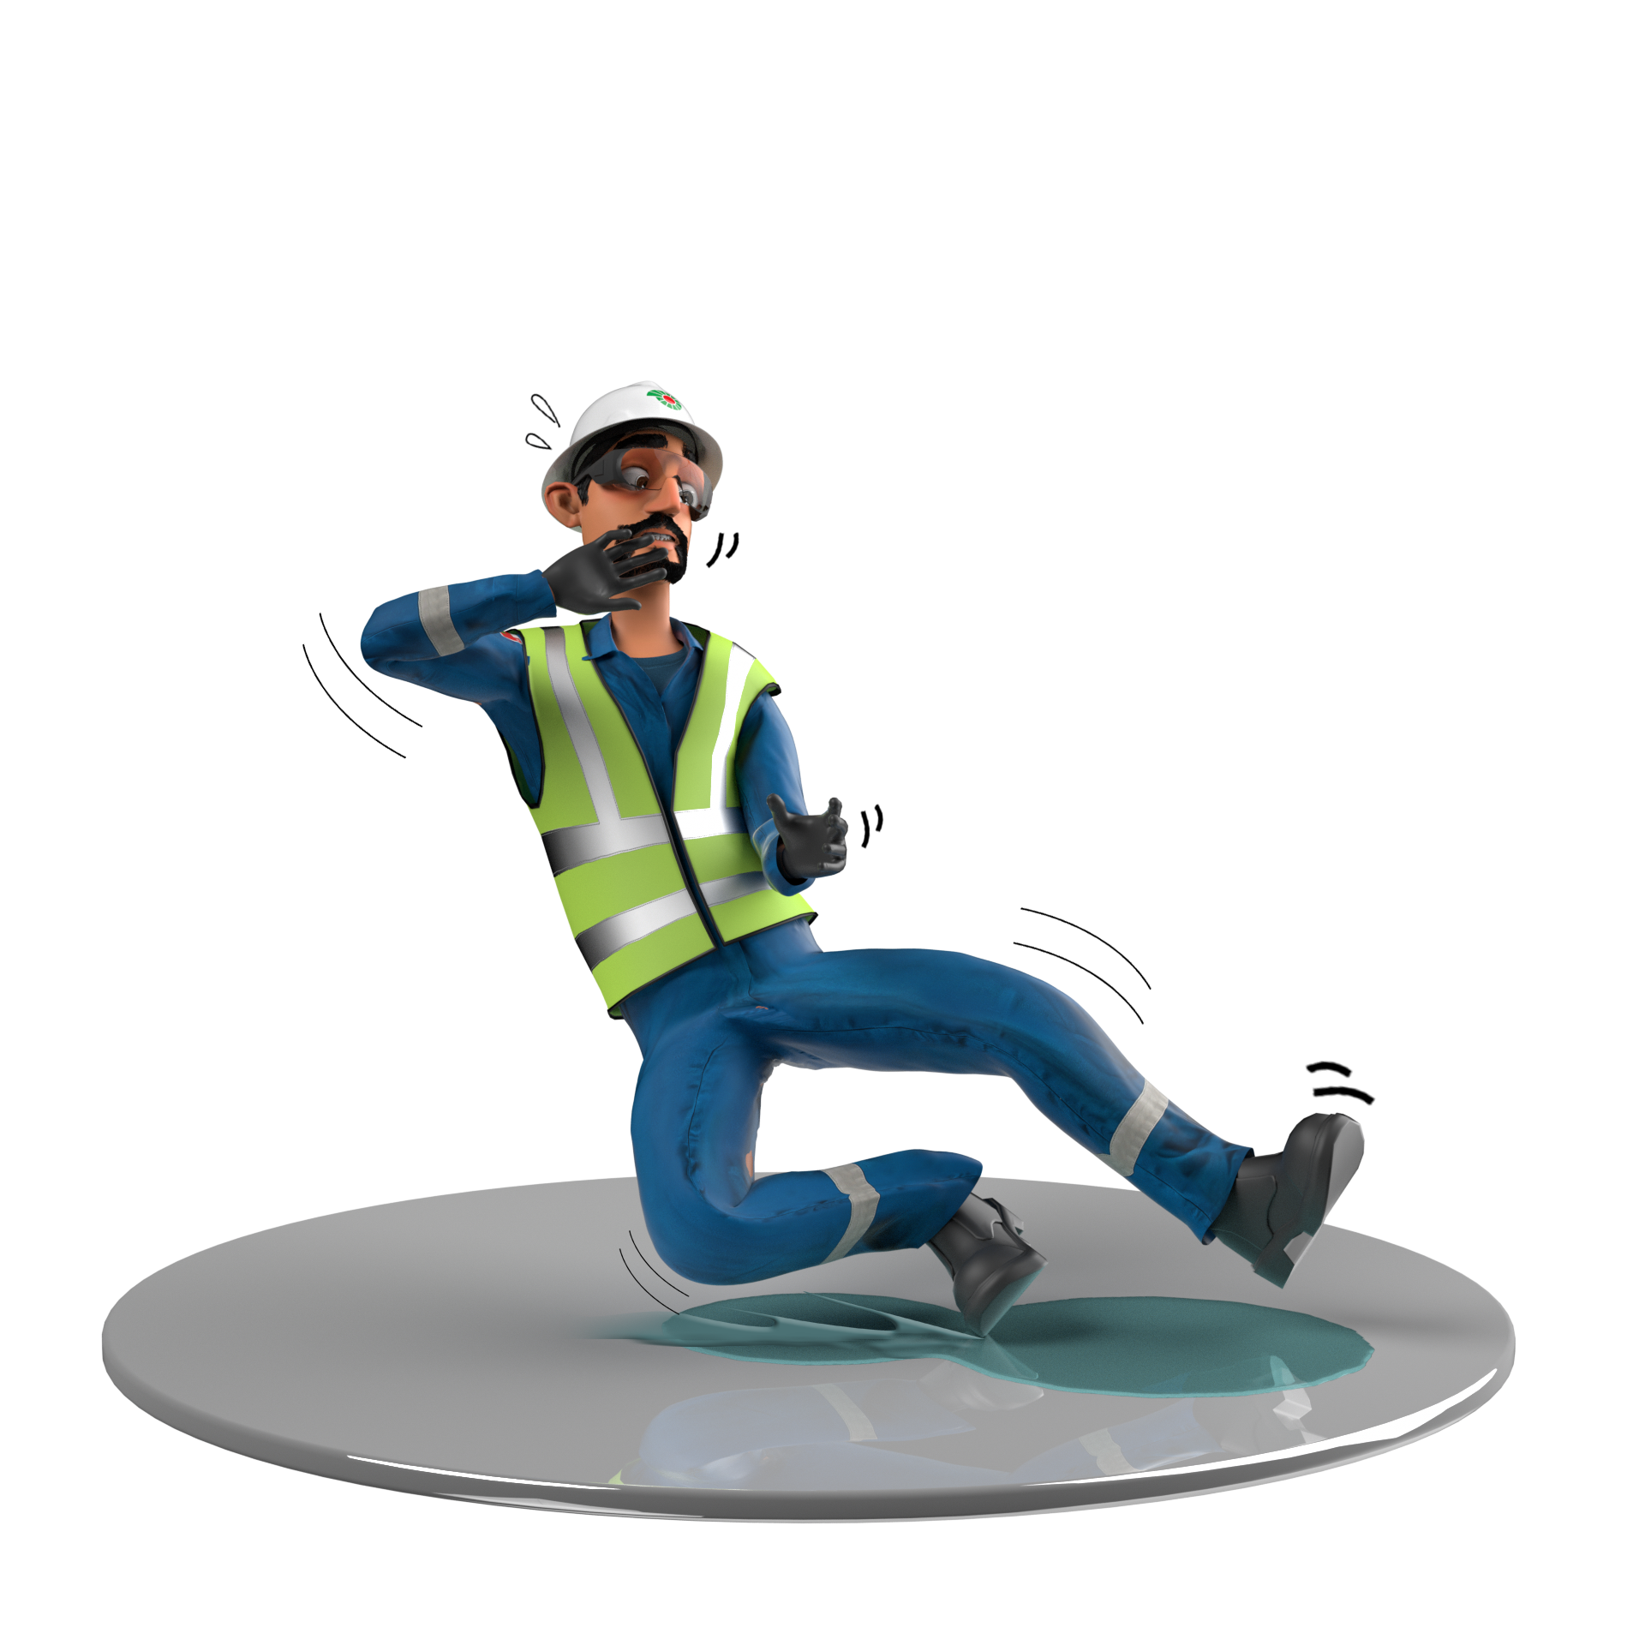
Slip, Trip & Fall
# | Short Description of Incidents (Hyperlinked) | Incident # | Activity | Actual Severity | Potential Severity
1 | Hoist Roustabout was working on the cellar to position one element of the Cellar | HiPo#77 | positioning of the cellar | FAC | C4P
2 | While the Steel Fixer was stepping onto the shuttering runner | LTI#02 | Formwork, Steel Fixing | LTI | C3P
Table of contents

Slide 40
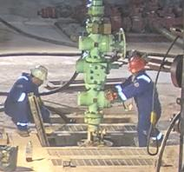
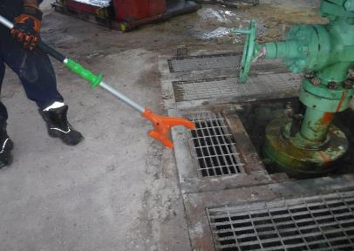
PDO Second Alert
Date: 25/11/2022 Incident title: HiPo#77 Pattern: Slip,Trip & Fall Potential severity: C4P Activity: positioning of the cellar
Target Audience: Rigs & Hoist. Rig Manager, Tool pusher, HSV.
What happened?
On 25th November 2022 at approximately 06:55 PM, Hoist Roustabout was working on the cellar to position one element of the Cellar Gratings after connecting the 2” 1502 HP hose c/w 2’’ NRV into A-Ann SOVs. While trying to check the stability of the grating using his feet; he fell into the Cellar down to his shoulders due to slide-tipped over the Cellar grating caught with its supporting frame. Two of his co-workers were nearby and helped him to get out of the cellar. He had been sent to the nearby Saih Rawl PDO Clinic where First Aid was applied due to tender swelling in both his knees, and bruises on his chest. IP was recommended to send him to Nizwa for X-ray. , X-ray revealed no fracture, and the IP was back to his regular duty.
Why it happened/Finding :
The grating wasn’t placed firmly, and RA stepped on it.
Specific procedure for removing and replacing grating wasn't available.
Neither RA nor his co-workers have used the full-body harness and fall arrester during this task.
RA is 8 years cumulative experience , 6 years with CPDS.
PTW ,TRIC card and JSA was in place.
If it is repeated, Why is it repeated:
Similar incident happened with other PDO Contractor: Inadequate Corrective actions for cellar grating design.
Learning from this incident :
Do not step on the gratings without confirming its firmly set.
During TBT Driller to discuss the use of push pull stick to ensure the gratings are stable and set firmly.
Rig manager to ensure crew members use fall arrestors while working around the cellar area.
Engineering team to review design of grating.
supporting frame to have stopper or bolting to keep it in place that can only be set correctly.
ensure the cellar is adequately covered with fixed , stable gratings.
Ensure grating is firmly set before stepping on it.
Notes:
Ensure all dates and titles are input
A short description should be provided without mentioning names of contractors or individuals. You should include, what happened, to who (by job title) and what injuries this resulted in. Nothing more!
Four to five bullet points highlighting the main findings from the investigation. Remember the target audience is the front-line staff so this should be written in simple terms in a way that everyone can understand.
The strap line should be the main point you want to get across
The images should be self explanatory, what went wrong (if you create a reconstruction please ensure you do not put people at risk) and below how it should be done.

Slide 41
Management self audit
Date: 25/11/2022 Incident title: HiPo#77 Pattern: Slip, Trip & Fall Potential severity: C4P Activity: positioning of the cellar
As a learning from this incident and ensure continual improvement all contract managers must review their HSE risk management against the questions asked below
Confirm the following:
Do your SOP & JSA for removing and installation of Gratings include;
  Inspected the gratings frames, plates for free movement before removing it.
  Use of harness while removing/ installing gratings.
  Do not step on the gratings without confirming its firmly set.
  Use push pull stick to ensure the gratings are stable and set firmly.
Do you check if the gratings are fit for purpose prior to use?
* If the answer is NO to any of the above questions, please ensure you take action to correct this finding
Notes:
Ensure all dates and titles are input
Make a list of closed questions (only ‘yes’ or ‘no’ as an answer) to ask others if they have the same issues based on the management or HSE-MS failings or shortfalls identified in the investigation.
Imagine you have to audit other companies to see if they could have the same issues.
These questions should start with: Do you ensure…………………?

Slide 42
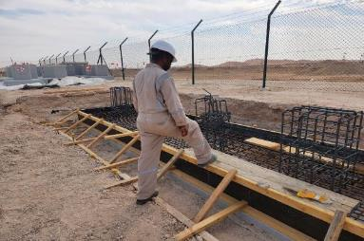
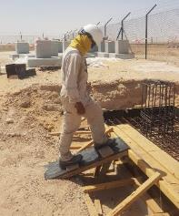
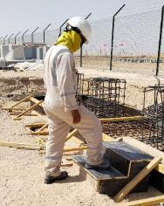
PDO Second Alert
Date: 14/03/2023 Incident title: LTI#02 Pattern: Slip & fall Potential severity: C3P Activity: Formwork, Steel Fixing
Target Audience: Drilling, Logistics, Operation & Construction
What happened?
On 14 March 2023 at 3:40 pm, while the steel Fixer, returning back from the rest shelter after drink water, stepped on the shuttering runner, lost balance and fell resting his left hand resulting in minor swelling and pain. He was initially seen by Medic and referred to Aster hospital in Ibri for detailed examination as advised by PDO Doctor, where X ray has taken which revealed displaced fracture involving distal radius.
Why it happened/Finding :
Steel fixer did not follow the human kinetic practices and was placing the foot on an unsafe position on top of the wooden runner, which caused him to lose balance.
The steel fixer failed to pay attention to his footing and surroundings which lead to lost his balance even through was discussed in the morning TBT.
The steel fixer was performing a routine activity without conscious thought and as a result was exposed to the hazard of fall.
Your learning from this incident..
Always be cautious of your surroundings and the hazards involved
Ensure the provision of safe access and egress in your work site.
Ensure you use safe access and egress
Always pay attention to where you are stepping
Ensure you intervene when you observe unsafe act/condition
Watch your steps to avoid trips & falls
Notes:
Ensure all dates and titles are input
A short description should be provided without mentioning names of contractors or individuals. You should include, what happened, to who (by job title) and what injuries this resulted in. Nothing more!
Four to five bullet points highlighting the main findings from the investigation. Remember the target audience is the front line staff so this should be written in simple terms in a way that everyone can understand.
The strap line should be the main point you want to get across
The images should be self explanatory, what went wrong (if you create a reconstruction please ensure you do not put people at risk) and below how it should be done.

Slide 43
Management self audit
Date: 14/03/2023 Incident title: LTI#02 Pattern: Slip & fall Potential severity: C3P Activity: Formwork, Steel Fixing
As a learning from this incident and ensure continual improvement all contract managers must review their HSE risk management against the questions asked below
Confirm the following:
Do you ensure that the hazards involved have been effectively assessed and captured in the TBT discussion prior to deploying the crew for the task?
Do you ensure the provision of safe access and egress for all works?
Do you ensure risk assessments and method statements are adequately capturing key stages of the activities involved?
Do you ensure your crews use and follow safe access and egress?
Do you ensure that the workers are aware of their authority to stop unsafe work practices?
* If the answer is NO to any of the above questions please ensure you take action to correct this finding
Notes:
Ensure all dates and titles are input
Make a list of closed questions (only ‘yes’ or ‘no’ as an answer) to ask others if they have the same issues based on the management or HSE-MS failings or shortfalls identified in the investigation.
Imagine you have to audit other companies to see if they could have the same issues.
These questions should start with: Do you ensure…………………?

Slide 44
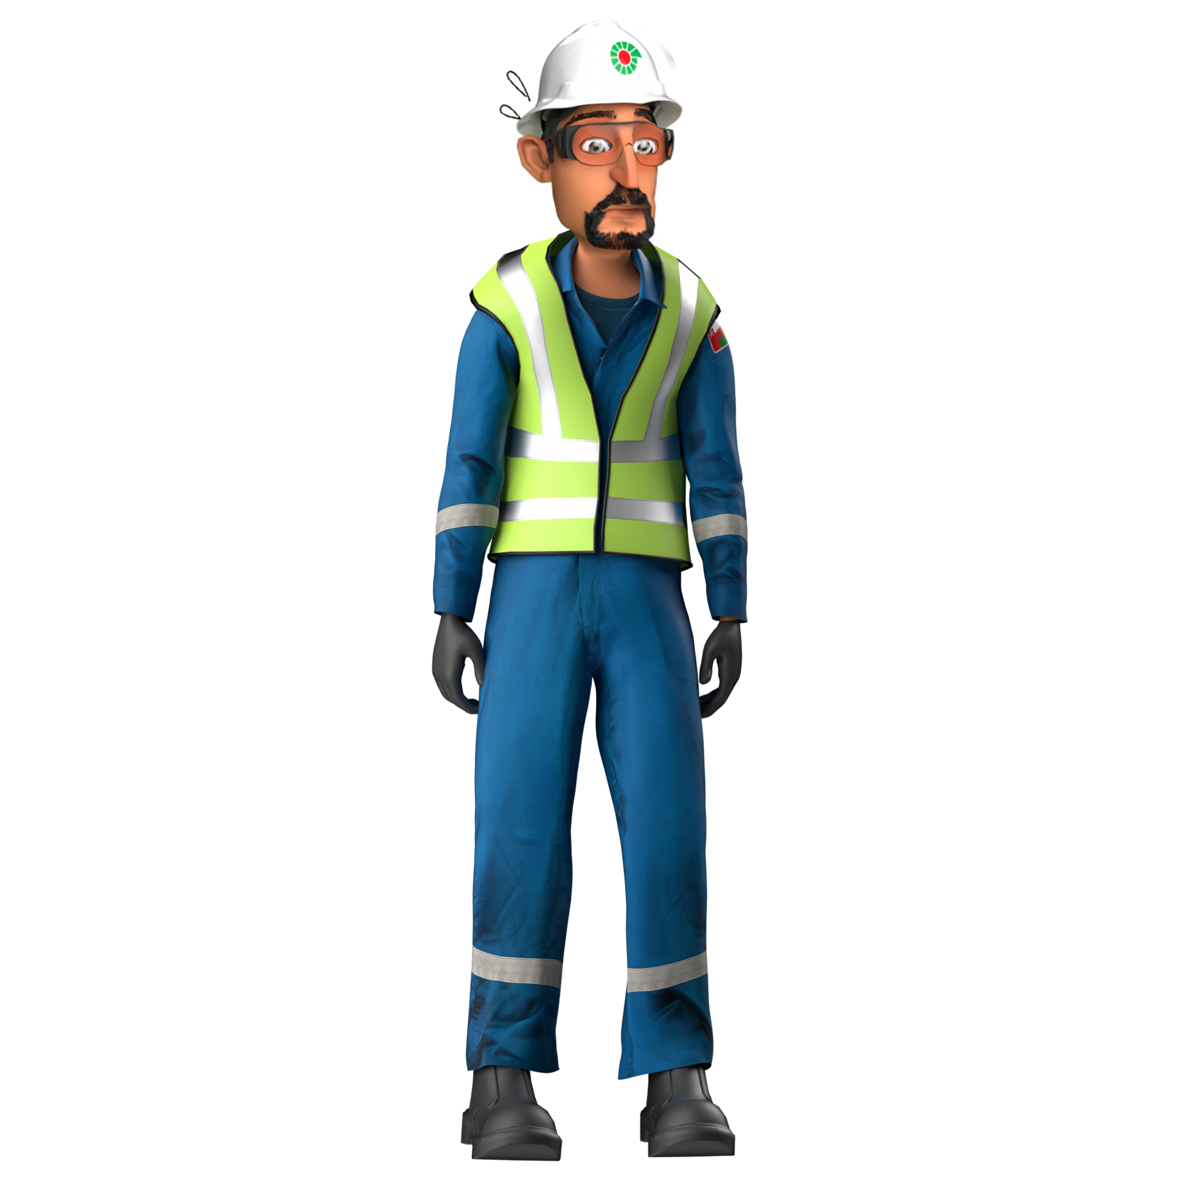
NAD
# | Short Description of Incidents (Hyperlinked) | Incident # | Actual Severity | Potential Severity
1 | Telecom Forman presented at clinic with chest pain and collapsed in the ambulance while being transferred to SQH | NAD#04
2 | Mason collapsed at construction site, admitted in hospital and passed away after a week due to cerebral stroke | NAD#05
Table of contents
Notes:
Ensure all dates and titles are input
A short description should be provided without mentioning names of contractors or individuals. You should include, what happened, to who (by job title) and what injuries this resulted in. Nothing more!
Four to five bullet points highlighting the main findings from the investigation. Remember the target audience is the front line staff so this should be written in simple terms in a way that everyone can understand.
The strap line should be the main point you want to get across
The images should be self explanatory, what went wrong (if you create a reconstruction please ensure you do not put people at risk) and below how it should be done.

Slide 45


PDO Second Alert
Date: 30.03.2023 Incident title: NAD#04
What happened?
On March 29th, 2023, a Telecom Installation Foreman, who had recently arrived from Muscat –post short emergency leave- and had just resumed duty in Marmul reported experiencing chest pain and difficulty of breathing to his Team Leader after the tarawih (Night) prayer. Team Leader advised him to visit the clinic for a check-up. At 21:32 Hrs he was examined by a nurse at the clinic, who then called the doctor and informed him about the findings. The doctor advised transferring the deceased to Salalah Hospital for further management. An ambulance was quickly arranged to transfer him to Salalah Hospital 22:40 Hrs. After 2 hours into the journey, he had a sudden cardiac arrest (Ventricular fibrillation). CPR commenced. Upon arrival at Salalah Hospital, the deceased couldn’t revive, and he was declared dead at 02:35 am on 30/03/2023
Do not ignore chest pains, seek immediate assistance even during commuting.
Your learning from this incident..
Ensure to call PDO emergency number 24385555 immediately for emergency assistance.
Ensure to conduct medical emergency drill as per HSE Plan by involving PDO medical team to evaluate the effectiveness of emergency response.
Educate employees to report immediately in case of any illness or discomfort.
Encourage all employees to maintain a healthy lifestyle (E.g., healthy diet, exercise
Report immediately in case of any pain
Do not ignore any signs of discomfort. Report to the clinic immediately
Notes:
No names or detail of company to link this to any recent specific incident

Slide 46


PDO Second Alert
Date: 21.04.2023 Incident title: NAD#05
What happened?
On Saturday, April 15th, at about 8:55 a.m., while the deceased, a 50-year-old employee of Towell Engineering was working at the construction site, he suddenly felt unwell and sat on floor. He was shifted to Tawoos Clinic and the doctor referred the deceased to Sultan Qaboos Ministry Hospital at Salalah. A specialist doctor recommended surgery for a decompressive craniectomy was continuously under observation, but his health condition didn't improve. Unfortunately, he passed away on 21st April 2023 at 03:25 pm.
Your learning from this incident..
Conduct continues health awareness campaigns to empower individuals to make healthier choices and reduce their risk of disease and disability
Conduct periodical drills related to Medical scenarios (to keep employees prepared for emergencies, work together under stress, effectiveness of emergency procedure and area of improvements)
Ensure calling 5555 in case of all emergencies ( Emphasis on 1st person response attending incident scene to call 5555 )
Encourage employees with chronic illness to attend scheduled follow up appts also the management to ensure tracking the health status of those employees with chronic illness.
“Start thinking wellness, not illness”
Notes:
No names or detail of company to link this to any recent specific incident

Slide 47
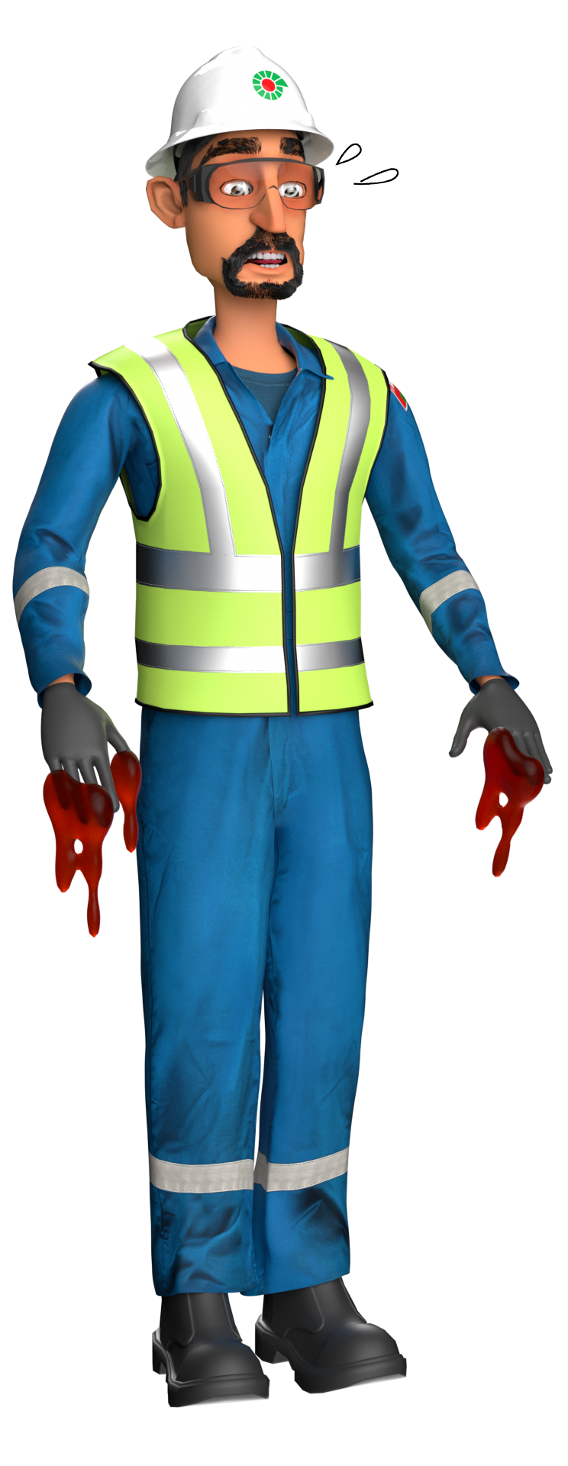
Hand & Finger
# | Short Description of Incidents (Hyperlinked) | Incident # | Activity | Actual Severity | Potential Severity
1 | Technician was removing the steel belt guard | LTI#12 | HVAC Maintenance | LTI | C2P
2 | Welder was involved in cutting pipe | LTI#13 | cutting pipe | LTI | D3P
Table of contents

Slide 48

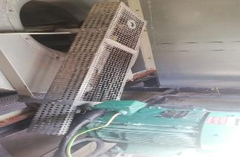
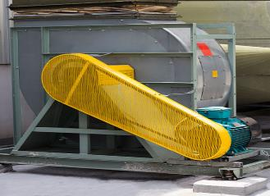

PDO Second Alert
Date:18/06/2023 Incident title: LTI#12, Pattern: Hands & Fingers Potential severity C2P Activity: HVAC Maintenance
Target Audience: Drilling, Logistics, Operation & Construction
What happened?
During a HVAC routine maintenance activity, a Technician was removing the steel belt guard. On removing the securing bolts, he found the guard to be held to the body of the HVAC unit. He positioned himself closer to the guard and place his right hand on the base of the unit and pulled the guard with the left hand. After a few seconds of grappling with the guard it suddenly fell form its position and landed on the right hand that was supporting the Technician, the impact resulted in a pinch injury to the middle finger of this right hand
Why it happened/Finding :
Incorrect posture for work
Enforced poor ergonomics for maintenance due to poor design
Failure to identify the finger pinch point hazard related to the task
Your learning from this incident..
Do you identify hand & finger hazards before starting any task and discuss them during TBT?
Are the sequencies of doing the task clearly documented and discussed prior to the task?
Do you consider the what can drop or suddenly move and trap your finger?
Do you Supervise the works from a safe distance, intervening when dangerous occurrences become obvious?
Guard intact
Keep Hands Free from Pinch Points
Notes:
Ensure all dates and titles are input
A short description should be provided without mentioning names of contractors or individuals. You should include, what happened, to who (by job title) and what injuries this resulted in. Nothing more!
Four to five bullet points highlighting the main findings from the investigation. Remember the target audience is the front line staff so this should be written in simple terms in a way that everyone can understand.
The strap line should be the main point you want to get across
The images should be self explanatory, what went wrong (if you create a reconstruction please ensure you do not put people at risk) and below how it should be done.

Slide 49
Management self-audit
Date:18/06/2023 Incident title: LTI#12, Pattern: Hands & Fingers Potential severity C2P Activity: HVAC Maintenance
As a learning from this incident and ensure continual improvement all contract managers must review their HSE risk management against the questions asked below
Confirm the following:
Do you ensure PTW holder supervises the job rather than carry out the work? Yes , this is the SOP that we follow , The PTW holder should only be supervising the work and not to physically participate in any maintenance duties.
Do you ensure the crew have identified all hazards before they complete the task? Yes
Do you ensure your crews understand the meaning of ‘Line of Fire’ Yes , Will provide a copies of TBT that covers this subject.
Do you ensure your crew understand they have the empowerment to intervene for any unsafe action, condition they may see? Yes , the crew are always encouraged to intervene whenever they witness an unsafe act or behavior. This is reiterated on all health and Safety discussions and TBT’s.
* If the answer is NO to any of the above questions please ensure you take action to correct this finding
Notes:
Ensure all dates and titles are input
Make a list of closed questions (only ‘yes’ or ‘no’ as an answer) to ask others if they have the same issues based on the management or HSE-MS failings or shortfalls identified in the investigation.
Imagine you have to audit other companies to see if they could have the same issues.
These questions should start with: Do you ensure…………………?

Slide 50
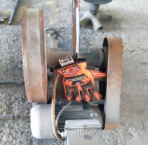
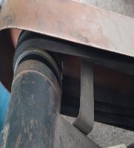

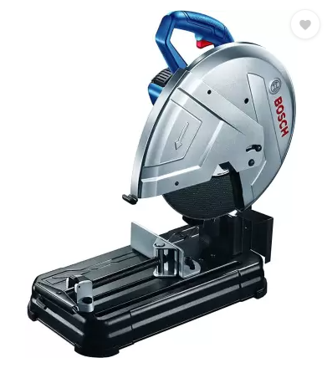
PDO Second Alert
Date: 16/09/2022 Incident title: LTI#3 Pattern: Hands & Finger Potential severity: D3P Activity: cutting pipe
Target Audience: Rig & Hoist( workshop, welder, mechanic, electrician, Roustabout, Floorman)
What happened?
Welder was involved in cutting pipe using a 14" cutting machine. After completing the task he attempted to switch off the machine with out full attention on the switch and accidently his right hand thumb got crush between the drive belt and pulley causing injury to his thumb.
Why it happened/Finding :
Guard for the drive belt is close from 3 side but open in the inner (switch) side as per the OEM design
The position of on/off was in top of machine at a distance of 10 cm from the drive belt guard.
Welder placed his hand in Line of fire(Rotating equipment) while trying to switch off.
There was no pinch point marking at the guard of cutting machine.
Inadequate risk assessment for the cutting machine
If it is repeated, Why is it repeated:
Ineffective learning management/implementation system
Your learning from this incident:
Welder should always ensure to focus and be attentive to the task in hand.
Welder should always ensure to keep hands and fingers away from line of fire or rotating equipment.
Supervisor should always ensure to identify and discuss all pinch points prior to task.
Supervisor should always ensure that the rotating equipment's are guarded from all sides.
Supervisor should always ensure to use cutting machine with dead-man switch in the handle.
Cutting machine with drive belt not guarded from all side
Cutting machine guarded from all side and Use cutting machine with dead-man switch in the handle
Keep hands and fingers away from rotating equipment
Notes:
Ensure all dates and titles are input
A short description should be provided without mentioning names of contractors or individuals. You should include, what happened, to who (by job title) and what injuries this resulted in. Nothing more!
Four to five bullet points highlighting the main findings from the investigation. Remember the target audience is the front line staff so this should be written in simple terms in a way that everyone can understand.
The strap line should be the main point you want to get across
The images should be self explanatory, what went wrong (if you create a reconstruction please ensure you do not put people at risk) and below how it should be done.

Slide 51
Management self audit
Date: 16/09/2022 Incident title: LTI#3 Pattern: Hands & Finger Potential severity: D3P Activity: cutting pipe
As a learning from this incident and ensure continual improvement all contract managers must review their HSE risk management against the questions asked below
Confirm the following:
Do you ensure that risk is not normalized for out of sight activities?
Do you ensure that rotating equipment's are guarded properly from all sides?
Do you ensure that pinch point register is kept up to date and marked with pinch point marking?
Do you ensure that all the hazards are identified and discussed effectively during TBT prior to the task?
Do you ensure that design considered for all equipment during purchase and risk assessed prior to sent to site?
* If the answer is NO to any of the above questions please ensure you take action to correct this finding
Notes:
Ensure all dates and titles are input
Make a list of closed questions (only ‘yes’ or ‘no’ as an answer) to ask others if they have the same issues based on the management or HSE-MS failings or shortfalls identified in the investigation.
Imagine you have to audit other companies to see if they could have the same issues.
These questions should start with: Do you ensure…………………?

Slide 52
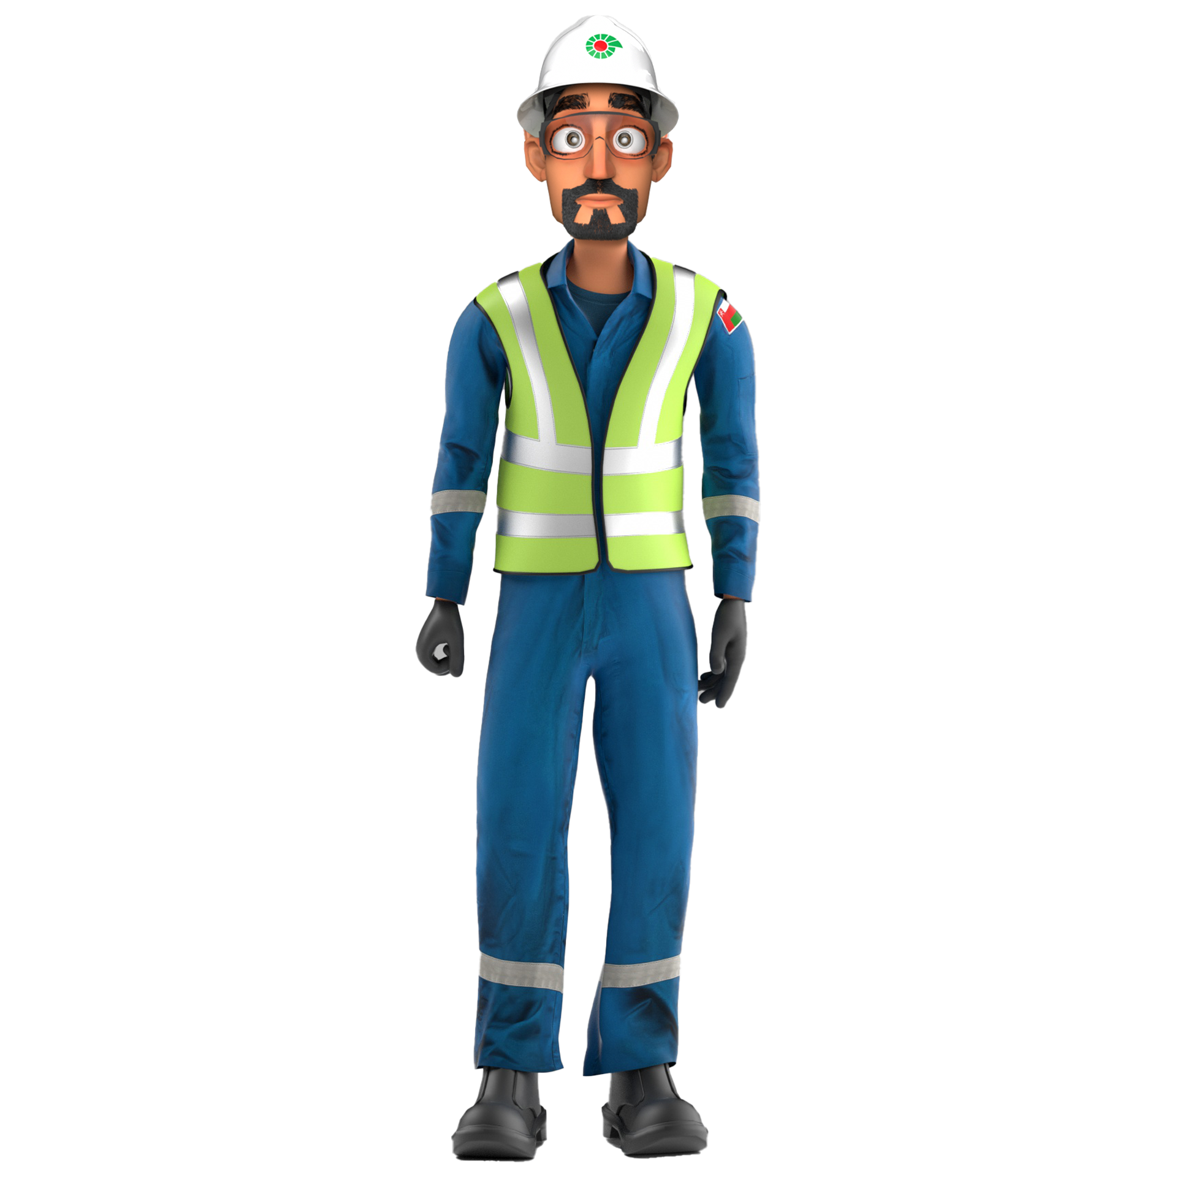
Remember
Safety is everyone responsibility & you are empowered to Intervene

