Slide 1
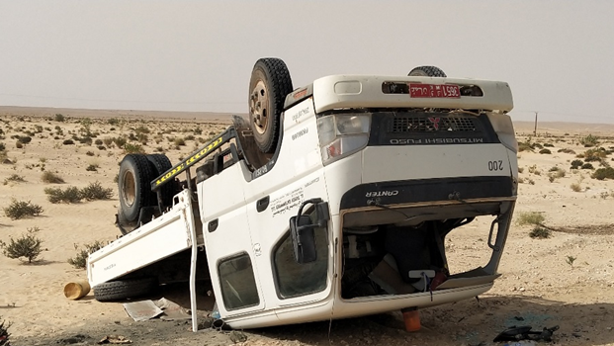
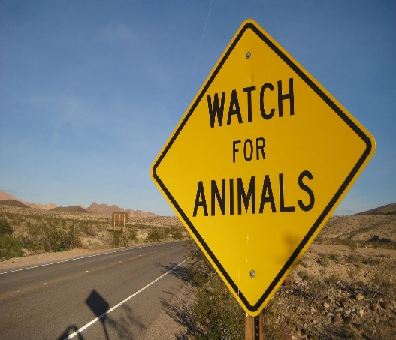
PDO Second Alert
Date: 14.09.2021 Incident Title: HIPO #51
What happened?
A 3 Ton canter while travelling from harweel to Marmul rolled over while controlling the vehicle to avoid camel hit, slight damage to the vehicle, no injury to the driver and the co-passenger got slight injury on his right arm and he was shifted to PDO Marmul clinic there initial medical management done. Incident informed to ROP, RSST and PDO Detail investigation in progress.
Your Learning from this incident..
Always pay attention scan ahead while driving.
Always be updated with surrounding environments.
Always apply defensive driving techniques.
Always pay attention to the traffic warning signs and react accordingly.
Always include all road related hazards in Tool Box Talk with Drivers
Reduce Speed
Always expect an unexpected on Roads; Be vigilant
Notes:
Ensure all dates and titles are input
A short description should be provided without mentioning names of contractors or individuals. You should include, what happened, to who (by job title) and what injuries this resulted in. Nothing more!
Four to five bullet points highlighting the main findings from the investigation. Remember the target audience is the front line staff so this should be written in simple terms in a way that everyone can understand.
The strap line should be the main point you want to get across
The images should be self explanatory, what went wrong (if you create a reconstruction please ensure you do not put people at risk) and below how it should be done.

Slide 2
Management self audit
Date: 14 Sep 21 Incident title: HIPO # 51
As a learning from this incident and ensure continual improvement all contract
managers must review their HSE HEMP against the questions asked below
Confirm the following:
Do you ensure that all your Drivers apply defensive driving technique?
Do you ensure that your Drivers drive as per the Road conditions?
Do you ensure that your Drivers are aware about the road hazards?
Do you ensure that your Drivers have sufficient rest before work?
Do you carry out further IVMS data analysis to identify driver behavior and act accordingly?
* If the answer is NO to any of the above questions please ensure you take action to correct this finding.
Notes:
Ensure all dates and titles are input
Make a list of closed questions (only ‘yes’ or ‘no’ as an answer) to ask others if they have the same issues based on the management or HSE-MS failings or shortfalls identified in the investigation.
Imagine you have to audit other companies to see if they could have the same issues.
These questions should start with: Do you ensure…………………?

