Slide 1
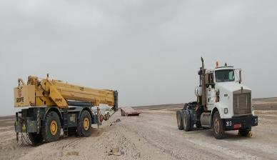
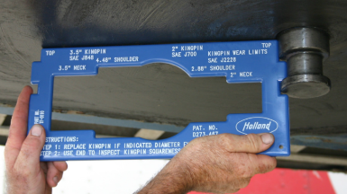
PDO Second Alert
Date: 16/09/2021 Incident title: HiPo#53 Pattern: Released energy Potential severity: B4P
Target Audience: All contractors within PDO concession
What happened?
On the 16th September 2021 at approx. 10:15 an OFSAT prime mover and lowbed trailer were transporting an 80t capacity (rough terrain) crane to the old location of Rig 64 which was located in Burhan. When they were approx. 1 km from the old location, the driver and his passenger (crane operator) felt a sudden jerk, unusual noise and the front of the prime mover raised up slightly. After they had stopped, both occupants exited the vehicle to find that the lowbed trailer had disconnected from the prime mover, had fallen to the ground and the restraining chains holding the crane had snapped which allowed the crane to roll forward and off the trailer onto the side of the road
Your learning from this incident..
Always ensure kingpins are inspected and certified.
Always ensure to reduce speed if the road condition produces excessive vibrations.
Always report poor road conditions or any other hazards.
Always ensure restrain chains are inspected, in good condition and installed properly.
Notes:
Ensure all dates and titles are input
A short description should be provided without mentioning names of contractors or individuals. You should include, what happened, to who (by job title) and what injuries this resulted in. Nothing more!
Four to five bullet points highlighting the main findings from the investigation. Remember the target audience is the front line staff so this should be written in simple terms in a way that everyone can understand.
The strap line should be the main point you want to get across
The images should be self explanatory, what went wrong (if you create a reconstruction please ensure you do not put people at risk) and below how it should be done.

Slide 2
Management self audit
Date:16/09/2021 Incident title: HiPo#53 Pattern: Released energy Potential severity: B4P
As a learning from this incident and ensure continual improvement all contract managers must review their HSE risk management against the questions asked below
Confirm the following:
Do you ensure all of your kingpins are readily inspected (NDT), visually checked and in good condition?
Do you ensure all of your drivers and helpers are competent and fully understand load security?
Do you ensure all of your drivers and journey managers are aware of road hazards reporting process?
Do you ensure all of your load restrain tackles are compliant to SP 2001, serviceable and in good condition?
* If the answer is NO to any of the above questions please ensure you take action to correct this finding
Notes:
Ensure all dates and titles are input
Make a list of closed questions (only ‘yes’ or ‘no’ as an answer) to ask others if they have the same issues based on the management or HSE-MS failings or shortfalls identified in the investigation.
Imagine you have to audit other companies to see if they could have the same issues.
These questions should start with: Do you ensure…………………?

