Slide 1
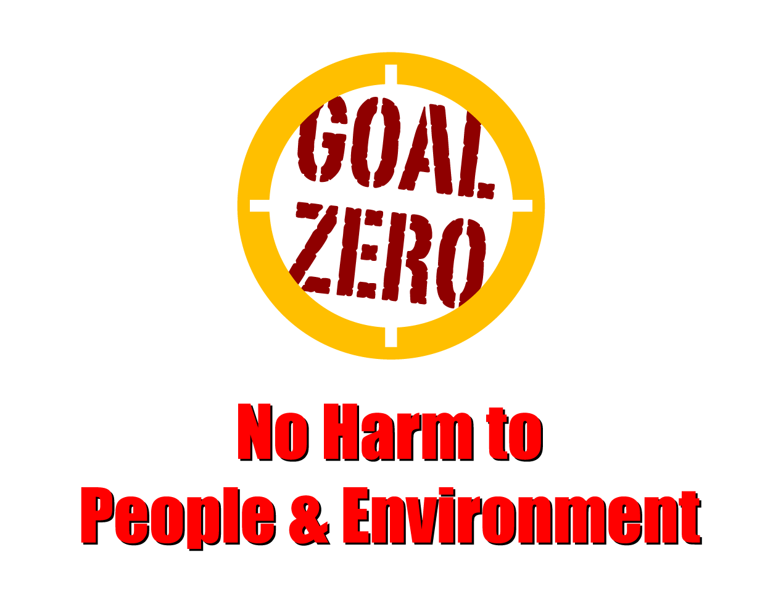
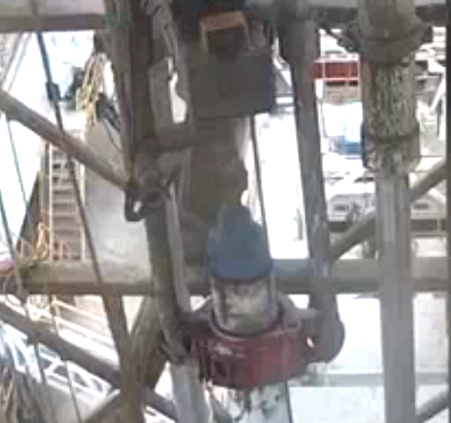
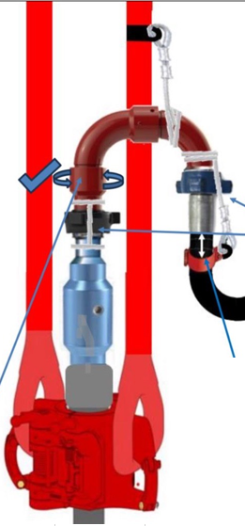
Learning From Incident - First Alert
Prevent
PIM # | 1168420 | Date & Time | 18.07.2024, 12:40 PM | Location | Lekhwair
Incident Type | LTI#10 | Category | Drop object | Activity | RIH 9” 5/8 casing and making up landing joint
Target Audience: Drilling & Operations
What happened:
On July 18th, at approximately 12:40 pm, the operation involved Running in Hole (RIH) a 9 5/8" casing along with the landing joint in preparation for a cementing job. To facilitate smooth landing at the desired depth and to enable circulation, the team decided to set up a circulating head along with the swivel. The swivel assembly stopped against the Top Drive bails, while the hammer union connection continued rotating. Unexpectedly, the swivel assembly disengaged from the hammer union connection dropping approximately 11 meters, striking the power tong body and the Floorman on the right forearm.
The Floorman received immediate medical attention from the Rig Medic X-ray revealed fracture of forearm close to the wrist area.
Initial Findings:
Swivel was not secured with secondary retention while making up the landing joint
The visual inspection of the swivel failed to recognize the potential hazard of the swivel disengaging from the hammer union.
The watch man on the MEWP to check on the swivel functionality left before completing the task.
Team failed to recognize the potential drops of the swivel although it was hammered onto the circulating head prior to PU the L/Joint.
SOP for RIH 9-5/8 casing did not cover the Rig up steps of the circulating head.
Engagement Questions:
How do you ensure to re-evaluate the setup process for circulating assembly methods for 9-5/8 casing in safe manner ?
How do you ensure Procedures are reviewed and Lessons are captured and translated in the SOP and Risk Assessments?
How do you continuously assess all potential dynamic line of fire hazards while working?
How do you ensure Mustae’ed is implemented in effective manner ?
How do you ensure that potential drop hazards are identified and secondary retention are installed ?
Always be aware of potential drop object while making up circulating head and ensure secondary retention in place
In case of an emergency please call PDO Emergency Number (Toll Free): 2467-5555
Notes:
Mr Musleh image on the top right will change according to incident pattern, MSE3 will provide you with the image as per the pattern
What happened: A short description should be provided without mentioning names of contractors or individuals. You should include, what happened, to who (by job title) and what injuries this resulted in. Nothing more!
Initial Finding: Four to five bullet points highlighting the initial main findings from the investigation. Remember the target audience is the front-line staff so this should be written in simple terms in a way that everyone can understand.
Learnings: Four to five learning message in the form of questionnaires linked with initial findings
The strap line should be the main learning point you want to get across
The images should be self explanatory, what went wrong (if you create a reconstruction please ensure you do not put people at risk) and below how it should be done.

Slide 2
Effective Learning
Date: 18-07-2024 PIM Number: 1168420 Pattern: DROPS/LOF Potential severity: C4P
To make sure learning is translated to the site day to day activities , please answer the below questions :-
How learning can be implemented at site ?
Enhance the Usage of Musta’ed Program On daily basis along with thorough reviews
Conduct and review all possible set ups of having temporary Pipe Work at height
How can you sustain the action ?
Verify the integrity of the controls during site visits and engagement
continuously assess all potential dynamic line of fire hazards while working
Disclaimer
This document is provided for information only. It may not be relied upon for any purpose. Neither PDO nor any party providing information for this document accepts any liability for its accuracy, completeness, omissions, advice, or any consequences arising from its use, even if reasonable care was not exercised. No representation or warranty, express or implied, is made that following this document will achieve any specific results or meet any legal or regulatory requirements. This document does not constitute technical advice; consult a qualified professional if such advice is needed
Notes:
Guideline for Effective Learning & Sustainability
•Can be replicated across similar contractor / activities
•Shall be SMART- Specific ,Measurable , Achievable ,Realistic & Timebound
•Can be implemented in a months' time

Slide 3

PDO Second Alert
PIM # | 1168420 | Date & Time | 18.07.2024, 12:40 PM | Location | Lekhwair
Incident Type | LTI#10 | Category | Drop object | Activity | RIH 9” 5/8 casing and making up landing joint
الفئة المستهدفة:
ماذا حدث؟
في 18 يوليو، في حوالي الساعة 12:40 ظهرًا، تضمنت العملية تشغيل غلاف مقاس 9 5/8 بوصة (RIH) مع وصلة الهبوط استعدادًا لمهمة التثبيت. لتسهيل الهبوط السلس على العمق المطلوب ولتمكين أثناء الدوران، قرر الفريق إعداد رأس دوار جنبًا إلى جنب مع المحور الدوار. توقفت المجموعة الدوارة مقابل كفالات المحرك العلوي، بينما استمرت وصلة المطرقة في الدوران بشكل غير متوقع، انفصلت المجموعة الدوارة عن وصلة المطرقة التي هبطت حوالي 11 مترًا. ضرب جسم ملقط الطاقة والرجل الأرضي على الساعد الأيمن.
تلقى Floorman رعاية طبية فورية من Rig Medic وكشفت الأشعة السينية عن كسر في الساعد بالقرب من منطقة المعصم
نتائج التحقيق:
لم يتم تأمين الدوران بالاحتفاظ الثانوي أثناء تكوين وصلة الهبوط
فشل الفحص البصري للمحور الدوار في التعرف على الخطر المحتمل لفصل القطب عن وصلة المطرقة.
فشل الفريق في التعرف على القطرات المحتملة للمحور الدوار على الرغم من أنه تم طرقه على الرأس الدائري قبل
لم يغطي إجراء التشغيل المعياري (SOP) الخاص بغلاف RIH 9-5/8 خطوات تجهيز الرأس الدائرية
الدروس المستفادة من الحادثة:
التأكد من إعادة تقييم عملية الإعداد لطرق التجميع المتداولة للغلاف 9-5/8 بطريقة آمنة.
تأكد من مراجعة الإجراءات واستقاء الدروس وترجمتها في إجراءات التشغيل القياسية وتقييمات المخاطر
التقييم المستمر لجميع الخطوط الديناميكية المحتملة لمخاطر الحريق أثناء العمل
ضمان تنفيذ Muste'ed بطريقة فعالة
تأكد من تحديد مخاطر السقوط المحتملة وتركيب الاحتفاظ الثانوي
كن دائمًا على دراية باحتمالية سقوط الجسم أثناء تشكيل الرأس الدائري وتأكد من الاحتفاظ الثانوي في مكانه
Notes:
Ensure all dates and titles are input
A short description should be provided without mentioning names of contractors or individuals. You should include, what happened, to who (by job title) and what injuries this resulted in. Nothing more!
Four to five bullet points highlighting the main findings from the investigation. Remember the target audience is the front line staff so this should be written in simple terms in a way that everyone can understand.
The strap line should be the main point you want to get across
The images should be self explanatory, what went wrong (if you create a reconstruction please ensure you do not put people at risk) and below how it should be done.

