Slide 1
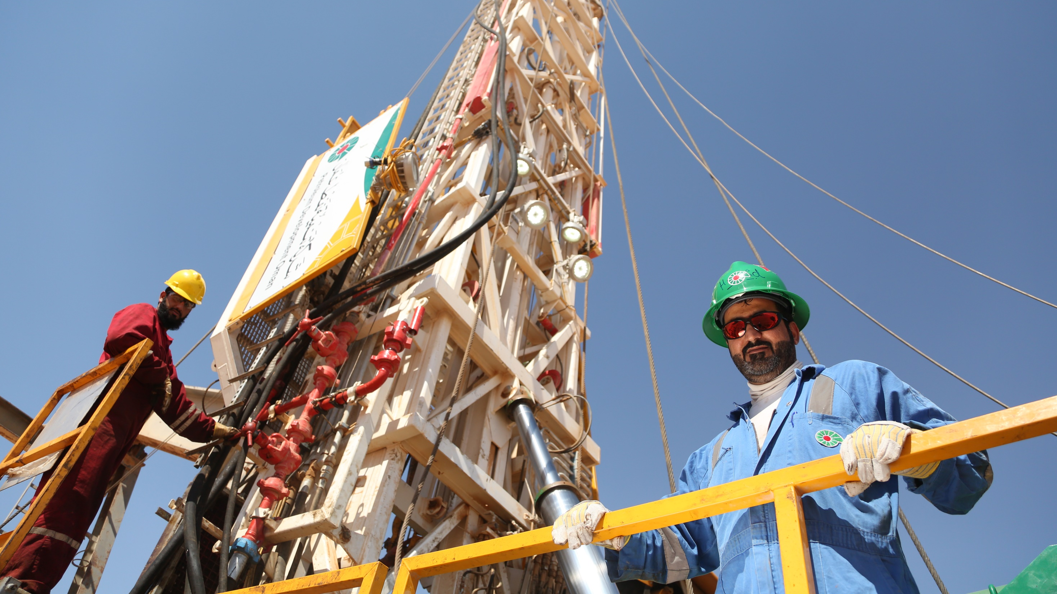
PDO Safety Stand Down
April 2024

Slide 2
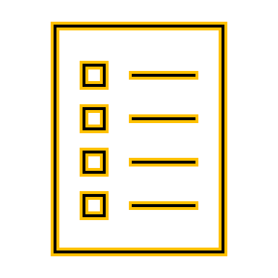
SAFETY STAND DOWN
What is a Safety Stand Down?
A Safety Stand down is a brief work stoppage to proactively discuss safety directly with employees, on risk awareness and how to prevent work related injuries and fatalities.
What is the objective of a Safety Stand Down?
Ensure Learning from incident are effectively communicated
Discuss this incident with your staff and reflect on the achievement and how you could prevent similar causation
Address possible challenges to eliminate incidents
Identify and agree on what people will do differently while learning from incidents

Slide 3
How to prepare for this Safety Stand Down?
Plan your stand-down
Assign supervisors to deliver
Select a time
Select incident link to your business
Use simple terminology
Host your stand-down
Describe the incident
Discuss Pattern
Discuss time of incident
Open discussion on reflective learning question?
What initial finding
What happened
Ask everyone to give his personal views
Encourage engagement
Ask people what they do differently /learning

Slide 4
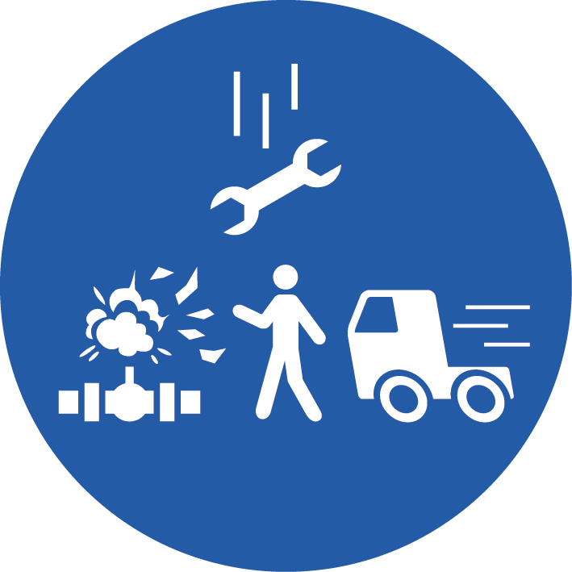
Fatal Incident 31st March 2024
What happened
While one of our Subontractor colleagues was involved in Rig Move activities, specifically, offloading a Diesel Tank to its final position, the Prime Mover involved with the activity suddenly moved, resulting in the Rig Move Helper receiving a fatal injury to his head.
Knowingly or unknowingly – he ended up in the ‘line of fire’.
There are a number of ‘key’ focus areas to consider to avoid a similar incident happening…
Life-Saving Rule #1
Managing
‘Line of Fire’
Managing
‘Work Activities’
Being safe during
‘Ramadan’ & ‘Eid Holidays’
Being safe for
‘Summer’
How do you ensure your Team are aware of the zone(s) within a work area where there is a risk of serious injury from Moving Objects, Vehicles, Pressure releases or Dropped Objects?
How do you ensure Contractors or Subcontractors, new to your location, are aware of these risks?
How do you ensure your Team has access to the correct SOP for the task, is effectively supervised and has adequate time to safely complete their work?
When you have new Contractors or Subcontractors at your location, how do you ensure they are following the safety rules and comply with the right procedures?
For the remainder of the Ramadan period, what are you doing to help people avoid fatigue and how do you plan your tasks to avoid this?
In preparation for the Eid Holidays, are you Teams aware of the potential increase in road hazards and the importance of using company provided transport to avoid private commuting?
Do you have specific plans in place to mitigate the effects of Summer for your teams working in the field?
Do your plans reflect a work schedule to ensure your staff and Contractors have an adequate work/rest schedule to minimise fatigue and avoid unsafe work practices?
If you are using Musta’ed….follow the steps correctly to ensure safe working practices!!

