Slide 1
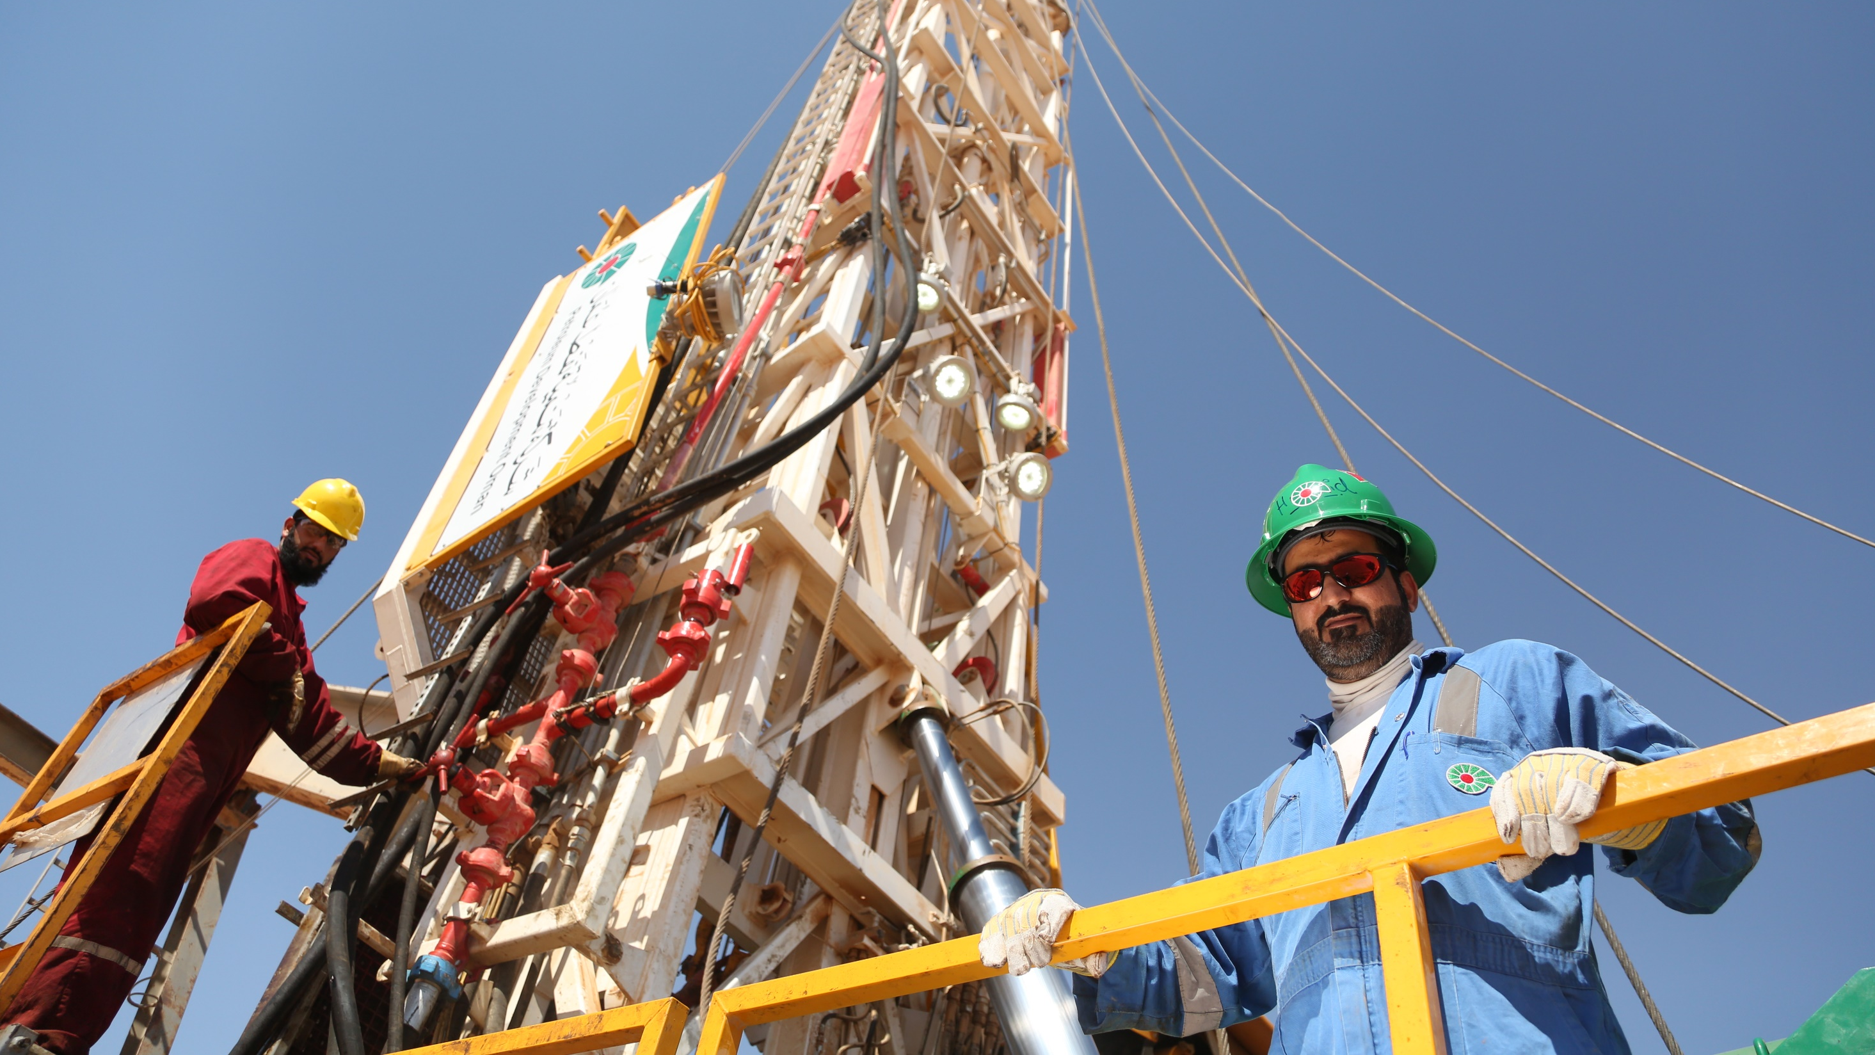
PDO Safety Stand Down
February 2023

Slide 2
PDO 2023 HSE Achievements
PDO has recently achieved a major milestone of 78 days and a total of 30 million manhours LTI free, breaking best record of 70 days and 7 million manhours LTI free in 1999.
40% drop in Driving Life Saving Rule violations in comparison to 2021.
70% of Wells Units are Goal Zero & 83% are LTI free.
29 years LTI Free achieved by CGG Services under Exploration Directorate (XD).
8 years LTI Free achieved by Al Ghalbi for pipeline maintenance contract under Infrastructure Directorate (UID).
10 Millions Manhours LTI Free Arabian Industry Projects Maintenance & Integrity (MIC) Contract South/ STS MIC North/ Al-Baraka Off-plot Delivery Contract (ODC) South (Bahja/Rima)

Slide 3
PDO Safety Stand Down
What is a Safety Stand Down?
A safety stand down is a brief work stoppage to proactively discuss safety directly with employees, on risk awareness and how to prevent work related injuries and fatalities.
What is the objective of a Safety Stand Down?
How to prepare for this Safety Stand Down?
Plan your stand-down
Assign supervisors to deliver
Select a time
Link the incident to your business
Use simple terminology
Ensure Learning from incident are effectively communicated
Discuss this incident with your staff and reflect on the achievement and how you could prevent similar causation
Address possible challenges to eliminate incidents
Agree on the implementation action plan
Host your stand-down
Describe the incident
Discuss previous related incidents
Recognize job hazards & mitigations
Evaluate PPE
Evaluate equipment & tools
Evaluate procedures
Evaluate trainings
Encourage crew engagement
Re-cap the takeaways

Slide 4
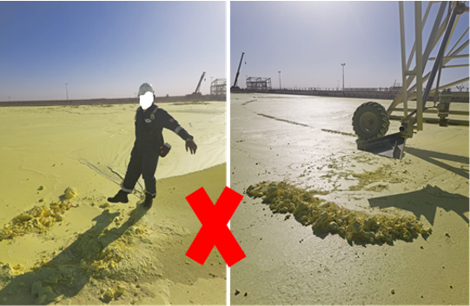
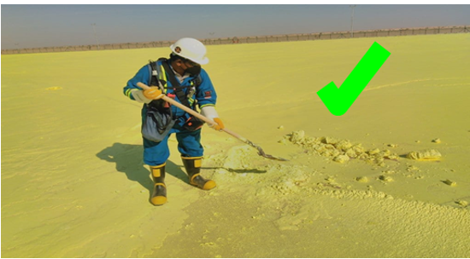
Learning From Incident - First Alert
PIM # | 1150055 | Date & Time | 09.02.2023 15:00 hrs | Direct / Depart | DPM / DOM
Incident Type | LTI#01 | Contractor | Enersul | Activity | Sulphur Pouring
Pattern | Chemical Burn | Location | Yibal Khuff | Learning Audience | All PDO & Contractors
What Happened | Initial Findings | Initial Learnings
While field operator was inside the boundary of Sulphur blocking area to remove the build-up Sulphur using his right foot, he stepped on a thin crust of solid Sulphur which was not completely solidified underneath and his foots exposed to hot liquid Sulphur resulted in burn injuries on both ankles. He was initially treated at PDO Yibal clinic before being referred to Nizwa Hospital where revealed 2nd degree burn in the ankle. | Sulphur was hot and not completely solidified. Field Operator was trying to drag the solid portion of Sulphur using his right foot. Field Operator was using the normal PPE which are not suitable for the liquid /molten Sulphur. Lack of supervision and intervention. Non availability of Safety Signages/Cautions for hazards (Hot Sulphur Hazards/Mandatory PPE). | How do you ensure the work is effectively supervised ? How do you ensure correct PPE is worn? What process do you have in place to ensure the operators are aware of hazard associated with the task ? How do you effectively manage risk associated with Sulphur block access?
PDO’s Golden Rules
Comply with the law, standards & procedures
Intervene on unsafe & non compliant actions
Respect our neighbors
PDO Emergency Number
2467-5555

Slide 5
Learning From Incident – Reflective Learning
Here are some reflective learning questions to use as part of your Safety Stand Down discussion:
What are the health concerns related to chemicals or hazardous materials you are working with at your site?
Are hazardous materials you are working with flammable?
What PPE should be worn while working with toxic chemicals/hazardous materials at your work site?
What should you do if your skin or eyes are exposed to toxic chemicals/materials?
Do you know where the safety data sheet for the hazardous materials or chemicals is kept?
Are safety mitigations for the hazards associated with hazardous materials included in your permit to work/trick card/toolbox talk?

