Slide 1
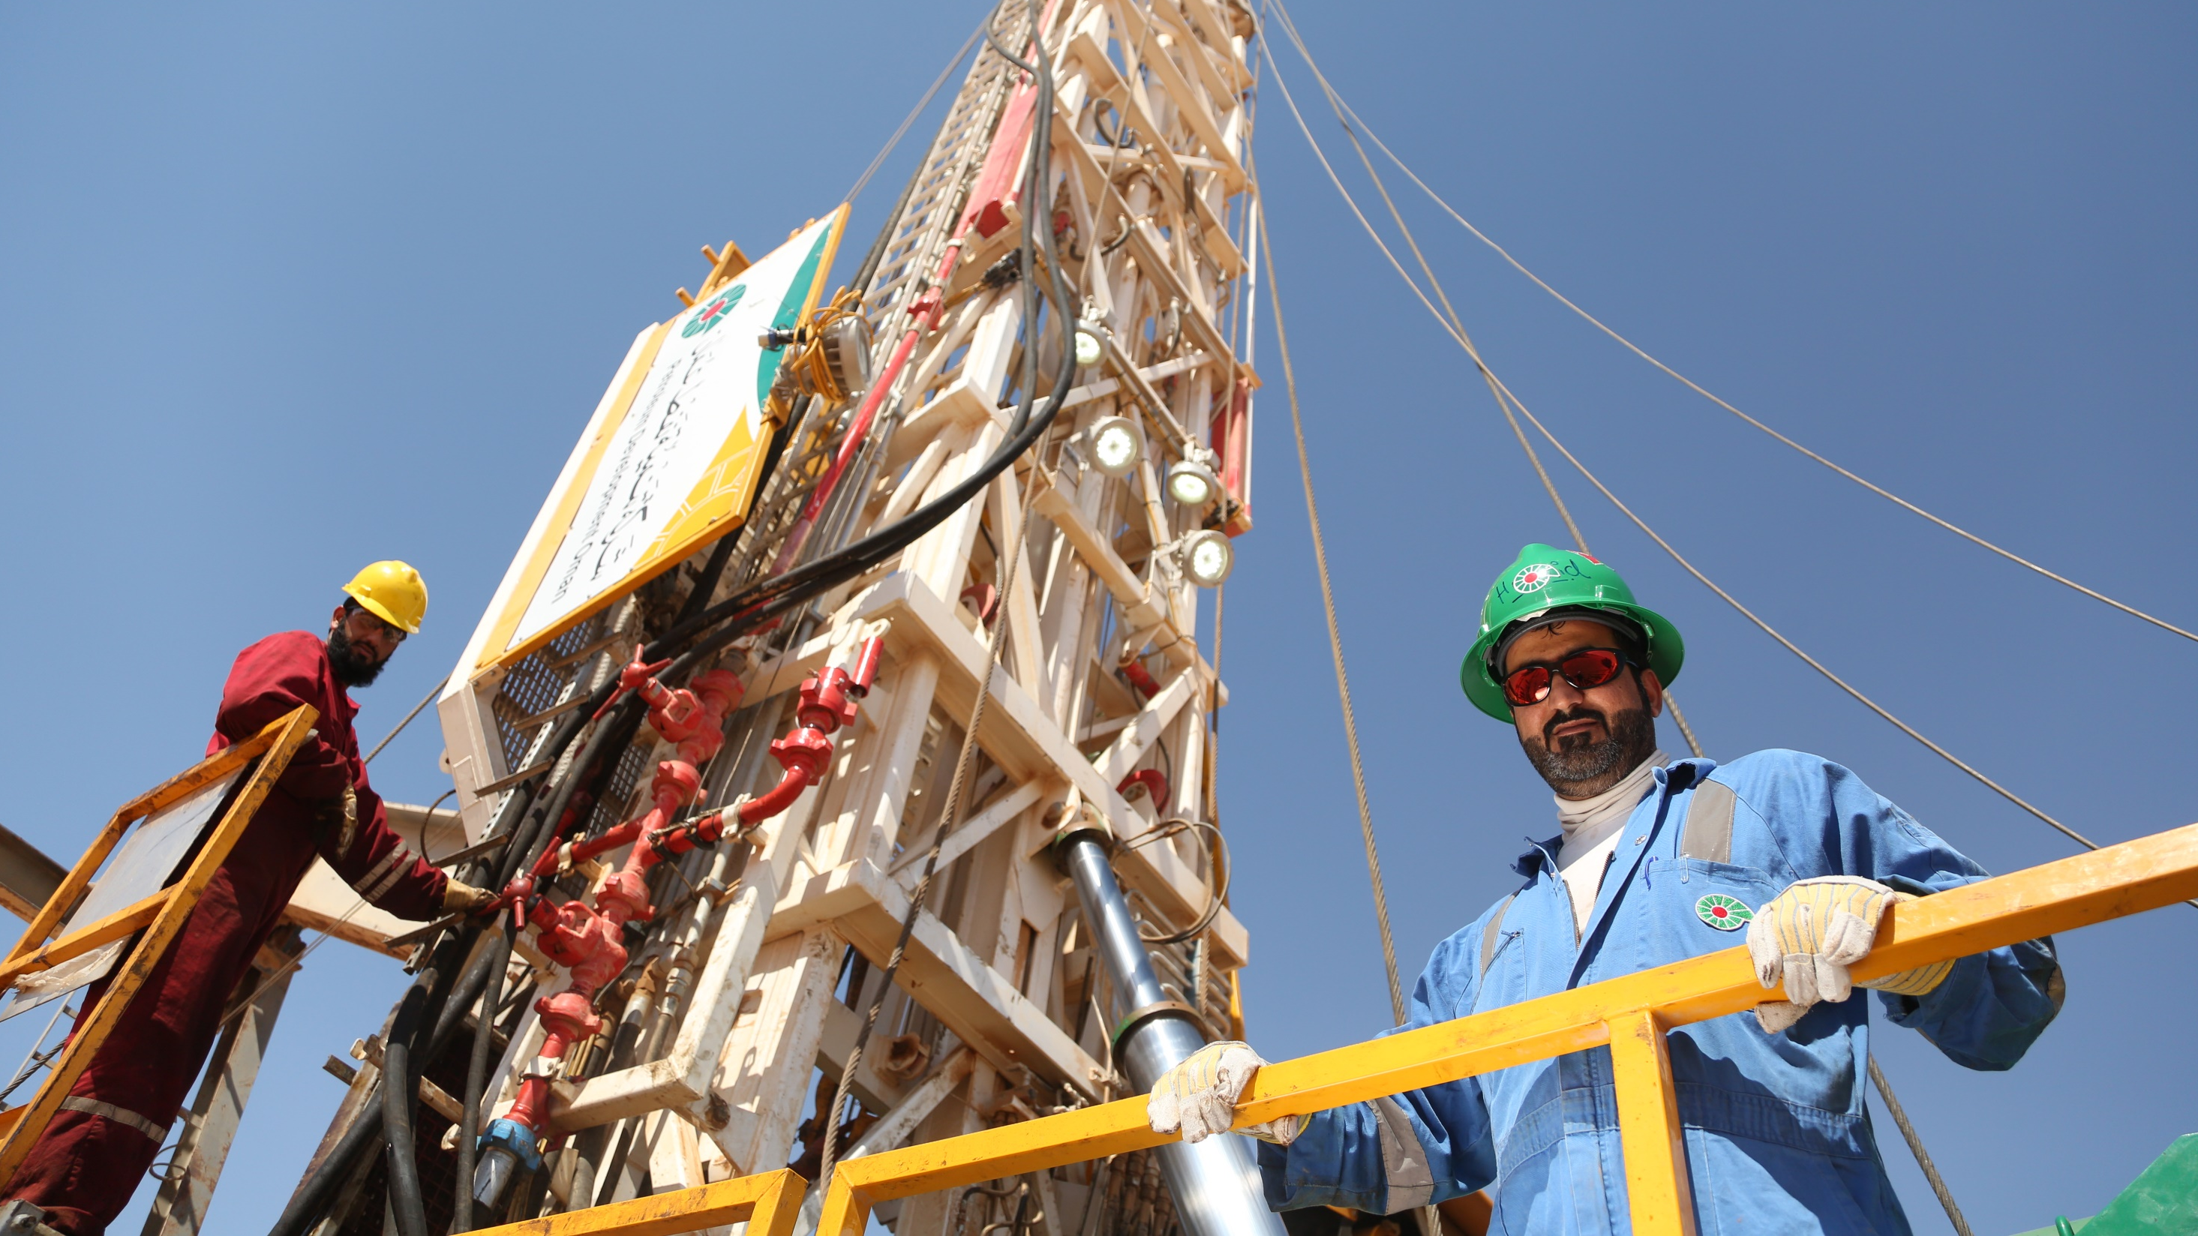
PDO Safety Stand Down
May 2023

Slide 2
SAFETY STAND DOWN
What is a Safety Stand Down?
A Safety Stand down is a brief work stoppage to proactively discuss safety directly with employees, on risk awareness and how to prevent work related injuries and fatalities.
What is the objective of a Safety Stand Down?
Ensure Learning from incident are effectively communicated
Discuss this incident with your staff and reflect on the achievement and how you could prevent similar causation
Address possible challenges to eliminate incidents
Identify and agree on what people will do differently while learning from incidents

Slide 3
How to prepare for this Safety Stand Down?
Plan your stand-down
Assign supervisors to deliver
Select a time
Select incident link to your business
Use simple terminology
Host your stand-down
Describe the incident
Discuss Pattern
Discuss time of incident
Open discussion on reflective learning question?
What initial finding
What happened
Ask everyone to give his personal views
Encourage engagement
Ask people what they do differently /learning

Slide 4
Initial insights from the incidents
Remember Safety day key message “Back to Basics”
A number of these incidents occurred in the afternoon or evening time often on the second half of their shift. Fatigue/ heat often contributes to people making errors or not being observant.
Most of these incidents occurred while conducting routine tasks – it becomes easier to overlook or be ‘blind’ to hazards you are familiar with every day.
Three of the incidents occurred while accessing/egressing the workplace. People’s situational awareness is often less when outside of a more controlled work environment governed by PTW, JSA etc. (out of site locations)
Three of the incidents also identified an element of ‘haste – trying to complete the work quickly’.
Poor or lack of supervision features as an influencing factor on some of these events.
Poor hazard identification is a consistent factor in most of the incidents.

Slide 5
Discussion Questions for your engagement
What signs do you look for to identify worker fatigue and how do you manage heat (summer campaign) at your location?
How can you improve hazard recognition awareness when people are undertaking ‘routine tasks’ such as accessing or egressing the workplace?
What precautions do you currently use when people are working at ‘out of sight’ locations? How can these be improved?
What are the factors, at your location, that may be influencing people working too quickly to complete a task and increasing their chance of injury? What can you do to ensure the work is completed in a timely manner without people being put at unnecessary risk of injury?
FROM YOUR DISCUSSION – WHAT WILL YOU DO DIFFERENTLY TO MINIMISE AN INCIDENT AT YOUR LOCATION?

Slide 6
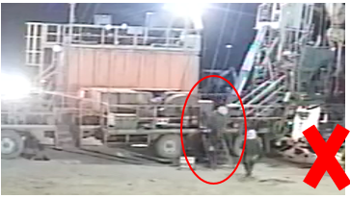
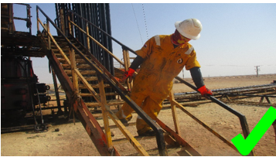
Learning From Incidents – First Alert
PIM # | 1153895 | Date & Time | 09.05.2023 @ 01:30 hrs | Direct / Depart | UWD / UWO
Incident Type | LTI#03 | Contractor | Weatherford | Activity | Descending from Hoist carrier stairs
Pattern | Slip, Trip& Fall | Location | WPH-40, Amal | Learning Audience | All PDO & Contractors
What Happened | Initial Findings | Reflective Question
While the Derrickman was descending from the hoist carrier staircase in a hurried manner, he twisted his foot and landed heavily on the ground resulting in a fractured at his right foot. | Derrickman descending the stairs in a hurried manner. Derrickman missed the last steps while descending. Derrickman descended the stairs without paying attention to where he was stepping. | How do you identify Slip, Trips and fall hazards around your working location? Why is it important to pay attention where you are stepping? How do you ensure safe descending/ascending while using the stairs?
PDO’s Golden Rules
Comply with the law, standards & procedures
Intervene on unsafe & noncompliant actions
Respect our neighbors
PDO Emergency Number
2467-5555

Slide 7
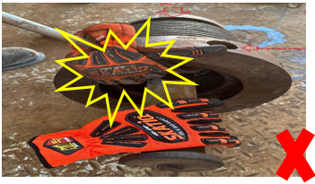
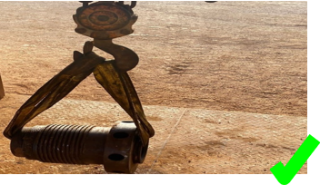
Learning From Incidents – First Alert
PIM # | 1154149 | Date & Time | 14.05.2023 @ 19:00 hrs | Direct / Depart | UWD / UWO
Incident Type | LTI#04 | Contractor | Shaleem | Activity | Changing mud pump liner
Pattern | Hands & Fingers | Location | Rig-81, Nimr | Learning Audience | All PDO & Contractors
What Happened | Initial Findings | Reflective Question
During the activity of changing the mud pump liner and while the Derrickman was attempting to lift the liner cap from the liner, his right-hand index finger got trapped between the cap and the liner resulting in a fracture. | The Standard Operating Practice (SOP) was available but not Followed. Supervisor failed to intervene when the job was not performed as planned. The Pinch Point Hazard was not identified. | Do you follow the SOP steps when performing manual handling activities ? How do you identify all Pinch Point Hazards prior starting the task? Do you intervene during unsafe acts while performing the task? How do you ensure effective supervision while carrying out a task?
PDO’s Golden Rules
Comply with the law, standards & procedures
Intervene on unsafe & noncompliant actions
Respect our neighbors
PDO Emergency Number
2467-5555

Slide 8
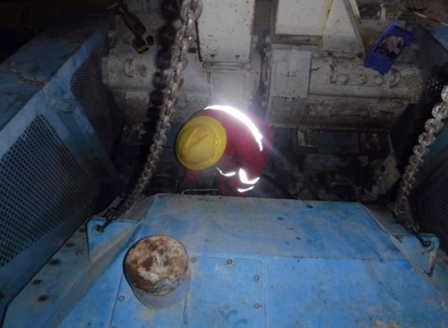
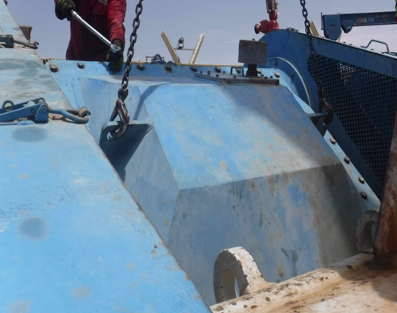
Learning From Incidents – First Alert
PIM # | 1154245 | Date & Time | 17.05.2023 @ 20:00 hrs | Direct / Depart | UWD / UWOX
Incident Type | LTI#05 | Contractor | KCA Deutag | Activity | Unbolting mud pump cover
Pattern | Released Energy | Location | Rig-50, Yibal | Learning Audience | All PDO & Contractors
What Happened | Initial Findings | Reflective Question
While the Mechanic was involved in unbolting the mud pump cover using a crane, the cover slightly moved and hit his left leg causing fracture at his left thigh. | The supervisor himself was carrying out the task without the help of banksman/assistant The JSA was not adequate to identify the line of fire hazard The situation was not reassessed after finding the cover was stuck | How do you ensure line of fire risks are identified prior stating the job? How do you ensure the tasks are being effectively supervised? Do you always ensure banks man is in place prior lifting a load? How do you ensure JSA’s are up to date and identifies risks associated with the job?
PDO’s Golden Rules
Comply with the law, standards & procedures
Intervene on unsafe & noncompliant actions
Respect our neighbors
PDO Emergency Number
2467-5555

Slide 9
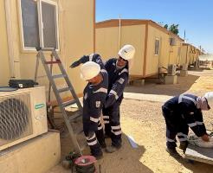
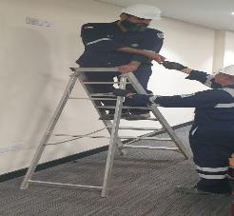
Learning From Incidents – First Alert
PIM # | 1154203 | Date & Time | 16.05.2023 @ 15:30 hrs | Direct / Depart | UID / UIB
Incident Type | LTI#06 | Contractor | Carilion | Activity | Climbing a ladder
Pattern | Hands & Fingers | Location | Accommodation behind room A19- Amal | Learning Audience | All PDO & Contractors
What Happened | Initial Findings | Reflective Question
While the Technician was climbing the ladder to fit a piece of trunking to the Air conditioning system (post repair), he lost his balance and fell landing on his left-hand resulting in a fracture to his left wrist. | Technician was carrying items up the steps and not maintaining 3 points of contact Procedures and training were not followed Alternative access method to work at height was not used | How do you identify hazards related to using stairs at your working location? Why is it important to pay attention where you are stepping? How do you ensure safe descending/ascending while using the stairs? How do you ensure to maintain housekeeping at all time ?
PDO’s Golden Rules
Comply with the law, standards & procedures
Intervene on unsafe & noncompliant actions
Respect our neighbors
PDO Emergency Number
2467-5555

Slide 10
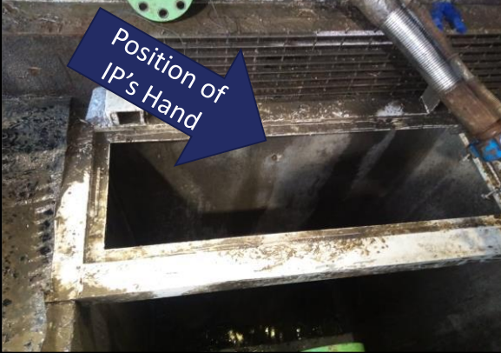
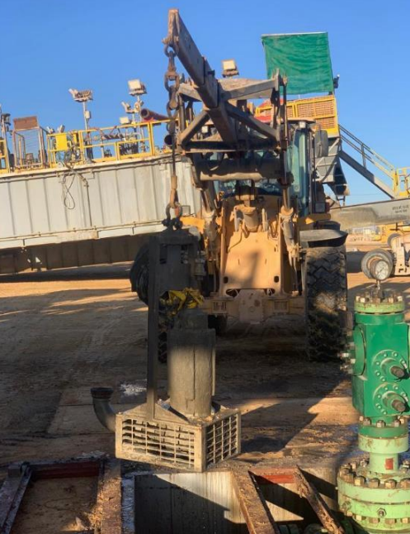
Learning From Incidents – First Alert
PIM # | 1154347 | Date & Time | 21.05.2023 @ 01:10 hrs | Direct / Depart | UWD / UWO
Incident Type | LTI#07 | Contractor | Weatherford | Activity | Lifting cellar pump
Pattern | Hands & Fingers | Location | Rig-150, Nimr | Learning Audience | All PDO & Contractors
What Happened | Initial Findings | Reflective Question
During the preparations for a rig move activity and while a Driller was operating the winch line to lift cellar pump, Floorman’s’ right hand finger got caught between the cellar pump and caller’s grating resulting in a fracture to his right-hand middle finger. | Procedure was not followed properly by the Banksman and the Floorman. The activity was unplanned and risk assessment was not conducted. Floorman put his hand in the line of fire and pinch point area whilst the winch was operated. | Do you ensure Mustaed /TBT engagement is effectively done prior the task ? How do you ensure all crew members are aware of all the pinch points related hazards? Do you always ensure that all activities are planned well before starting the task? Do you ensure to use appropriate tools and equipment for the task?
PDO’s Golden Rules
Comply with the law, standards & procedures
Intervene on unsafe & noncompliant actions
Respect our neighbors
PDO Emergency Number
2467-5555

Slide 11
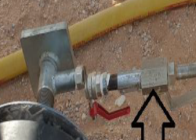
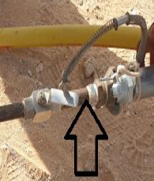
Learning From Incidents – First Alert
PIM # | 1154239 | Date & Time | 17.05.2023 @ 16:00 hrs | Direct / Depart | DPM / DCM
Incident Type | LTI#08 | Contractor | SAS | Activity | Air pressure testing
Pattern | Released Energy | Location | New Dhulaima LPS Pipeline, Lekhwair | Learning Audience | All PDO & Contractors
What Happened | Initial Findings | Reflective Question
During the air pressure testing of 16” HDPE liner for a line section and while the PTW holder and Helper were attempting to carry out pressure verification check on the gauge attached to the manifold, the ball valve attached to the gauge suddenly failed and caused the manifold to detach and hit the Helpers’ left leg resulting in a fracture | The whip lock arrestor between the test plug and manifold section was missing. No support was provided for the manifold section during the air filling time. Anchoring wasn’t done for the manifold section to prevent whipping in case of valve failure. MTC or rating certificate were not available for the ball valve and the test plug. | Do you ensure you aware of all pressure release hazards before starting the task? How do you ensure using the correct rated tools, materials and fittings for the activity? Do you ensure to follow the correct procedure before starting the task? How do you ensure you intervene in case of unsafe condition?
PDO’s Golden Rules
Comply with the law, standards & procedures
Intervene on unsafe & noncompliant actions
Respect our neighbors
PDO Emergency Number
2467-5555

Slide 12
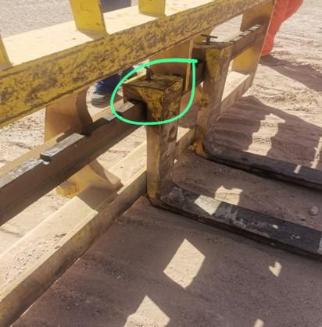
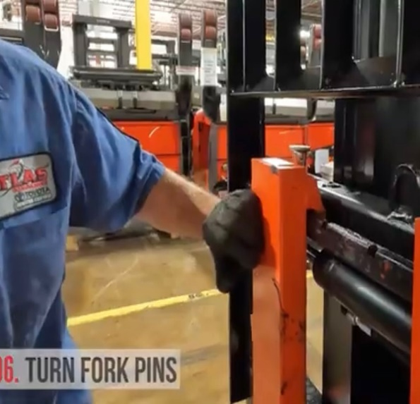
Learning From Incidents – First Alert
PIM # | 1154426 | Date & Time | 22.05.2023 @ 11:00 hrs | Direct / Depart | UWD / UWO
Incident Type | LTI#09 | Contractor | Midwesco | Activity | Adjusting the forks of the forklift
Pattern | Hands & Fingers | Location | WPH-12, Qarn Alam | Learning Audience | All PDO & Contractors
What Happened | Initial Findings | Reflective Question
While the Roustabout was attempting to adjust the forks of the forklift , his left-hand finger got crushed between the fork and its holder resulting in a fracture at his left-hand index finger. | Forklift was called from nearby hoist to carry some housekeeping work. Forklift was equipped with Forks instead of a Bucket that is more suitable for such work Forklift was not able to collect the torn chemical bags with the Forks | Do you ensure Mustaed engagement is effectively done prior the task ? How do you ensure all crew members are aware of all the pinch points related hazards? Do you always ensure that all activities are planned well before starting the task? Do you ensure to use appropriate tools and equipment for the task?
PDO’s Golden Rules
Comply with the law, standards & procedures
Intervene on unsafe & noncompliant actions
Respect our neighbors
PDO Emergency Number
2467-5555

