Slide 1
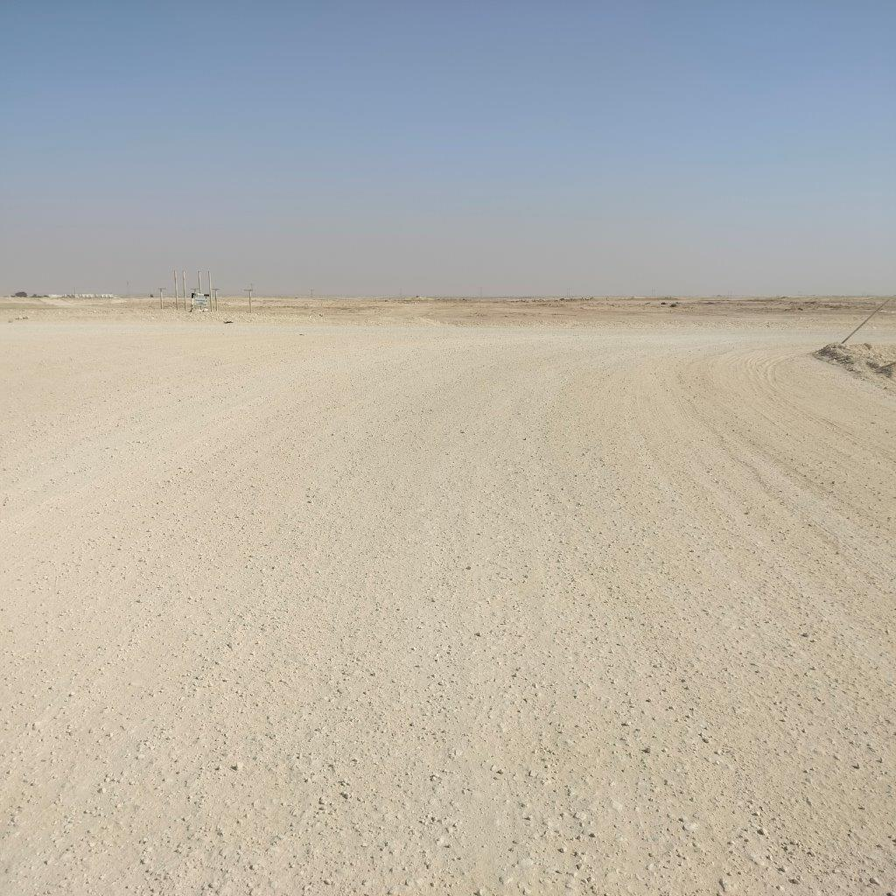

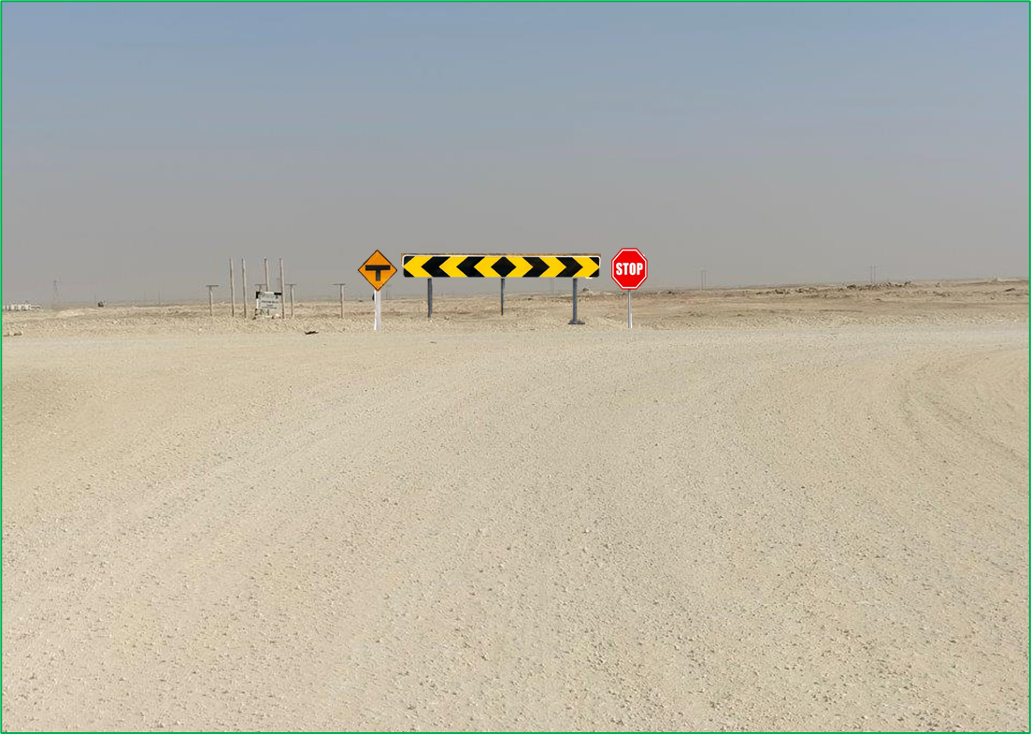

PDO Second Alert
Date: Time: | 16/01/2025 15:30 | Incident title: PIM# | LTI#01 1174063 | Risk Category: Injury / Asset Damaged: | MVI Collision Vehicle damage | Actual Severity: Potential severity: | 2P D4P | Activity: Location: | Driving Runib
Target Audience: Drilling, Logistics, Operation & Construction
What happened?
At 2:45 PM, Rig Driver was transporting two passengers from the Rig Camp to the Rig site using the crew bus. On the way to the Rig site, at 3:00 PM, the Driver received instructions to collect a parcel for the Rig from a nearby location on Blacktop Road. After picking up the parcel, the Driver was driving on a graded road and was supposed to make a right turn at a T-junction.
However, at 3:15 PM, as the Driver approached the T-junction, he went straight across the road instead of turning right, driving at a speed of 70 km/h. This caused a sudden jerking movement in the bus. Although the Driver was able to stop the bus safely, he reported back pain. He was subsequently taken to Haima Hospital, accompanied by the Rig Medic.
The medical assessment confirmed he had suffered an injury to one of the vertebral bones. Both passengers reported no injuries and all vehicle occupants were wearing their seatbelts.
Why it happened/Finding:
The graded road conditions were good; however, no sign was posted at the T-junction to alert drivers.
The Road Sign polls (no warning signs attached) had no impact on the Driver’s understanding there was a junction ahead.
Driver was unaware that he was at the T-junction due to lack of concentration/focus, potentially fatigued.
Driver Fatigue Management System (DFMS) was not installed to indicate if there was evidence of Drivers Fatigue.
Your learning from this incident:
On graded, less used, roads, don’t expect all junctions to have road markings.
Always control your vehicle speed limit when driving on graded roads in case you meet the unexpected.
Before embarking on your journey, ensure T-junctions are identified clearly on your Journey Plan.
The DFMS system is there to keep drivers safe from fatigue – ensure it is clear and uncovered at all times.
JUNCTION
Rig Direction
Bus drove through
T-junction
WHEN AT A
T-JUNCTION!
Always stay attentive while Driving and STOP at the T-Junction.
Notes:
Ensure all dates and titles are input
A short description should be provided without mentioning names of contractors or individuals. You should include, what happened, to who (by job title) and what injuries this resulted in. Nothing more!
Four to five bullet points highlighting the main findings from the investigation. Remember the target audience is the front line staff so this should be written in simple terms in a way that everyone can understand.
The strap line should be the main point you want to get across
The images should be self explanatory, what went wrong (if you create a reconstruction please ensure you do not put people at risk) and below how it should be done.

Slide 2
Effective Learning
Date: Time: | 16/01/2025 15:30 | Incident title: PIM# | LTI#01 1174063 | Risk Category: Injury / Asset Damaged: | MVI Collision Vehicle damage | Actual Severity: Potential severity: | 2P D4P | Activity: Location: | Driving Runib
To make sure learning is translated to the site day to day activities , please answer the below questions :-
How learning can be implemented at site ?
Ensure that Driver Fatigue management system (DFMS) is in installed in all vehicles.
During road surveys, check for any missing signboards.
Implement control measures to enhance drivers' awareness and ensure they remain alert and focused while driving, especially around T-junctions.
How can you sustain the action ?
Implement a Driver Evaluation program effectively.
Actions learned from the incident shall be incorporated into the Management self-verification program.
Emphasis the importance of driver behaviour around T-junctions.
Notes:
Guideline for Effective Learning & Sustainability
•Can be replicated across similar contractor / activities
•Shall be SMART- Specific ,Measurable , Achievable ,Realistic & Timebound
•Can be implemented in a months' time

