Slide 1
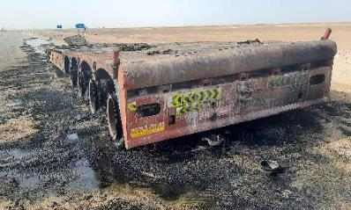



PDO Second Alert
Date: June 22, May 23 & June 23 Incident title: HiPo#41(2022)/#22/#26 Pattern: Fire (AD) Potential severity: B4A Activity: Driving
Target Audience: Drilling, Logistics, Operation & Construction
What happened?
In the last year 3 very similar incidents have occurred whilst vehicles were travelling on the road. In 2022 a heavy goods vehicle suffered a fire to the rear-front trailer axle (right side), in May 2023 a crane travelling to Fahud suffered a fire originating in the engine compartment and in June 2023 a lowbed trailer carrying a crane caught fire to the passenger side rear wheels.
In all 3 of these occasions the fire could not be extinguished by the drivers using the on-board fire extinguishers. NO injuries were sustained, however the fire caused extensive damage to the equipment.
Why it happened/Finding :
HiPo#41 (2022) – result of poor brake maintenance
HiPo#22 (2023) – due to extent of damage, investigation did not identify the immediate cause
HiPo#26 (2023) – the most likely cause was as a result of tyre damage and friction causing the tyres to ignite
Your learning from this incident..
Always ensure vehicles are maintained in accordance with manufacturers recommendations
Always ensure tyres pressures and conditions are checked regularly including vehicle stops
Always ensure you attempt to extinguish the fire when it is safe to do so
Always ensure you contact PDO emergency team in case of fire
Fire Prevention is better than Fire Reaction
Notes:
Ensure all dates and titles are input
A short description should be provided without mentioning names of contractors or individuals. You should include, what happened, to who (by job title) and what injuries this resulted in. Nothing more!
Four to five bullet points highlighting the main findings from the investigation. Remember the target audience is the front line staff so this should be written in simple terms in a way that everyone can understand.
The strap line should be the main point you want to get across
The images should be self explanatory, what went wrong (if you create a reconstruction please ensure you do not put people at risk) and below how it should be done.

Slide 2
Management self audit
Date: June 22, May 23 & June 23 Incident title: HiPo#41(2022)/#22/#26 Pattern: Fire (AD) Potential severity: B4A Activity: Driving
As a learning from this incident and ensure continual improvement all contract managers must review their HSE risk management against the questions asked below
Confirm the following:
Do you ensure maintenance is conducted in line with manufacturers recommendations as a minimal?
Do you ensure drivers check tyres correctly during stops (load security checks and rest stops) including between twin wheels?
Do you ensure your workers are aware of basic fire response?
Do you ensure your workers are aware of the PDO emergency number and when to contact them?
Do you ensure you carry out emergency drill as per the plan?
* If the answer is NO to any of the above questions please ensure you take action to correct this finding
Notes:
Ensure all dates and titles are input
Make a list of closed questions (only ‘yes’ or ‘no’ as an answer) to ask others if they have the same issues based on the management or HSE-MS failings or shortfalls identified in the investigation.
Imagine you have to audit other companies to see if they could have the same issues.
These questions should start with: Do you ensure…………………?

