Slide 1
Notes for the facilitators
Introduction
The focus for the process safety day 2017 is on employees and (sub) contractors coming together in teams to engage personally with each other. As a team leader, line manager or supervisor your role is to bring your team together and help them have this conversation. The next step in our journey to goal zero is behavioural and the answer lies in knowing how to deal with dilemmas and in addressing risk normalisation (which are the themes for 2017)
Tips
Try to reserve at least 90 minutes for a session to get the most out of your conversation.
Book your room and calendars of relevant personnel early, so all your team members can participate.
Don’t organise big town hall sessions. If you have a large team divide them into smaller groups of maximum 30 participants.
Refer to the facilitator notes with each of the slides to gain more insights
Remember to ask open questions – who, what, why, where, which to encourage conversation
PDO staff can directly play the videos from the PDO tube links in the presentation slides but it is highly recommended to keep a back up of the videos by downloading from the livelink or copy paste from S:\!!Process Safety Day. The downloaded videos are in .mp4 format and shall be played using windows media player (double click on this image to know how)
You might ask the group if they wish to watch the video again
You will face disagreements but do not try to resolve them during the session. Acknowledge the disagreement and arrange to discuss the issue separately.
Do not forget to take some photographs of your session and upload on the webpage.
For the group activity if time is constrained you could just ask any two teams to report back on Risk Normalisation and the other two teams on Dilemmas. See how the session is progressing and you can decide on the best fit.
At the end of the session remind participants that they need to mark their attendance and decide on who will upload the team commitment

Slide 2


PROCESS SAFETY DAY 2017
Dealing with Risk Normalisation & Dilemmas
Team Leader or Supervisor Led Reflective Learning Session
Notes:
Facilitator notes:
Download the Process Safety Day 2017 videos from the link in first slide beforehand and keep them as a back up. This is just in case if PDO tube has some network issues
Note: Make sure there are max. 30 participants & you have at least 90 min available for this activity!

Slide 3
AGENDA
Welcome and Safety Brief 10 minutes
General Talk on Process Safety 10 minutes
Risk Normalisation –MD Video 10 minutes
Discussion Break and Feedback 20 minutes
Dilemmas – TD Video 10 minutes
Discussion Break and Feedback 20 minutes
Personal Commitments and Further Actions 10 minutes
90 minutes

Slide 4
SAFETY FIRST
FOR THIS MEETING, PLEASE REVIEW
THE FOLLOWING FOR YOUR LOCATION
First and Secondary Emergency Exits
Emergency Contact Numbers
Assembly Point
Fire Drills Scheduled
Alarm Sirens/Bell
First Aid Kits and First Aid Number (do we have a first aider in the room?)
Location of Toilets
Location of Coffee and Tea
Notes:
Facilitator notes:
Remember to start your session with focus on safety and wellbeing of those in the room.
Agree some ground rules for the conversation at the start of the meeting and ensure at least one of them refers to how people will be treated e.g. with respect, everyone allowed their say, Keep an open mind, all contributions are valid etc.

Slide 5
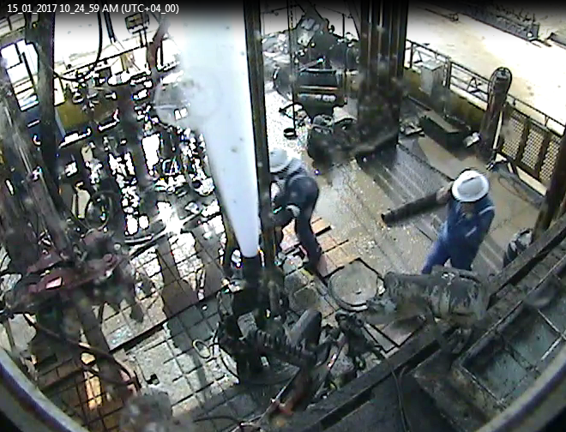
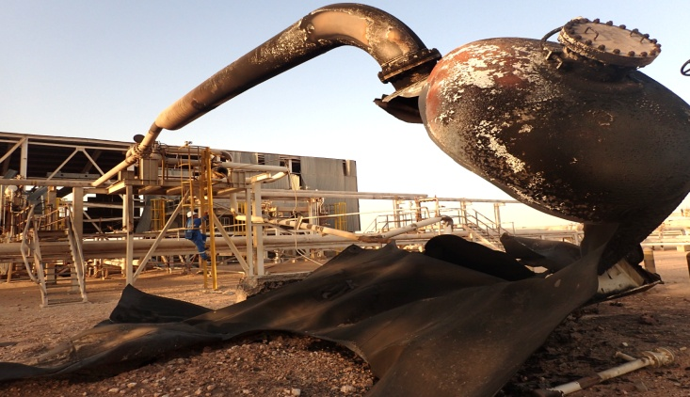
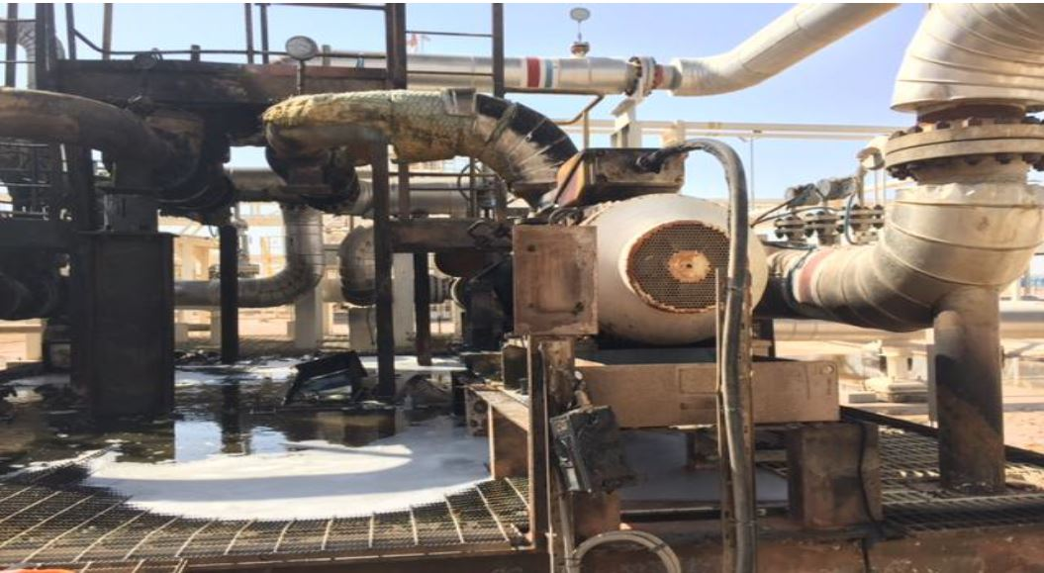
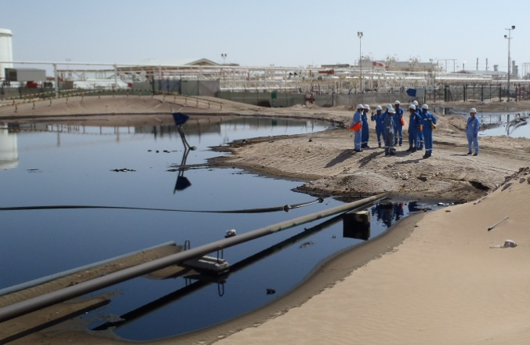
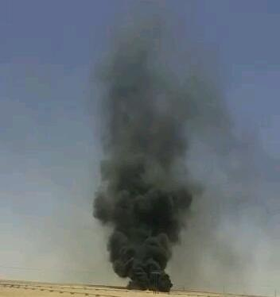
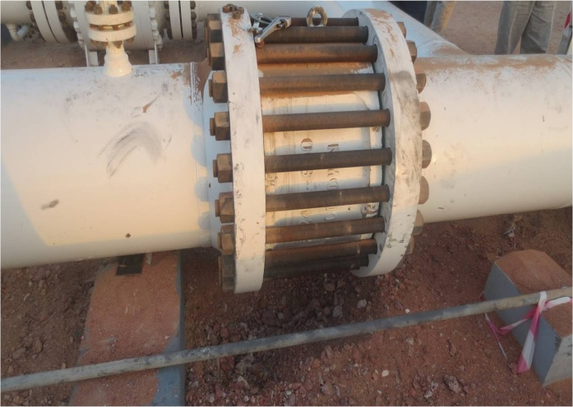
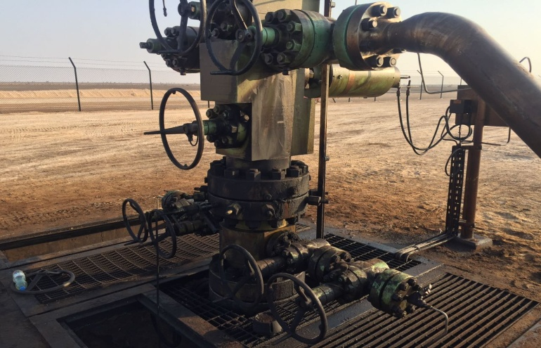
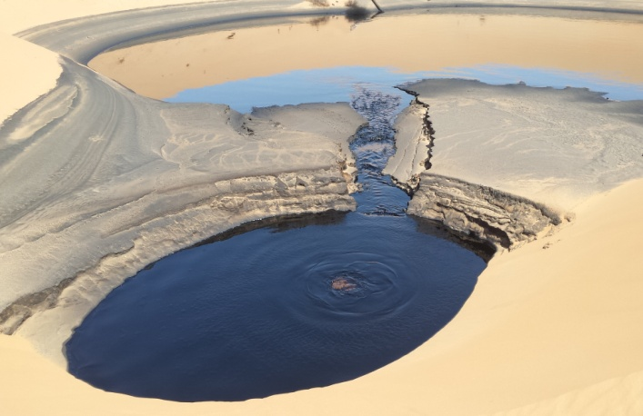
PROCESS SAFETY INCIDENTS ARE STILL HAPPENING
Bahja Explosion and Fire (8 Dec 2016)
Natih Kick Rig 8 (15 Jan 2017)
Al Noor Pump Fire (10 Dec 2016)
RECURRING ISSUES
Risk assessment not appropriate
Procedures not followed
Design & construction-related failures
Management of change
Corrosion-related failures
Erosion of barriers overtime
Competency -related issues
MOL Corrosion Coupon Incident & Spill (25 Feb 2016)
Sadad LLRTP Fire and MTC (5 Jun 2016)
MOL Corrosion Coupon Incident & Spill (25 Feb 2016)
Barik South Manifold Condensate leak (21 Dec 2015)
Lekhwair C Test Header leak (1 Oct 2015)
Kauthar - Heat exchanger gas leak (24 Oct 2015)
GGP Wafer Type NRV Leak (25 May 2017)
SN 77 Gasket Leak 25 Oct 2016
Notes:
Facilitator notes:
Process Safety incidents have a number of reoccurring issues
Poor Risk Assessment
Inadequate procedures
Erosion of barriers overtime
Management of Change
It will be good to read a brief description of some of these incidents by referring to the AI-PS incident Data Book (http://portal.corp.pdo.om/solutions/LKB/MSE/AIPSM/Pages/HomePage.aspx). Use the search function with key words to find the incident in the databbook. (eg. Bahja Explosion, Al Noor Pump Fire etc.). Talk briefly about 2-3 incidents which are closer to your operations
Address the importance of Process Safety. Asset Integrity-Process Safety Management (AI-PSM) is crucial for achieving the Company’s strategic goal “Our Assets Are Safe and We Know It” and to prevent any tragic incidents.
We work in an industry that involves operation of processes that contain flammable materials at high temperatures and pressures. When something goes wrong, it can go very wrong. Fortunately, we can work with these materials safely. We do this by following the AI-PS requirements and maintaining our barriers.

Slide 6
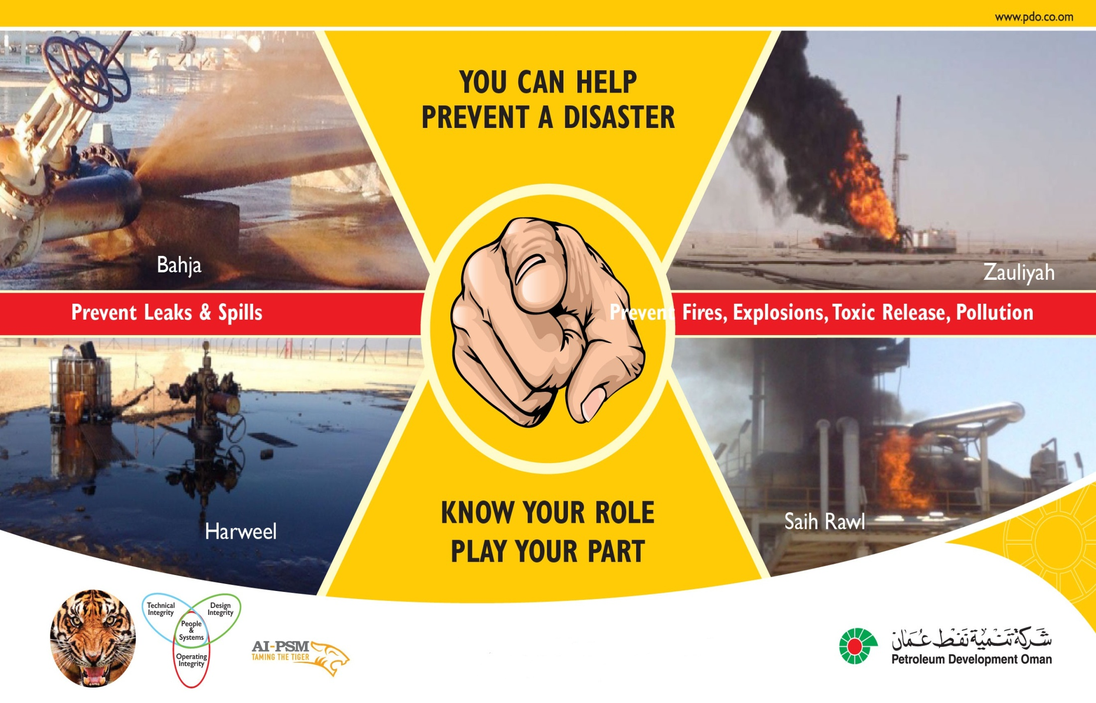
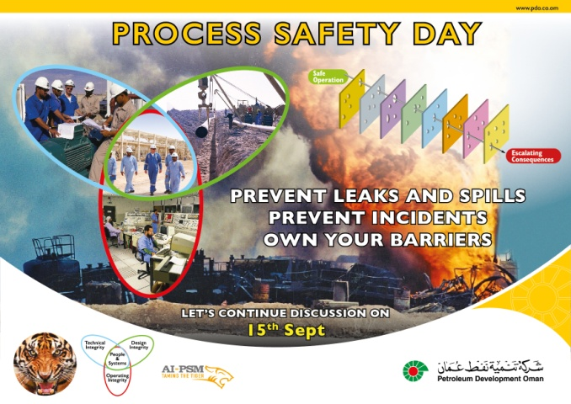
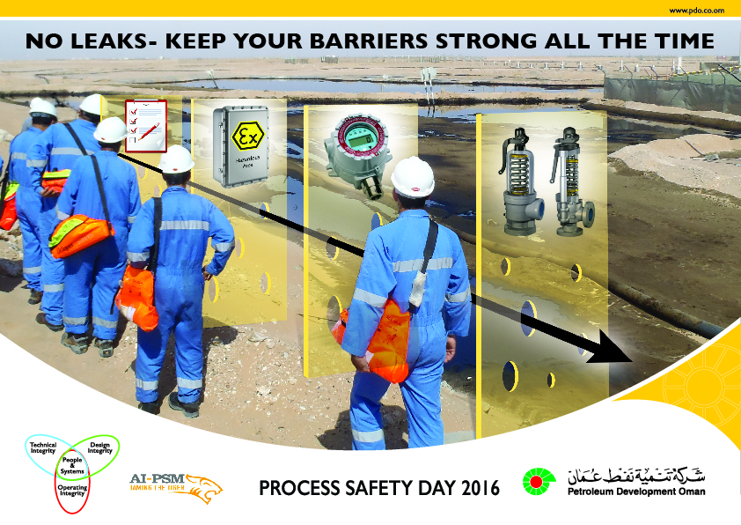
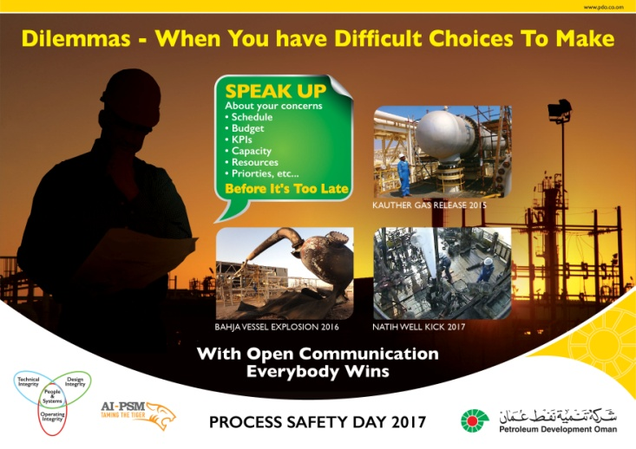
PROCESS SAFETY DAY JOURNEY
2014 Theme: Know Your Role, Play Your Part
2015 Theme: I Own My Barriers
2016 Theme: I Keep My Barriers Strong
2017 Theme: Dealing with Risk Normalisation & Dilemmas
Notes:
Facilitator notes:
This slide is intended to show the progression of the Process Safety Day
This will be the fourth year that we have brought everyone together to build on everything we have achieved so far and find even better ways to sustain and improve our AI-PSM performance in order to avoid incidents.
In the last process safety days we have been focusing more on the technical side (barriers) as evidenced by the last 3 years themes
2014 Theme: Know Your Role, Play Your Part ;
2015 Theme: I Own My Barriers ;
2016 Theme: I Keep My Barriers Strong
Hardware issues are easier to fix and we have made great progress in resolving hardware related issues. This year we are focusing more on the Human issues for Asset Integrity Process Safety management
The next step in our journey towards goal zero is behavioral. We cannot engineer our way to goal zero but have to behave our way to goal zero
Part of the the answer lies in in addressing risk normalisation and knowing how to deal with dilemmas (which are the themes for 2017).

Slide 7
MDs MESSAGE ON RISK NORMALISATION
  Internal PDO users Click Here
  External users (Contractor Staff) * Click Here
  *For external users (contractor staff ) it is recommended to download the videos before hand from the process safety day webpage & use windows media player to play them (double click on this image to know how)
Notes:
Facilitator notes:
Ask the group if they have fully understood the MDs message. You might ask the group if they wish to watch the video again.
Please reinforce that this issue is close to the heart of the top management of the company and they wanted to be personally involved and share their thoughts with everyone.
Although they might appear to be far away from what happens in your team day to day, this video demonstrates that they believe in the safety of everyone in the organization.
In the video the MD shares the inevitability and dangers of normalising risks

Slide 8
RISK NORMALISATION – WHAT DOES IT MEAN?
Risk normalisation: The gradual process through which risky/dangerous practice or conditions become acceptable over time. For example:
Routinely drive close to the vehicle in front
Using knives for various tasks where something else may be more appropriate
Risk normalisation in a hazardous environment is very dangerous. For example:
A hydrocarbon drips that you see every day
Critical integrity related tasks are not performed because nothing happens
Accepting passing valves or defective instruments
Process safety safeguards are routinely bypassed without authorisation
High equipment/piping vibrations
Operations with continuous alarms
Using same paperwork of a previous job to complete formalities of Permit to Work.
etc……
Notes:
Facilitator notes:
There are illustrative examples only but use them to help you think of your own examples, ones which your team will most relate to. Facilitating the conversation will be easier for you and more impactful for the team when you use local examples.
Share any relevant personal examples or stories that you have. Generally audience listen more intently to messages with a personal angle.
Take time before Process Safety Day to talk to some people about their work and the risks. Observe routine activities to look for examples & talk to people about risks that are normalised and where they face dilemmas.
Try to avoid generalisation. If people don’t recognise something they can relate to, they are more likely to ‘switch off’. The more specific it is to their type of work, location and situation, the more likely they are to understand
what the themes mean and be able to personalise them.
You could use something like this
Risk Normalisation is a mental process which allows you to turn on your gas appliance or drive your car without a paralysing fear of your house blowing up or of being in an accident. It is not necessarily a bad
thing. It is what allows us to get out of bed each morning and carry on with our day.
But Risk Normalisation becomes a problem at work when we become so accustomed to, and comfortable with, risks that we shouldn’t be comfortable with,

Slide 9
DISCUSSION BREAK 1
Split people into four groups and discuss the question(s) on the slide. 10 minutes to discuss and 10 minutes to report back to the entire team
What risks have you NORMALISED? Can you think of such examples, whether at work or at home?
Would you allow someone you love dearly to take the same risk you routinely take?
What clues are there that you are unable to see hazards in front of you? How can we see with fresh eyes again?
If you see risk normalisation by others, would you intervene? What reaction do you expect ?
WHAT WILL YOU NOW DO DIFFERENTLY TO TACKLE RISK NORMALISATION? - COME UP WITH TWO POINTS AS A TEAM
Notes:
Facilitator notes:
Remember to keep an eye on time so you can guide the conversation to adequately cover both the themes.
To save time here you could just ask any two teams to report back. This would depend on how the engagement is progressing.
This could also be an opportunity to ask a few people to specifically bring along some examples with them to share in the conversation. Talk to them beforehand about the themes so they understand what
you are looking for. Once one person has spoken, it is usually enough to make others feel more relaxed and prepared to speak as well.

Slide 10
TDs MESSAGE ON DEALING WITH DILEMMAS
  Internal PDO users Click Here
  External users (Contractor Staff)* Click Here
  *For external users (contractor staff ) it is recommended to download the videos before hand from the process safety day webpage & use windows media player to play them (double click on this image to know how)
Notes:
Facilitator notes:
Ask the group if they have fully understood the TDs message. You might ask the group if they wish to watch the video again.
Please reinforce that this issue is close to the heart of the top management of the company and they wanted to be personally involved and share their thoughts with everyone

Slide 11
DILEMMAS - EXAMPLES
Dilemmas are when we are conscious that we have difficult choices to make. Everyone faces difficult choices. For example:
You spot something that doesn’t look right. A loose step on the stairs or a smoke alarm covered over or abnormal noise from equipment. You want to report it, but you feel it could be silly and somebody else would have already reported it.
It’s the end of the year and time for performance appraisals. You have been tasked to do a job for which you don’t have the resources. You can complete the job only if you miss certain integrity/quality checks.
A contractor colleague is told that the pump he is going to work on has been isolated and depressurised but the PTW does not have a mechanical isolation form. The operator assures him that all is ok and that the job is urgent. What should the contractor do?
Notes:
Facilitator notes:
There are illustrative examples given in this pack but use them to help you think of your own examples, ones which your team will most relate to.
Local examples that are relevant to your team will have more of an impact in helping them understand what addressing dilemmas means to them and how the themes can be used.
Talk to people before hand on the dilemmas they face.
Here is one more example
You have to drive home after a long, difficult day. You are stressed and very tired, but just want to get home.Do you
A) get straight in the car, stressed and fatigued (because you do that all the time) and hope it will be OK?
B) stop, take the time to wind down, get some refreshment, a nap, a coffee before setting out later, but refreshed?
C) decide it is not safe to drive at all?

Slide 12
DISCUSSION BREAK 2
Split people into four groups and discuss the question(s) on the slide. 10 minutes to discuss and 10 minutes to report back to the entire team.
What kind of DILEMMAS are you faced with?
How do you handle a DILEMMA when faced with one? Do you always do the right thing : even when it means ‘getting out of your comfort zone’?
How can YOU encourage more people to speak up and share their DILEMMAS?
Do you feel empowered to speak up / ask for help? Do you feel supported and cared for by your manager and teammates when it comes to difficult choices and asking for help?
Are you yourself approachable and open for conversations?
WHAT WILL YOU NOW DO DIFFERENTLY ? – Come up with two points as a team
Notes:
Facilitator notes:
Remember to keep an eye on time so you can guide the conversation to adequately cover both the themes.
To save time here you could just ask any two teams to report back. This would depend on how the engagement is progressing.
Refer to facilitators notes in slide 8.

Slide 13
PERSONAL COMMITMENT AND FURTHER ACTIONS
Upload your team commitments (Click here )
Please mark you attendance for this session (Click here)
Upload pictures of your event on the Process Safety Day webpage (Click here )
Participate in the Process Safety Day quiz ( here) and win amazing prizes!
THANK YOU
SHUKRAN
Notes:
Facilitator notes:
Please ensure that action points have been captured. During conversation individuals will have identified things related to the two themes that they can do differently. These may be applicable to the team as a whole. Ensure that everyone is clear on what actions have been committed to.
Make clear to everyone that although Process Safety Day 2017 is one day, the intention is that this conversation will keep going. This is everyone’s responsibility, not just yours, so ask your team how they would like to keep this conversation going.
Thank everyone for joining the conversation and for their contribution.

