Slide 1
Notes for the facilitators
Introduction
On the annual process safety days - Employees and (sub)contractors come together in teams to engage personally with each other. As a team leader, line manager or supervisor your role is to bring your team together and help them have the conversation.
Tips
Try to reserve at least 90 minutes for a session to get the most out of your conversation. Book your room and calendars of relevant personnel early, so all your team members can participate. Don’t organise big town hall sessions. If you have a large team divide them into smaller groups of maximum 30 participants.
If on PDO network you can directly play the videos from the PDO tube links in the presentation slides but it is highly recommended to keep a back up of the videos (on your desktop) by downloading from the livelink or copy paste from S:\!!Process Safety Day. The downloaded videos are in .mp4 format and shall be played using windows media player (double click on this image to know how)
Refer to the facilitator notes with each of the slides to gain more insights
You might ask the group if they wish to watch the video again
Remember to ask open questions – who, what, why, where, which to encourage conversation
You will face disagreements but do not try to resolve them during the session. Acknowledge the disagreement and arrange to discuss the issue separately.
Do not forget to take some photographs of your session, create a folder and upload on the webpage.
There are 4 case studies available in the presentation pack. Pick only one which is most relevant for your team/discipline.
At the end of the session remind participants that they need to mark their attendance and inform that you will upload the team commitments
Process Safety Day Webpage is available at this link

Slide 2


PROCESS SAFETY DAY 2018
We Comply Because We Care.
Violations Are Not An Option.
Team Leader or Supervisor-Led Reflective Learning Session
Notes:
Facilitator notes:
Download the Process Safety Day 2018 videos from the link in first slide beforehand and keep them as a back up. This is just in case if you are not able to play the videos from PDO tube.
Note: Make sure there are max. 30 participants & you have at least 90 min available for this activity!

Slide 3
AGENDA
Welcome And Safety Brief 5 minutes
Introduction Video Message by TD 5 minutes
General Talk On Process Safety 10 minutes
Video – Understanding Human Failures & Violations 10 minutes
Discussion Break And Feedback 20 minutes
Video – Why Compliance Is important 10 minutes
Discussion Break And Feedback 25 minutes
Personal Commitments And Further Actions 5 minutes
90 minutes

Slide 4
SAFETY FIRST
FOR THIS MEETING, PLEASE REVIEW
THE FOLLOWING FOR YOUR LOCATION
Emergency Exits
Emergency Contact Numbers
Assembly Point
Fire Drills Scheduled
Alarm Sirens/Bell
First Aid Kits and First Aid Number (do we have a First Aider in the room?)
Location of Toilets
Location of Coffee and Tea
Notes:
Facilitator notes:
Remember to start your session with focus on safety and wellbeing of those in the room.
Agree some ground rules for the conversation at the start of the meeting and ensure at least one of them refers to how people will be treated e.g. with respect, everyone allowed their say, Keep an open mind, all contributions are valid etc.

Slide 5
Introduction Video Message By TD
  Users on PDO network Click Here
  Users outside PDO network (Contractor Offices) Click Here
  *It is strongly recommended to keep a back up copy of videos
  Users on PDO network can either download from livelink or Copy Paste from S:\!!Process Safety Day
  Users outside PDO network can download the videos from the process safety day webpage
  Downloaded videos are in .mp4 format and please use windows media player to play the same (double click on this image below to know how)
Notes:
What was the common factor amongst all these incidents - Human Failure. Majority of the incidents in the world are caused by human failure and PDO is no exception
Avoiding Human Failures - issue is close to the heart of the top management of the company as the TD wants to be personally involved and share his thoughts with everyone.

Slide 6
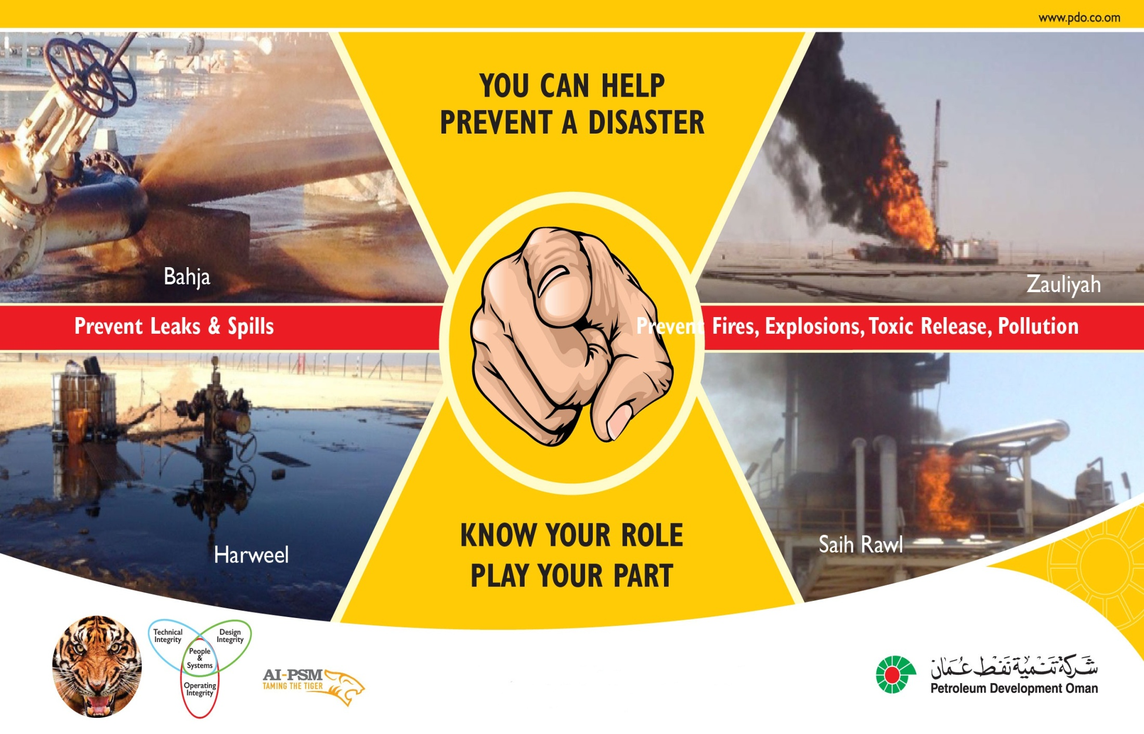
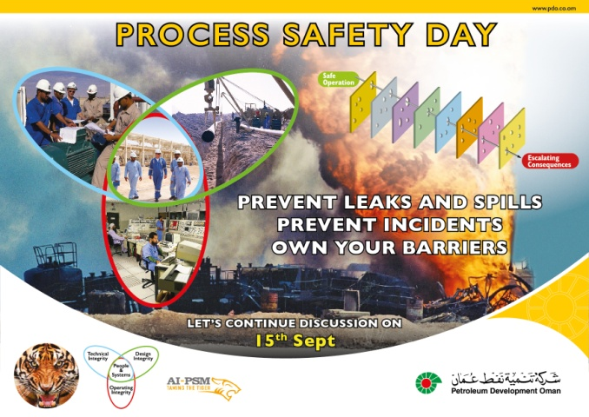
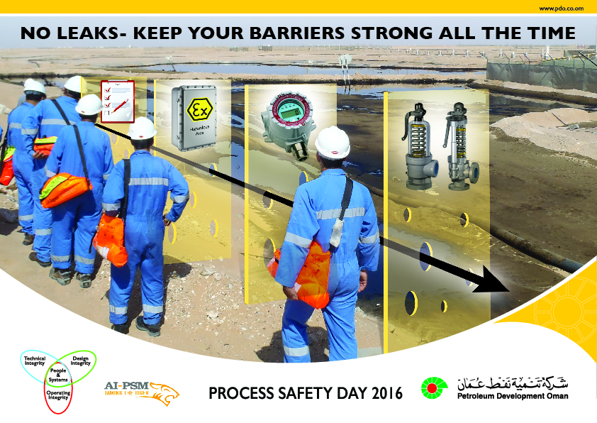


PROCESS SAFETY DAYS: THE LAST 5 YEARS JOURNEY
2014 Theme:
Know Your Role, Play Your Part
2015 Theme:
I Own My Barriers
2016 Theme:
I Keep My Barriers Strong
2018 Theme: We Comply Because We Care. Violations Are Not An Option.
2017 Theme:
Dealing with Risk Normalisation & Dilemmas
Notes:
Year on Year we have made progress on our AI-PSM journey to prevent incidents.
In previous years the process safety day themes have been
2014 was “Know Your Role Play Your Part” and focused on understanding individuals roles and responsibilities to avoid incidents
2015 & 2016 was about owning and maintaining the hardware side of process safety barriers with the themes “I Own My Barriers” and “I keep my barriers strong” respectively
2017 and this year is focus is on the human aspects and how right behaviors improve AI-PS performance.
The next step in our journey to goal zero is behavioural and a key aspect of it is full compliance with the set rules and procedures and not tolerating violations –the theme for this year
To achieve goal zero we need to reduce the potential for accidents more, especially to eliminate the largest contributor: of all human failures

Slide 7
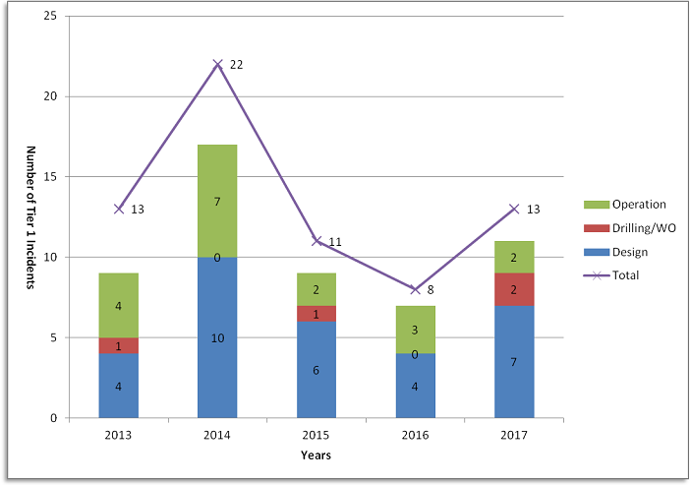
Process Safety Incidents & Non- Compliance
Violation: 75% of Tier 1 Process Safety Incidents have elements of non-compliance
Non-compliance either as initial cause or as contributing element
Non-compliance is across
  Drilling
  Well Operations
  Design Integrity
  Technical Integrity
  Operating Integrity
Question : How many Tier 1 Process Safety Incidents we had in the current year
till 23rd Sept? Which are those?
Notes:
In 75% of the Tier 1 incidents non-compliance was an issue - either as part of the initial cause, or as a contributing factor during the event or in the aftermath.
Non-complying is in this case considered not obeying/following the agreed rules.
Non-compliance is not only the ‘last man standing’ being the operator. Non-compliance is all across the board.
It is within the design integrity (deviating from design rules, not providing the quality control during construction, starting up with open high PSUA findings),
During maintenance (not executing tests on SCEs as per required standards or not flagging that element did not pass the test), and during operation (taking shortcuts such as draining equipment under pressure while operating manual requires it to be done on gravity, or not following the Emergency Response procedures thereby delaying the emergency response which can lead to further escalation)
Till 23rd Sept we had two confirmed Tier 1 Process Safety Incidents. More details about these incidents can be found in the Incident Data Book
Liquid (crude oil) carryover to flare stack at Fahud NOCS Plant on 09 Feb 2018 (http://portal.corp.pdo.om/solutions/LKB/MSE/AIPSM/Lists/Incidents/Display-Incident.aspx?ID=268)
Wellhead wing valve gas leak at Qarn Alam, Barik -37 on 23rd July 2018 (http://portal.corp.pdo.om/solutions/LKB/MSE/AIPSM/Lists/Incidents/Display-Incident.aspx?ID=298)

Slide 8
Video Message Understanding Human Failures
  Users on PDO network Click Here
  Users outside PDO network (Contractor Offices) Click Here
  *It is strongly recommended to keep a back up copy of videos
  Users on PDO network can either download from livelink or Copy Paste from S:\!!Process Safety Day
  Users outside PDO network can download the videos from the Process Safety Day Web Page
  Downloaded videos are in .mp4 format and please use windows media player to play the same (double click on this image below to know how)
Notes:
Facilitator notes:
Ask the group if they have fully understood the message. You might ask the group if they wish to watch the video again.

Slide 9
DISCUSSION BREAK 1
Split people into four groups and discuss the questions on the slide. 10 minutes to discuss & after that only 2 randomly selected groups will report back (5 minutes each) to the entire team.
What is the most thoughtless thing you have done or seen involving violations?
In your group, is it sometimes necessary to bend some of the rules? Why is that?
Which rules in your experience are extremely difficult to apply?
Why do we rarely reward compliance?
Notes:
Facilitator notes:
Remember to keep an eye on time so you can guide the conversation to adequately cover both the themes.
To save time here you could just ask any two teams to report back. This would depend on how the engagement is progressing.
This could also be an opportunity to ask a few people to specifically bring along some examples with them to share in the conversation. Talk to them beforehand about the themes so they understand what
you are looking for. Once one person has spoken, it is usually enough to make others feel more relaxed and prepared to speak as well.

Slide 10
Video Message Importance of Compliance by TD
  Users on PDO network Click Here
  Users outside PDO network (Contractor Offices) Click Here
  *It is strongly recommended to keep a back up copy of videos
  Users on PDO network can either download from livelink or Copy Paste from S:\!!Process Safety Day
  Users outside PDO network can download the videos from the Process Safety Day Web Page
  Downloaded videos are in .mp4 format and please use windows media player to play the same (double click on this image below to know how)
Notes:
Facilitator notes:
Ask the group if they have fully understood the message. You might ask the group if they wish to watch the video again.
Please reinforce that this issue is close to the heart of the top management of the company and they wanted to be personally involved and share their thoughts with everyone

Slide 11
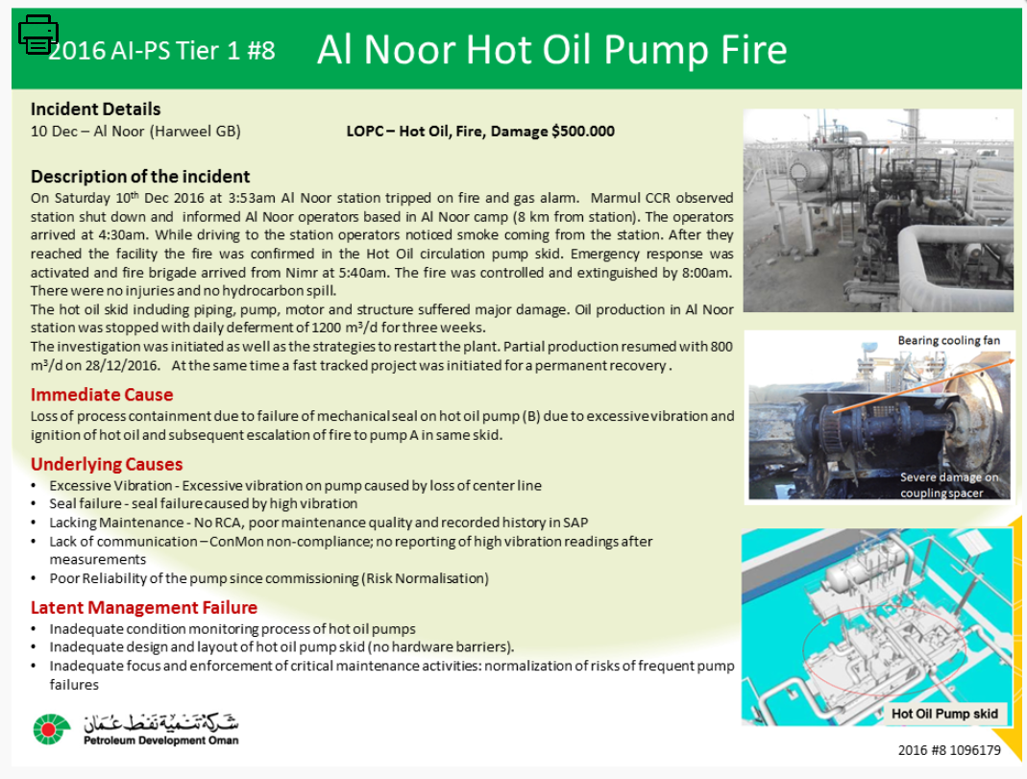
Case Study for O&M Staff(only one per engagement session)
Notes:
We commit to comply not because of the fear of punishment but because we all care for each other?
If you wish to know more about the incident then refer to the incident data book
(http://portal.corp.pdo.om/solutions/LKB/MSE/AIPSM/Datapacks/AIPSM-00206)

Slide 12
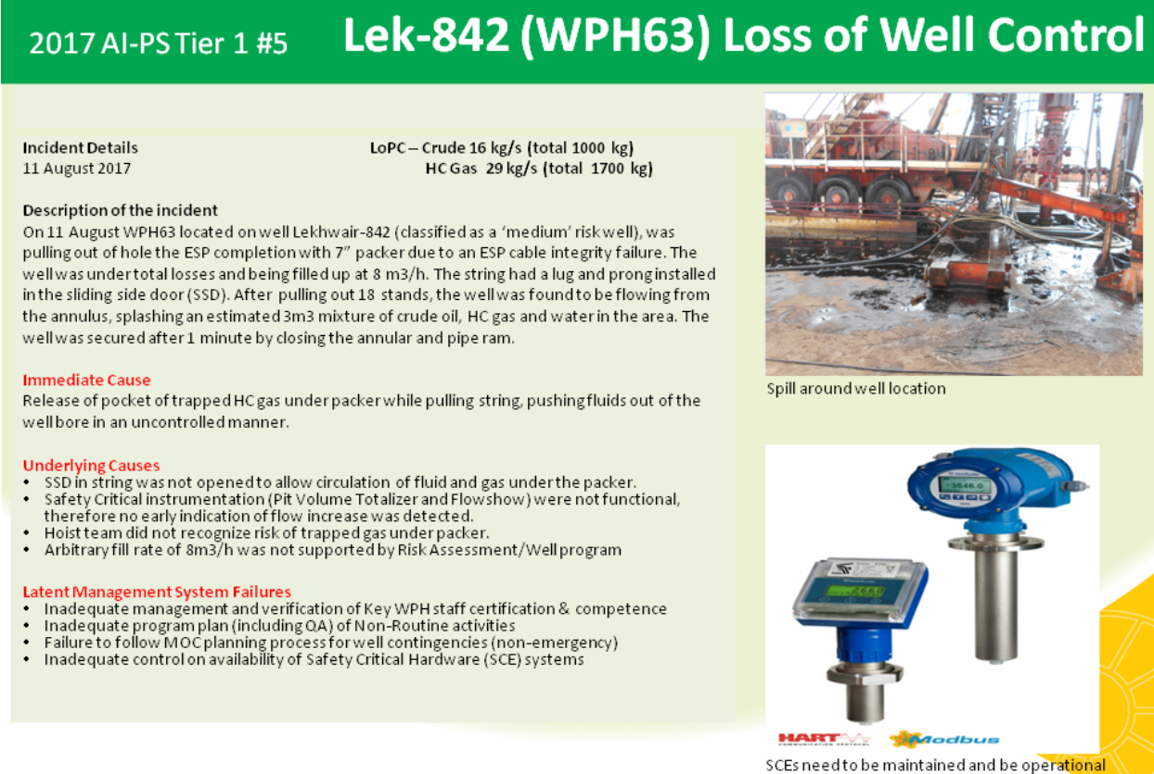
Case Study-Subsurface Staff(only one per engagement session)
Notes:
We commit to comply not because of the fear of punishment but because we all care for each other?
If you wish to know more about the incident then refer to the incident data book
(http://portal.corp.pdo.om/solutions/LKB/MSE/AIPSM//DataPacks/AIPSM-00240)

Slide 13
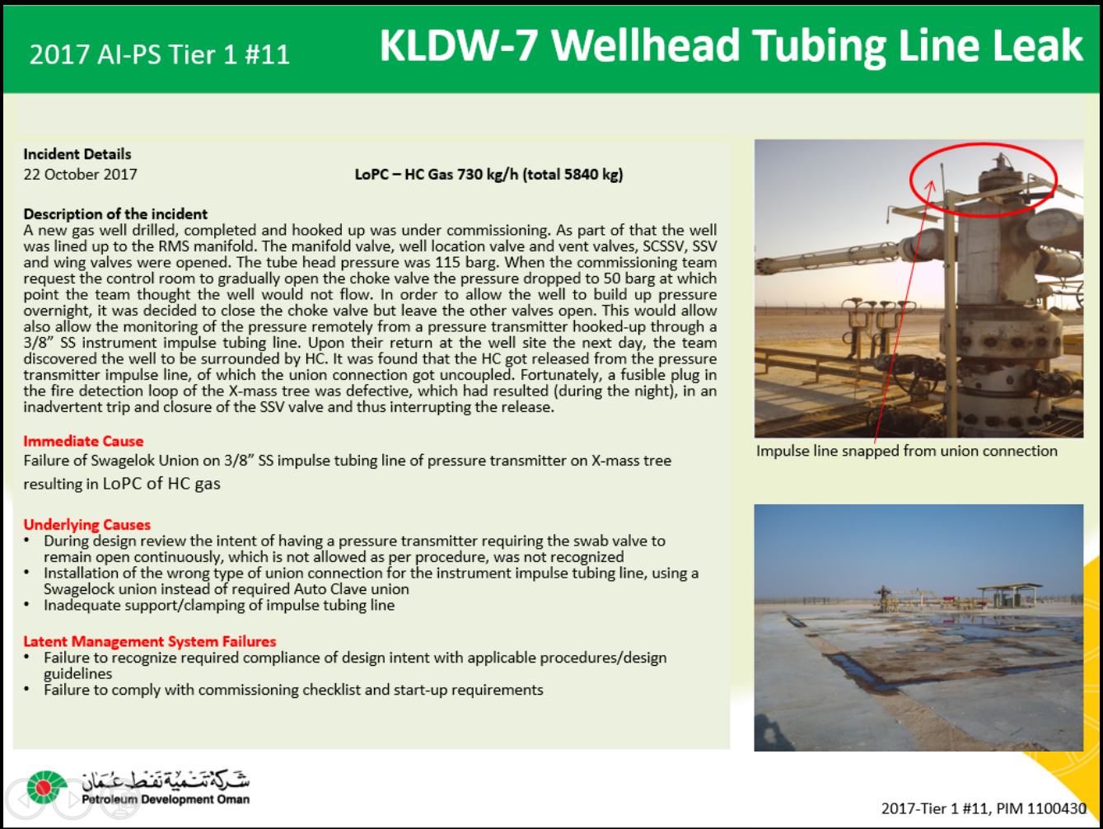
Case Study for Engineering Staff (only one per engagement session)
Notes:
We commit to comply not because of the fear of punishment but because we all care for each other?
If you wish to know more about the incident then refer to the incident data book
(http://portal.corp.pdo.om/solutions/LKB/MSE/AIPSM//DataPacks/AIPSM-00259)

Slide 14
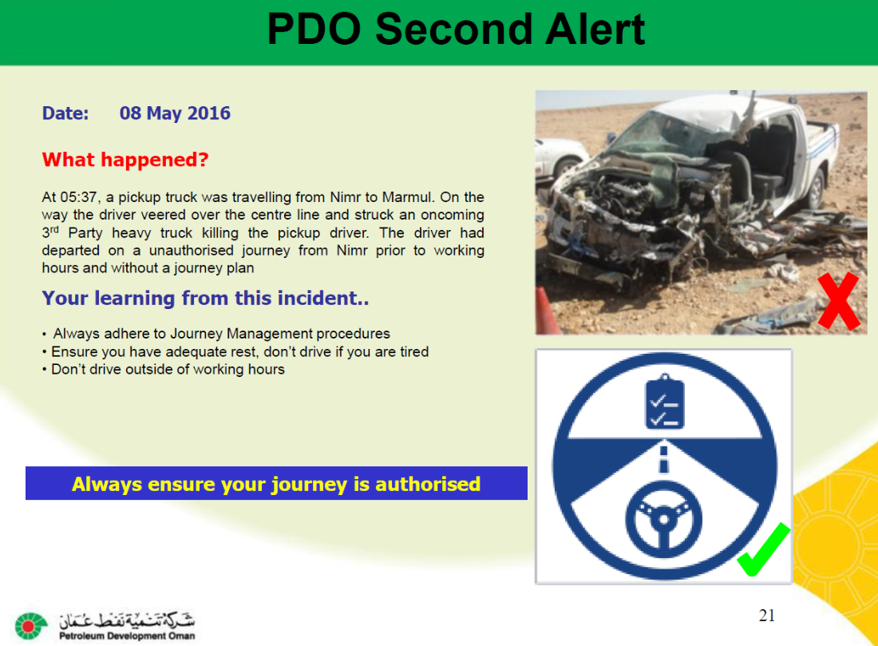
Case Study For Non-Technical Staff
Notes:
We commit to comply not because of the fear of punishment but because we all care for each other?
If you wish to know more about the incident then refer to the incident data book (Data Pack)

Slide 15
Discussion Break 2 – Team Discussion
Split people into four groups and discuss the question(s) on the slide.
10 minutes to discuss and only 2 randomly selected groups will report back to (5 minutes each) the entire team.
What kind of violations or human errors do you see in this case study?
What would you have done differently under the circumstances?
Would compliance have prevented this incident from happening? If yes, how?
Why should we commit ourselves to always comply with the established rules and procedures?
Notes:
We commit to comply not because of the fear of punishment but because we all care for each other?
If you wish to know more about the incident then refer to the incident data book

Slide 16
PERSONAL COMMITMENT AND FURTHER ACTIONS
Upload your team commitments (Click here)
Please mark you attendance for this session (Click here)
Create a folder and upload pictures of your event on the Process Safety Day webpage (Click here)
Participate in the Process Safety Day quiz (Click here) and win amazing prizes!
THANK YOU
SHUKRAN
Notes:
Facilitator notes:
Please ensure that action points have been captured. During conversation individuals will have identified things related to the two themes that they can do differently. These may be applicable to the team as a whole. Ensure that everyone is clear on what actions have been committed to.
Make clear to everyone that although Process Safety Day 2018 is one day, the intention is that this conversation will keep going. This is everyone’s responsibility, not just yours, so ask your team how they would like to keep this conversation going.
Thank everyone for joining the conversation and for their contribution.

