Slide 1
Incident Reporting
What is an Incident?
An incident is an unplanned or undesired event that can cause injury, asset damage and or impact environment or reputation.
Should I report Incidents?
Report all incidents, whether they are Near Misses or Incidents with or without Injury, Asset Damage or Environmental Impact. Report to your Line Supervisor without fear of reprisal.
Why should I report Incidents?
Incident investigation always provides Learning which when applied prohibit re-occurence

Slide 2
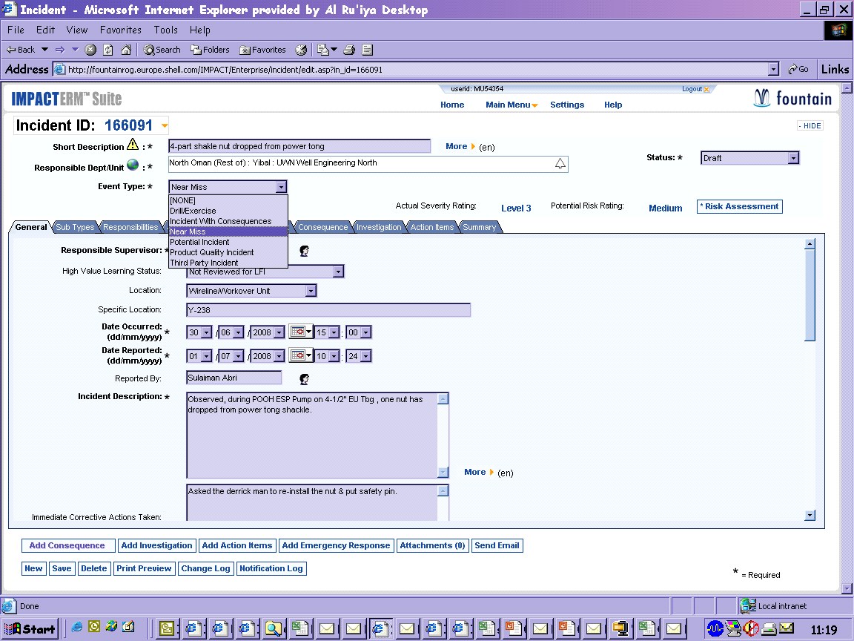
What is a Near Miss?
An incident that could have caused illness, injury or damage to assets, the environment or company reputation, but did not. All near misses shall be treated as incidents and shall be investigated and reported according to their potential risk
A Near Miss is reported into PIM
Select EVENT
TYPE
-
near miss
or potential
incident

Slide 3

What is STOP?
An interaction with a frontline worker(s), initiated by a supervisor or manager in which:
Exposure is observed.
Feedback/Coaching is provided.
A discussion is held to strengthen understanding of exposures.
Exposure recognition is a fundamental part of the supervisor’s role.
A STOP Observation is made in a STOP Card and logged into the
STOP Database
Notes:
Say: The definition of a Safety Contact is in your Participant Workbook. Take a moment to read the definition, and underline the key words that resonate with you. [Allow a few moments for participants to do this.]
Ask: What are the most important points? What does this mean to you? How would you put it into your own words?
Do: Facilitate the discussions.
Say: The key points are you, as a leader, must start the interaction with the frontline worker and engage them in a safety conversation. You have a fundamental role in recognizing exposure.
Ask.: In an average week, how often are you at the job site or work area? [Many answers will be that they are in the area a certain number of hours per week.] Doing Safety Contacts is not designed to add another task but to get more impact out of the times that you’re out in the work area so that each time you’re there it’s having a positive impact on safety.
Transition: Let’s talk about the elements of an effective Safety Contact.
[Go to next slide/exercise]

Slide 4
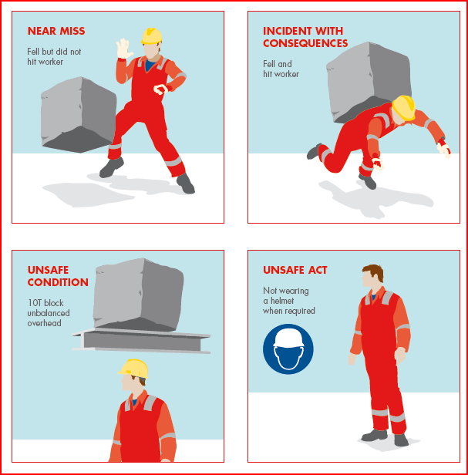
What is the difference?
Report in PIM + state outcomes
Report in PIM as a Near Miss
Make a STOP Observation and enter into STOP Database
Make a STOP Observation and enter into STOP Database

Slide 5
What is an Incident with outcomes
An incident may have outcomes such as injury to personnel, asset damage, environmental or reputational impact occurs. This includes a FAC, MTC, RWC too.
An incident with outcomes is reported into PIM

