Slide 1

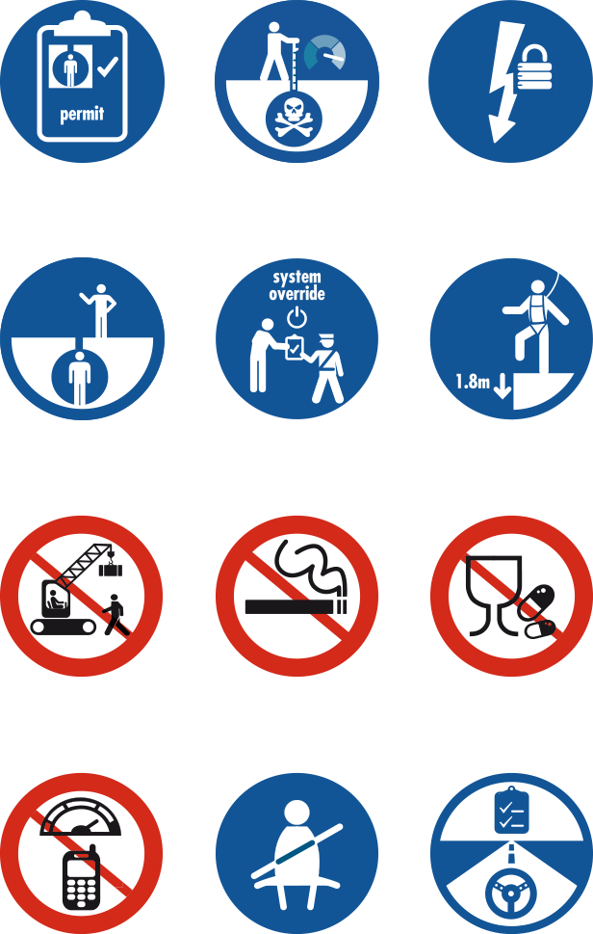
RE-ENERGISING THE LIFE-SAVING RULES
Leader’s Guide
17 September 2014
Notes:
Information for supervisors:
Please go to the next page (slide 2) to find guidance on how to prepare for this session successfully
The session is intended to be held face to face where possible

Slide 2

Instructions for supervisors
This session should be run by the direct Supervisor or manager of a work group (not the HSE representative)
Organise a suitable room for the engagement session, preferably with a projector or screen to show the video and presentation
Print out a copy of the presentation and video reflection guide to use as your notes for the session
You can print out the presentation to include the speaker notes by choosing the ‘notes pages’ option (Print ➔ “Print What” ➔ “Notes Pages”)
We suggest you run both the video and the reflection video more than once prior to the session with your staff
Remember telling people the answer stops them thinking for themselves, asking questions makes people think

Slide 3
Safety First!
First and secondary Emergency Exits
Emergency contact numbers
Assembly Point
Fire drills scheduled
Alarm sirens/bell
First aid kits and first aid number (do we have a first aider in the room?)
Location of toilets
Location of coffee and tea, during break

Slide 4
Plan for today’s session
Intro (10 minutes)
Video (10 minutes)
Discussion (10 minutes)
Reflection Video (10 minutes)
Discussion (20 minutes)
Reality + Summary (10 minutes)
Consequences (10 minutes)
How to Intervene (inc. peer to peer)
(20 minutes)
Close (10 mins)
Notes:
Intent: Setting clear expectations
It is important to make the session as interactive as possible by asking questions and involving as many people as you can. Please take time in setting up your session in advance and giving yourself time for proper preparation.
Go through the running order – verify timings yourself.

Slide 5
CONTENTS
Why have this session ?
Session Overview?
Video & Discussion
Reality + Summary
Consequences
Intervention
Reporting
Close
Notes:
Tell your team what you plan to do and how the session is structured
Why do we want to re-energise the 12 Life Saving Rules?
The Rules set out clear and simple ‘dos and don’ts’ covering activities with the highest potential safety risk.
New people join each year, so it is important to re-energise our Life-Saving Rules to ensure we all understand them and also how they apply in our workplace. The next slide will outline what are the desired outcomes from today’s engagement session.

Slide 6
Life-Saving Rules re-energise – Communication goals
After this session
you should:
KNOW
The Life-Saving Rules
The Rules save lives
Why we need to know and follow them
How to intervene and report when you observe a violation
FEEL
Committed to the Life Saving Rules – they could save your life
Intervention is an act of caring, not an accusation
Intervention could “save the life” of your colleague
DO
Ask if you need clarification
Agree to comply, observe, intervene and report
Discuss how to prevent Life-Saving Rule violations in team talks
Try out the reporting system if needed

Slide 7




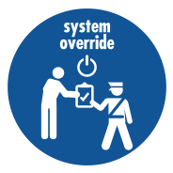
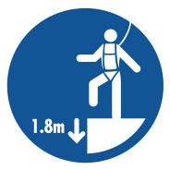






The Life Saving Rules
Work with a valid work permit when required
Conduct gas tests when required
Verify isolation before work begins and use the specified life protecting equipment
Obtain authorisation before entering a confined space
Obtain authorisation before overriding or disabling safety critical equipment
Protect yourself against a fall when working at height
Do not walk under a suspended load
Do not smoke outside designated smoking areas
No alcohol or drugs while working or driving
While driving, do not use your phone and do not exceed speed limits
Wear your
seat belt
Follow prescribed Journey Management Plan
Notes:
- If you have time you can show the mini-clips ( from the CD) of the Life Saving Rules related to you function otherwise you can show the slide only.

Slide 8




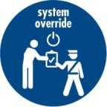
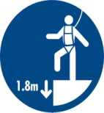



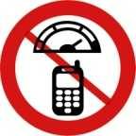


Life Saving Rule Violations – what they tell us?
 | PTW | Gas Testing | Isolation | Confined Space | System Over-ride | Working at Heights | Under suspended loads | Unauthorized smoking | drugs and Alcohol | Speeding & GSM | Seat Belts | JMP | Total
2014 | 2 | 0 | 0 | 0 | 1 | 3 | 0 | 0 | 0 | 29 | 31 | 55 | 121
2013 | 4 | 0 | 1 | 0 | 0 | 1 | 0 | 0 | 2 | 3 | 66 | 90 | 167
2012 | 9 | 0 | 0 | 0 | 1 | 3 | 1 | 2 | 1 | 43 | 49 | 81 | 190
2011 | 4 | 0 | 1 | 0 | 0 | 5 | 2 | 1 | 2 | 94 | 39 | 58 | 206
2010 | 33 | 0 | 0 | 0 | 0 | 7 | 2 | 1 | 2 | 272 | 65 | 65 | 447
90% of the reported LSR are road safety related
>80% of the reported LSR violations are in MAF by the RSST
This list of the reported LSR violations are reported by PDO,
The contractor LSR violations are captured internally and does not reflect either in PIM or the PDO statistics.
Notes:
This slide provides the trend of reporting Life Saving Rules and the focus on the Road Safety related Life Saving Rule violations identified by the RSST.
The gap in reporting Worksite related violation of Life Saving Rules; while >80% of our injuries are caused by worksite hazards.

Slide 9
Video
We will now watch a short video of a typical work scenario
What we show here is a scenario from any Oil & Gas business
Your task:
Watch the video , Spot safe and unsafe! And take notes
Notes:
Intent: Interactive; Train observation skills, understanding and application of Rules at workplace, make them relevant to individuals work
Key Message: Everyone plays a role in watching out for each other - even before work is done
Process:
Invite audience to watch the short 2 min video (recommendation – play it twice to allow people to spot more things)
Advise them that the video is animated and shows at typical work scenario in any oil and gas business.
Ask them to write down as many compliant and non compliant acts as possible.
Let them know you will have a discussion after the video was played twice

Slide 10
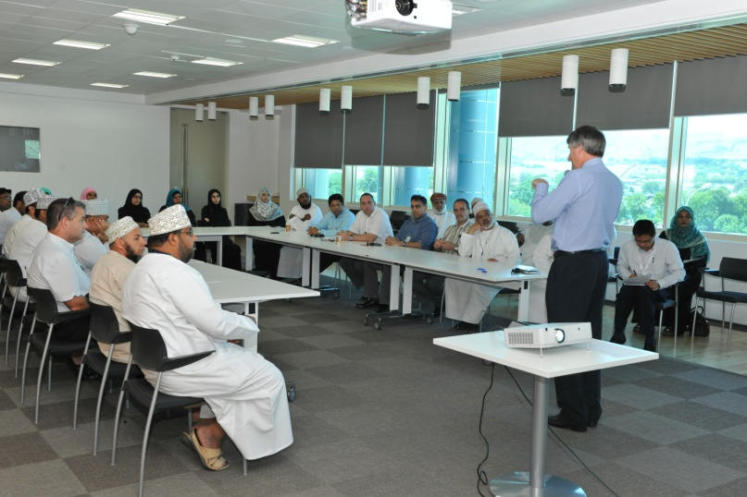
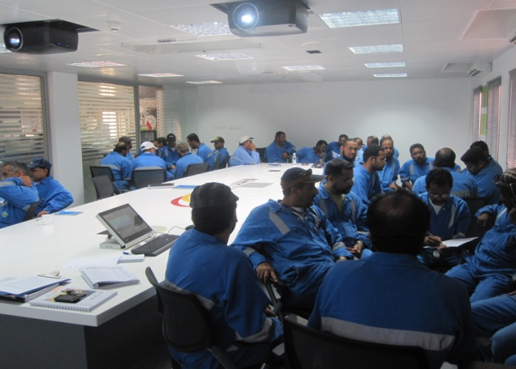
Discussion
Which Life-Saving Rules were followed and when?
Which Life-Saving Rules were broken and when?
Notes:
The video contains several situations of compliance and non-compliance to the Life-Saving Rules
It is recommended to play the video a couple of times (duration of video is around 2 minutes)
It is likely that not all of them will be spotted.
Let the audience watch the video once to just observe safe and unsafe acts
Play the video a second time and ask them to take notes about their observation
(Consider to play it a third time if needed by the audience)
After the video was played (x-times), start a discussion with the group.
What have they observed? Which compliant and non-compliant situations were discovered
Ask them to focus only on the Life Saving Rules, although they might identify other unsafe situations. If so, recognise them for their additional observation but make clear what is a Life Saving Rules and what is not
It is recommended to take notes of answers to reflect later if all situations have been identified.
Tell them you will play a reflection version of the video which highlights all the situations and you will discuss them one by one

Slide 11
Discussion
Play Reflection Video
Green traffic light: Why is this compliant
to the Life-Saving Rules?
Amber / Red traffic light: What has
to change to make this compliant to the
Life-Saving Rules?
Notes:
Play the reflection video (this time with the “solution” where all relevant acts are highlighted with a traffic light (red / green / amber) + the Life-Saving Rule symbol.
Recommendation: Pause the reflection video each time a compliant or non-compliant situation is highlighted.
Ask each time based on the traffic light result:
Green:
why is this situation compliant with the Life-Saving Rules, what is in place to keep the person safe?
Red:
why is this situation non-compliant with the Life-Saving Rules, what has to change, what is wrong here?
if this goes wrong, what could happen to the worker? (….he could lose his/her life)
Amber (optional: not all videos have amber situations covered):
why this situation is highlighted amber and not red or green?
what does the person need to do now to make it compliant to the Life-Saving Rules and to ensure he/she is safe?
Recognise the audience for active contribution and good discussion. Reinforce the message that our commitment to the Rules will keep us safe!
Recommended that the supervisor takes notes of the answers s/he receives on a flipchart

Slide 12
Discussion
What are the most important rules for us
to follow in our work place?
How can we help each other follow the rules?
  How do we set clear expectations on the Life-Saving Rules?
  How do we help new people know and understand the Life-Saving Rules?
Notes:
Have another discussion and take notes of the answers you receive on a flipchart (or alternative):
Choose which questions are most relevant for your team, or if running a longer session all questions can be covered in order.
Which rules are especially relevant in your specific workplace?
What could be the consequences if that Rule was broken?
How does following the Rules keep us safe?
How can we help each other follow the rules?
How do we set clear expectations on the Life-Saving Rules?
How do we help new people?
OPTIONAL: For a deeper discussion ask participants to actually imagine and articulate how someone could get hurt or how someone is kept safe.

Slide 13

Reality + Summary
The Life-Saving Rules
have saved lives
We need to look after each other and follow the Life-Saving Rules without exception
They are there to save
our life and the lives
of others
Let´s be committed,
not just compliant
If you work for us, you must follow the Life-Saving Rules
Notes:
You can use this slide to summarize again on the importance of the Rules
Make clear that the Rules are here to save peoples life
Our own lives and of others around us
We need to help each other understand and follow the rules without exception
Let´s work together to establish a culture of commitment
You can use the slides provided, but also include examples of local incidents, or Rule breaches, or lives saved by complying with the Rules.
If you have any local examples / pictures, feel free to add these

Slide 14
Consequences
What happens if we follow
the rules…
What happens if we don’t follow the rules…
Notes:
Intent: Make it personal; What would it mean to individuals;
We want positive consequences for following the Life-Saving Rules;
However the focus must be on Saving Lives.
Question: What could be the consequences be if we follow the Life-Saving rules?
Agree to all positive answers
Question: What could the consequences be if we do not follow the Life-Saving rules?
The worst consequences are that someone loses his or her life!
Consider a real story on what the impact was on the environment of someone who died at work (family, friends, supervisor, colleagues).

Slide 15
Consequences
What remains unchanged:
The aim of the Life-Saving Rules is to prevent harm and save lives
Each incident will be fully investigated
Failure to comply will result in maximum appropriate disciplinary action for all involved in accordance to local law
The Life-Saving Rules are there to save our life and the lives of others
If you choose to break the Rules, you choose not to work for us.
Notes:
Intent: Make it personal; What would it mean to individuals;
We want positive consequences for following the Life-Saving Rules;
However the focus must be on Saving Lives.
Question: What could be the consequences be if we follow the Life-Saving rules?
Agree to all positive answers
Question: What could the consequences be if we do not follow the Life-Saving rules?
The worst consequences are that someone loses his or her life!
Consider a real story on what the impact was on the environment of someone who died at work (family, friends, supervisor, colleagues).

Slide 16
Reporting
When you see someone break a Life-Saving Rule:
Intervene
Reporting is not about blame. It’s about collecting information to help us understand why rules are being broken and what we need to do to make sure it doesn’t happen again.
Report
Notes:
Intent: Understand the importance of intervention; Understand how to deal with interventions; Know what your company expects you to do when you see someone break a Life-Saving Rule
Key Messages:
You should always intervene and whenever somebody intervenes with you, there is only one correct reply - THANK YOU!
You have a duty to report any Life-Saving Rule Violations to help understand why there was a violation and any necessary actions can be taken to make compliance easier
Peer to peer reporting is all about reporting to learn about issues with a specific Rule, not about the person breaking it!
Check how your Company applies disciplinary action before facilitating this session
4. Intervention and reporting within your work team (peer to peer) should be encouraged therefore should not be subject to disciplinary action if the unsafe activity stops immediately.
5. For a violation observed by a supervisor maximum appropriate disciplinary action should always apply

Slide 17
Intervention
What is an intervention?
A conversation between at least two people
Should relate to a safe or an unsafe act
Learning opportunity
Includes open questions and active listening
Focuses on what could go wrong
Agrees an immediate action
Focus on the behaviours, not the individual
Why do we want everyone to intervene?
Care for each other, save lives and prevent injuries creating a safer working environment
You and I are responsible
to intervene with each other. Failure to intervene is like
an unsafe act.
Whenever somebody intervenes with you, there is only one correct answer – THANK YOU!
Notes:
Intent: Understand the importance of intervention;
It is key to look after each other and to be committed to follow the Rules
Our focus is on being safe as team;
There is no difference between employees and contractors;
Encourage contractors to intervene with employees;
Everyone should watch out for each other; Make it personal;
Re-enforce the message:
Why do we want everyone to intervene?:
To help creating a proactive and safe working environment, because
We want to save lives,
We want to prevent injuries and
We have to look after each other
Key message:
If something goes wrong, we don‘t want to ask ourselves ‘could I have done more?‘

Slide 18
Peer to Peer Intervention
What is different about peer to peer interventions?
Colleagues in the same team (peers) can and do look out for each other.
Intervention with a peer can happen before a rule is broken OR to correct
an unsafe act or situation.
Intervention and reporting within your team is a learning opportunity and will not normally be subject to disciplinary action if the unsafe activity stops immediately.
When you intervene with a peer you are helping to keep them safe and stay out of trouble.
Please report all interventions
as it helps the company learn and become an even safer place to work.
Peer-to-Peer intervention guidelines: Click here
Notes:
Consider to adjust the following point in the main slide if not appropriate for your organisation:
Intervention and reporting within your team is a learning opportunity and should be encouraged therefore should not be subject to disciplinary action if the unsafe activity stops immediately.
Intent: Understand that peer to peer interventions are out of care for colleauges, peer to peer interventions are about a team looking after itself;
Everyone should watch out for each other; Make it personal;

Slide 19
Reporting incidents
An incident is an unplanned or undesired event that can cause injury, asset damage and/or impact environment or reputation.
Why should you report an incident?
Incident investigations always provides Learning which when applied prohibit reoccurrence
Types of incidents to report :
Life Saving Rule violations
Near Misses
Incidents with or without Injury ?
Asset Damage
Incidents with Environmental Impact

Slide 20
Close
THANK YOU for your active participation and please remember:
Follow the Life-Saving Rules and help others to comply!
By intervening you might save someone’s life. By not complying you might lose your life!
Any further queries refer to LSR-FAQs click here
Notes:
Thank the audience for their time, effort and commitment
Ensure that actions / notes taken during the session will be followed up.

